Slide 1
CSSE 371 - Software Requirements and Specification
CSSE 372 - Software Project Management
Brent Mundy

Slide 2
Introduction
About Me
Brent Mundy is a User Experience Analyst at ANGEL Learning. At ANGEL, his responsibilities include: usability testing; UI prototyping; product management; and functional requirements documentation. In addition to working at ANGEL, he has contributed to a number of other education and technology websites including: InformIT.com, CourseCompass, MyPearsonStore.com, MyMathLab, PeachpitPress.com, and CiscoPress.com. Brent received a Masters Degree in Information Science from Indiana University in 2000.

Slide 3
Before we get started…
Confidentiality

Slide 4
Agenda
Overview of the ANGEL product development cycle
Explore a specific feature
Overview of user testing at ANGEL
Open the floor for questions…

Slide 5
Products Process
Vision
Specification
Release
Code Complete
Testing

Slide 6
Process Over Versions
Vision
Specification
Release
Code Complete
Testing
Vision
Specification
Release
Code Complete
Testing
Vision
Specification
Release
Code Complete
Testing

Slide 7
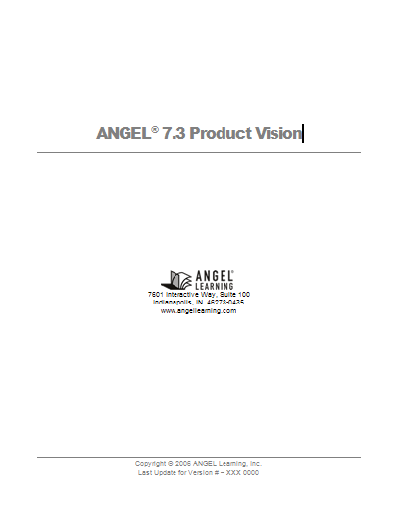
Role of Requirements Documentation
Translate Vision into interface-level specification
Focus Groups and Usability Testing
Developers create technical spec
QA creates test plans

Slide 8
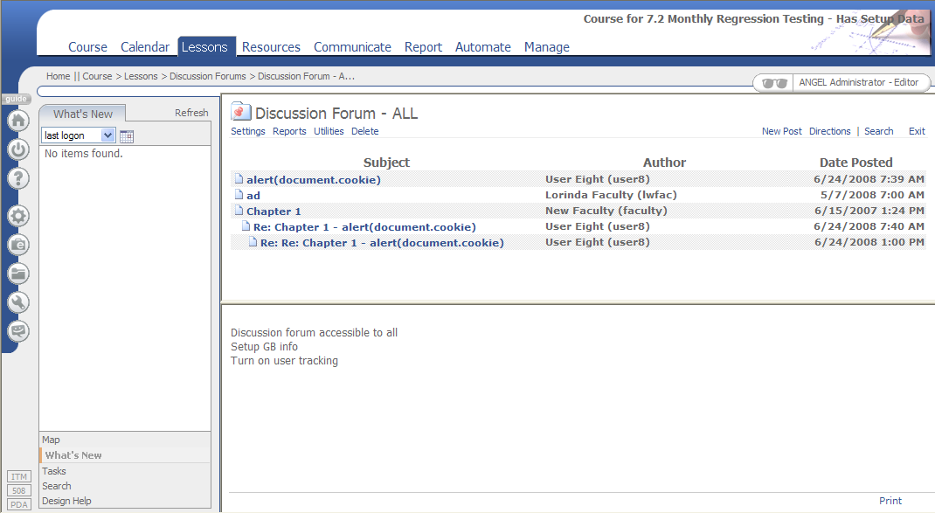
7.3 Vision Item: Update Discussions

Slide 9
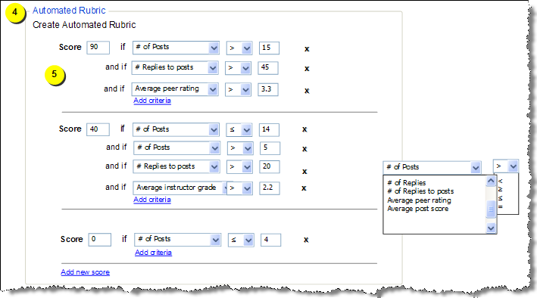
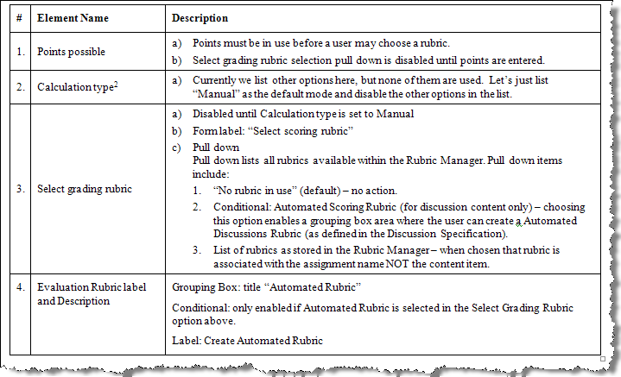
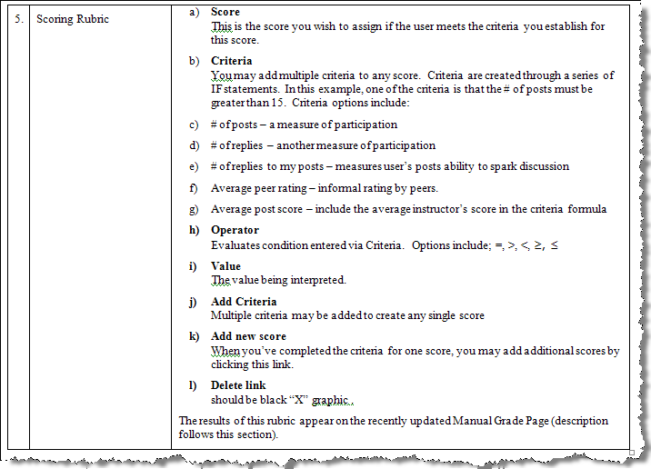
Specifying Products and Features

Slide 10
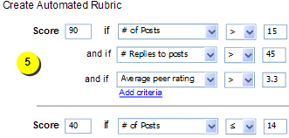
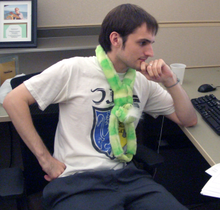

A development analogy
Reads
Spec doc
Writes
Developer
Code

Slide 11
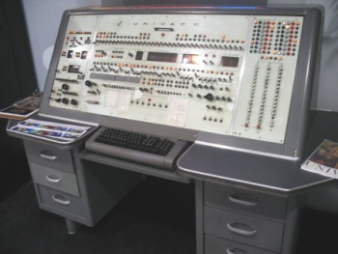
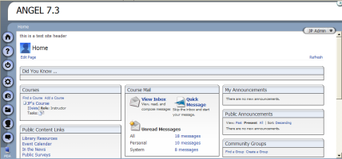
A development analogy
Reads
Makes
Computer

Slide 12
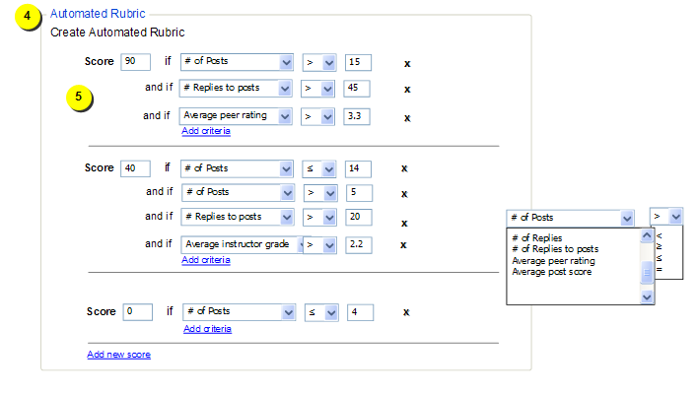
Functional Spec (part 1)

Slide 13
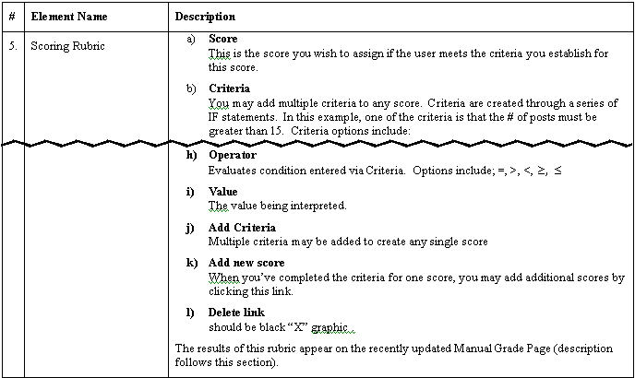
Functional Spec (part 2)

Slide 14
What data do we need?
Criteria
Criteria Set

Slide 15
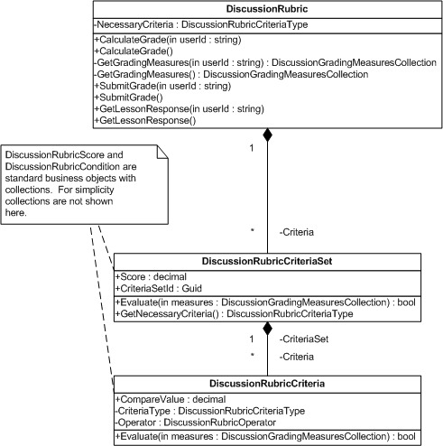
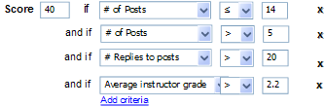
Technical Spec - UML

Slide 16
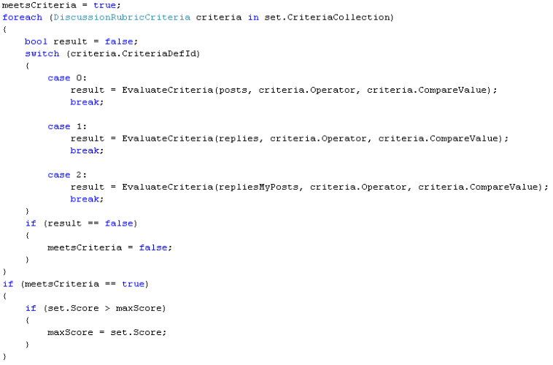
Rubric business logic

Slide 17
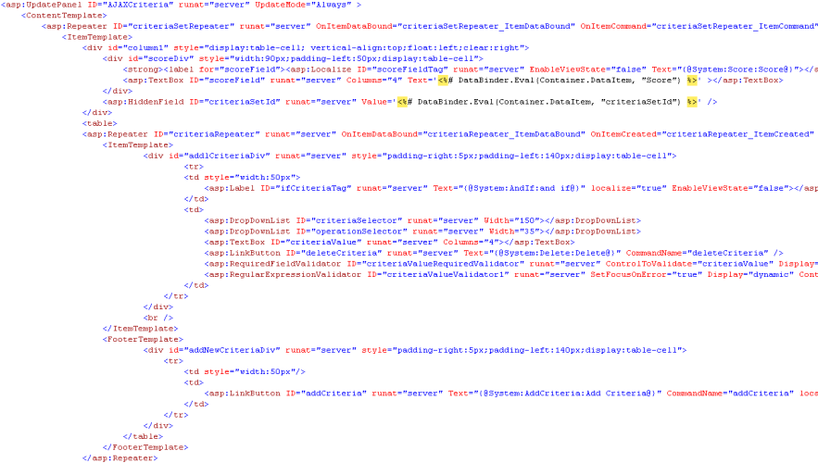
Rubric presentation code

Slide 18
Usability at ANGEL

Slide 19
Usability Definition
Usability is a property of websites that
relates to ease of use. Usability is commonly
defined as having three core components:
  Effectiveness
  Efficiency
  Satisfaction

Slide 20

The Usability Iceberg
10% Look
(visuals, layout, colors, etc.)
30% Feel
(menus, buttons, controls, etc.)
60% User Task Goals
(workflow, navigation, objects and relationships, etc.)
Adapted from “Common User Access Guide to User Interface Design”, copyright 1991 IBM
Notes:
20
User research is the only way to understand and improve the 60% hidden beneath the surface.

Slide 21
Reduce Development Costs
Cost of a Change
100x
$
1x
Analysis Design Construction Test Maintenance
“The rule of thumb in many usability-aware organizations is that the cost-benefit ratio for usability is $1:$10-$100. Once a system is in development, correcting a problem costs 10 times as much as fixing the same problem in design. If the system has been released, it costs 100 times as much relative to fixing in design.” (Gilb, 1988)
Notes:
“Savings from earlier vs. later changes: Changes cost less when made
earlier in the development life cycle. Twenty changes in a project, at 32
hours per change and [a minimal] hourly rate of $35, would cost
$22,400. Reducing this to 8 hours per change would reduce the cost to
$5,600. Savings = $16,800.” (Human Factors International, 2001)
“A study of software engineering cost estimates showed that 63% of
large software projects significantly overran their estimates (Nielsen,
1993). When asked to explain their inaccurate cost estimates, software
managers cited 24 different reasons and, interestingly, the four reasons
rated as having the highest responsibility were related to usability
engineering. Proper usability engineering methodology will prevent most
such problems and thus substantially reduce cost overruns in software
projects.” (Nielsen, 1993)
Return on Investment for Usable User-Interface Design: Examples and Statistics
http://www.amanda.com/resources/ROI/AMA_ROIWhitePaper_28Feb02.pdf

Slide 22
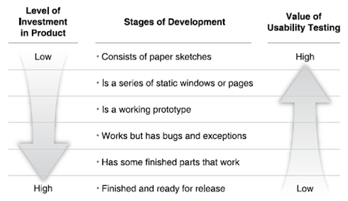
When is the best time for testing?
Sooner is better!

Slide 23
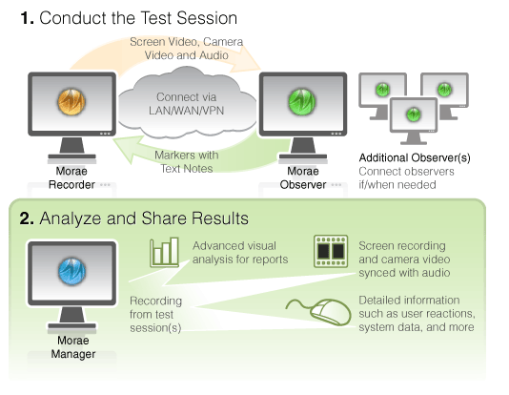
ANGEL Usability Lab
The core of the mobile
usability lab is Morae, a
software package from
Techsmith.
With Morae we can:
  Record audio, video, and
  keystroke data from every
  usability session
  Observe and log important moments
  Analyze recordings
  Share insights

Slide 24
Example Morae Recording

Slide 25
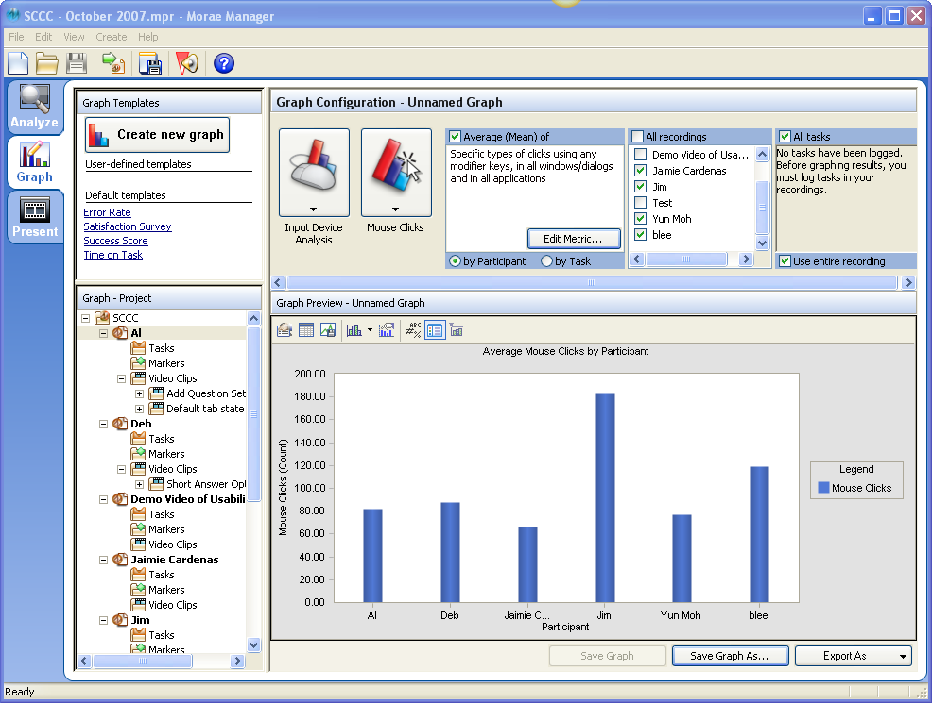
Example of Click Data

Slide 26
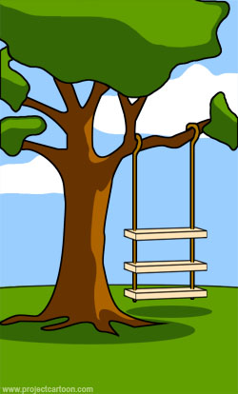
Origin of a Usability Issue
How management described it…

Slide 27

How Product Management documented it…

Slide 28

How Development built it…

Slide 29

How the customer installed it…

Slide 30
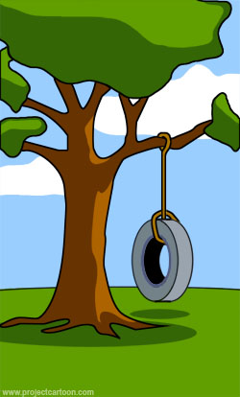
What the customer really wanted…

Slide 31
Usability Data
When and how do we incorporate usability data in
the product development cycle?
Vision
Requirements Gathering
Development
QA
Released Software
  Maintenance cycles
  Service packs

Slide 32
Wrap up
Questions?

