Slide 1
SpellChecker and Suggester
Other projects have been highly-specified. For this one, you have a lot of leeway and can be very creative.
GUI-based program
Check the words of a text file for spelling
  User can browse to file
Flag words that are not in program's dictionary
Suggest possible alternate spellings
  Think of ways misspelling can occur:
    missing or added letters
    transposed letters
    no space between words
    things you come up with
An interface that allows user to correct the spelling.
  change, ignore, ignore all, …

Slide 2
SpellChecker and Suggester
Some GUI things you'll want to learn how to do
  Browse to a file and open it
  Deal with text in a text box
  Display a list of choices and get user selection
Some things to do if you didn't do them already.
  Look for a dictionary to use (share it!)
  Look at user interfaces of some spell-checkers
  Look up various Java classes that may be useful
    Especially helpful: The Java Swing book from Safari Tech Books online (see course syllabus)

Slide 3
Mini-project timetable
Now. Look for a dictionary, think about the kinds of spelling errors you want to detect/correct.
Day 25. Begin working with your partners.
Day 27. Demonstrate some progress in class.
Day 30. Final submission of the project is due.

Slide 4
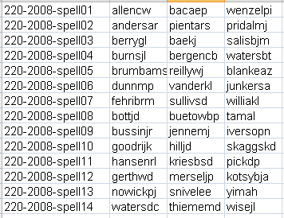
Spell-checker teams
Repositories will be available soon

