Slide 1
CSSE 220 Day 29
Analysis of Algorithms continued
Recursion

Slide 2
Questions?
On Capstone Project?
  Automatic extension to Monday morning
  If a team member does not wish to join the team in its extension-decision, see me to work it out
  Final reflection is open – do it when you are done with project!!!
On Exam 2?
  Complete by now unless you have made/make arrangements with me
On grading of Exam 1:
  Earn back points!
  Fix FIXME’s (but keep FIXME in comment) and recommit.
  Complete before the final exam.
Final exam:
  Take it either (your choice):
    Tuesday 1 p.m. in F-231 (CSSE conference room), or
    Friday 1 p.m. in G-313 or G-315 (your choice)
  Open everything, HALF paper and pencil, about 90 minutes
  Covers last few days
Questions on anything else?

Slide 3
Outline of today’s session
Algorithm analysis, review
Recursion, review
Recursion, making it efficient
Data structures, how to choose
Implementation of Linked Lists
Work on Capstone

Slide 4
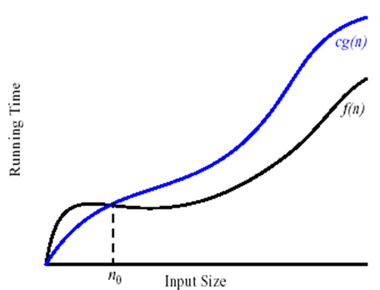
Definition of big-Oh
Formal:
  We say that f(n) is O(g(n)) if and only if
  there exist constants c and n₀ such that
  for every n ≥ n₀ we have
  f(n) ≤ c × g(n)
Informal:
  f(n) is roughly
  proportional to g(n),
  for large n

Slide 5
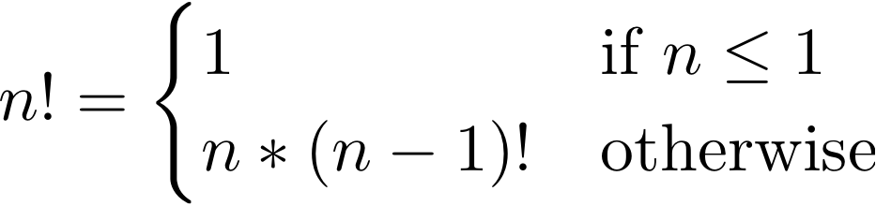
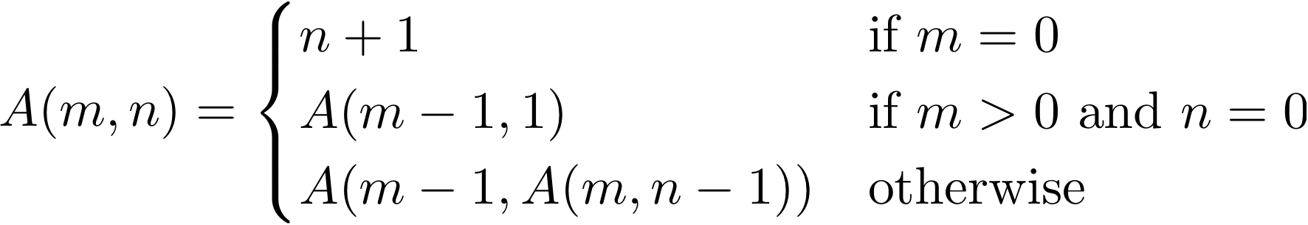
Recursive Functions
Base Case
Factorial:
Ackermann function:
Recursive step
Q4
Notes:
When does the base case for the Ackermann function occur?
Ackermann has two recursive cases. How do they differ?

Slide 6
Key Rules to Using Recursion
Always have a base case that doesn’t recurse
Make sure recursive case always makes progress, by solving a smaller problem
You gotta believe
  Trust in the recursive solution
  Just consider one step at a time

Slide 7
Course Goals for Searching and Sorting: You should be able to …
Describe basic searching & sorting algorithms:
  Search
    Linear search of an UNsorted array
    Linear seach of a sorted array (silly, but good example)
    Binary search of a sorted array
  Sort
    Selection sort
    Insertion sort
    Merge sort
Determine the best and worst case inputs for each
Derive the run-time efficiency of each, for best and worst-case

Slide 8
Recap: Search, unorganized data
For an unsorted / unorganized array:
  Linear search is as good as anything:
    Go through the elements of the array, one by one
    Quit when you find the element (best-case = early) or you get to the end of the array (worst-case)
  We’ll see mapping techniques for unsorted but organized data
  Best-case: O(1)
  Worst-case: O(n)
Notes:
Ask about running time
Best and worst cases? (They are all the same)

Slide 9
Recap: Search, sorted data
For a sorted array:
  Linear search of a SORTED array:
    Go through the elements starting at the beginning
    Stop when either:
      You find the sought-for number, or
      You get past where the sought-for number would be
  But binary search (next slide) is MUCH better
  Best-case: O(1)
  Worst-case: O(n)
Notes:
Ask about running time
Best and worst cases? (They are all the same)

Slide 10
Recap: Search, sorted data
search(Comparable[] a, int start, int stop, Comparable sought) {
if (start > stop) {
return NOT_FOUND;
}
int middle = (left + right) / 2;
int comparison = a[middle].compareTo(sought);
if (comparison == 0) {
return middle;
} else if (comparison > 0) {
return search(a, 0, middle – 1, sought);
} else {
return search(a, middle + 1, stop, sought);
}
}
  Best-case: O(1)
  Worst-case: O(log n)
Notes:
Ask about running time
Best and worst cases? (They are all the same)

Slide 11
Recap: Selection Sort
Basic idea:
  Think of the list as having a sorted part (at the beginning) and an unsorted part (the rest)
  Find the smallest number
  in the unsorted part
  Exchange it with the element
  at the beginning of the
  unsorted part (making the
  sorted part bigger and the
  unsorted part smaller)
Repeat until unsorted part is empty
  Best-case: O(n²)
  Worst-case: O(n²)
Notes:
Ask about running time
Best and worst cases? (They are all the same)

Slide 12
Recap: Insertion Sort
Basic idea:
  Think of the list as having a sorted part (at the beginning) and an unsorted part (the rest)
  Get the first number in the
  unsorted part
  Insert it into the correct
  location in the sorted part,
  moving larger values up
  in the array to make room
Repeat until unsorted part is empty
  Best-case: O(n)
  Worst-case: O(n²)
Notes:
Best case, worst case?
Analysys.

Slide 13
Merge Sort
Basic recursive idea:
  If list is length 0 or 1, then it’s already sorted
  Otherwise:
    Divide list into two halves
    Recursively sort the two halves
    Merge the sorted halves back together
Analysis: use tree-based sketch…
  Best-case: O(n log n)
  Worst-case: O(n log n)

Slide 14
Outline of today’s session
Algorithm analysis, review
Recursion, review
Recursion, making it efficient
Data structures, how to choose
Implementation of Linked Lists
Work on Capstone

Slide 15
What the Fib?
A more careful analysis yields a smaller base but it is still exponential.
Why does recursive Fibonacci take so long?!?
  Answer: it recomputes subproblems repeatedly: O(2^{n})
Can we fix it? Yes! Just:
  “Memorize” every solution we find to subproblems, and
  Before you recursively compute a solution to a subproblem, look it up in the “memory table” to see if you have already computed it
This is a classic time-space tradeoff
  A deep discovery of computer science
  Tune the solution by varying the amount of storage space used and the amount of computation performed
  Studied by “Complexity Theorists”
  Used everyday by software engineers

Slide 16
Outline of today’s session
Algorithm analysis, review
Recursion, review
Recursion, making it efficient
Data structures, how to choose
Implementation of Linked Lists
Work on Capstone

Slide 17
Data Structures
Understanding the engineering trade-offs when storing data

Slide 18
Data Structures Recap
Efficient ways to store data based on how we’ll use it
So far we’ve seen ArrayLists
  Fast addition to end of list
  Fast access to any existing position
  Slow inserts to and deletes from middle of list
Notes:
Q: Have to move all the other elements up or down to make/use room. O(n)

Slide 19
Another List Data Structure
What if we have to add/remove data from a list frequently?
LinkedLists support this:
  Fast insertion and removal of elements
    Once we know where they go
  Slow access to arbitrary elements
“random access”
Notes:
- Examples: employee list, music play list
Sketch a linked list on the board.
Then show insertion and deletion.

Slide 20
LinkedList<E> Methods
void addFirst(E element)
void addLast(E element)
E getFirst()
E getLast()
E removeFirst()
E removeLast()
What about accessing the middle of the list?
  LinkedList<E> implements Iterable<E>

Slide 21
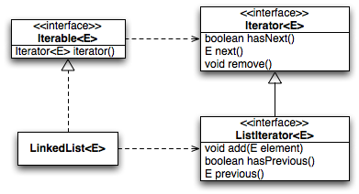
Accessing the Middle of a LinkedList
Notes:
Hand-out copies of slide UML.
Complete first two TODO items in LinkedListDemo

Slide 22
An Insider’s View
for (String s : list) {
// do something
}
Iterator<String> iter =
list.iterator();
while (iter.hasNext()) {
String s = iter.next();
// do something
}
Enhanced For Loop
What Compiler Generates
Notes:
Complete last TODO item in LinkedListDemo

Slide 23
Implementing LinkedList
A simplified version, with just the essentials
Won’t implement the java.util.List interface
Will have the usual linked list behavior
  Fast insertion and removal of elements
    Once we know where they go
  Slow random access
Notes:
Review the provided code in lists.MyLinkedList.
Implement the TODO items.

Slide 24
Abstract Data Types (ADTs)
Boil down data types (e.g., lists) to their essential operations
Choosing a data structure for a project then becomes:
  Identify the operations needed
  Identify the abstract data type that most efficient supports those operations
Goal: that you understand several basic abstract data types and when to use them

Slide 25
Common ADTs
Array List
Linked List
Stack
Queue
Set
Map
Implementations for all of these are provided by the Java Collections Framework in the java.util package.

Slide 26
Array Lists and Linked Lists
Operations Provided | Array List Efficiency | Linked List Efficiency
Random access | O(1) | O(n)
Add/remove item | O(n) (do you see why?) | O(1) if you are “at” the item
Q1,2

Slide 27
Stacks
A last-in, first-out (LIFO) data structure
Real-world stacks
  Plate dispensers in the cafeteria
  Pancakes!
Some uses:
  Tracking paths through a maze
  Providing “unlimited undo” in an application
Operations Provided | Efficiency
Push item | O(1)
Pop item | O(1)
Implemented by Stack, LinkedList, and ArrayDeque in Java
Q3
Notes:
Draw stack on board showing push and pop.
Exercise: print words in reverse order.

Slide 28
Queues
A first-in, first-out (FIFO) data structure
Real-world queues
  Waiting line at the BMV
  Character on Star Trek TNG
Some uses:
  Scheduling access to shared resource (e.g., printer)
Operations Provided | Efficiency
Enqueue item | O(1)
Dequeue item | O(1)
Implemented by LinkedList and ArrayDeque in Java
Q4
Notes:
Draw queue on board showing enqueue and dequeue.
Exercise: n-words before, i.e. pairs of words: (current word, nth word previous)

Slide 29
Sets
Unordered collections without duplicates
Real-world sets
  Students
  Collectibles
Some uses:
  Quickly checking if an item is in a collection
Operations | HashSet | TreeSet
Add/remove item | O(1) | O(lg n)
Contains? | O(1) | O(lg n)
Can hog space
Sorts items!
Q5
Notes:
Sketch a tree set on the board. Don’t worry about the details, just convey the gist of it to give the intuition for the log n performance. (Example use of TreeSet for quiz: tracking the cards in a hand where size is small and we might want to display them in sorted order.)
Exercise: print an alphabetical list of all words that appear in the input file.

Slide 30
Maps
Associate keys with values
Real-world “maps”
  Dictionary
  Phone book
Some uses:
  Associating student ID with transcript
  Associating name with high scores
Operations | HashMap | TreeMap
Insert key-value pair | O(1) | O(lg n)
Look up value for key | O(1) | O(lg n)
Can hog space
Sorts items by key!
Q6
Notes:
Exercise, count how many words have each length. Print the number of words of various lengths.

Slide 31
Outline of today’s session
Algorithm analysis, review
Recursion, review
Recursion, making it efficient
Data structures, how to choose
Implementation of Linked Lists – part of your final exam!
Work on Capstone

