Slide 1
CSSE 220 Day 27
Analysis of Algorithms intro
Notes:
Bring sets of shuffled cards (index cards numbered 1-30) for teams of 3 students to sort.
Bring printed schedule of classes for search example.
Bring index cards for Mini-Project intro.

Slide 2
Program “goodness”
What is “goodness”?
How to measure efficiency?
  Profiling, Big-Oh
Big-Oh:
  Motivation
  Informal examples
  Informal definition
  Formal definition
    Mathematical
  Application: examples
  Best, worst, average case

Slide 3
What makes a program “good”
Correct – meets specifications
Easy to understand
Easy to modify
Easy to write
Runs fast
Uses reasonable set of resources
  Time
  Space (main memory)
  Hard-drive space
  Peripherals
  …

Slide 4
Measuring program effciency
What kinds of things should we measure?
  CPU time
  memory used
  disk transfers
  network bandwidth
Mostly in this course, we focus on the first two, and especially on CPU time
One way to measure CPU time: profiling
  Run the program in a variety of situations / inputs
  Call System.currentTimeMillis()
What are the problems with profiling?

Slide 5
Big-Oh motivation: why profiling is not enough
Results from profiling depend on:
  Power of machine you use
    CPU, RAM, etc
  State of machine you use
    What else is running? How much RAM is available? …
  What inputs do you choose to run?
    Size of input
    Specific input

Slide 6
Big-Oh motivation: what it provides
Big-Oh is a mathematical definition that allows us to:
  Determine how fast a program is (in big-Oh terms)
  Share results with others in terms that are universally understood
Features of big-Oh
  Allows paper-and-pencil analysis
  Is much easier / faster than profiling
  Is a function of the size of the input
  Focuses our attention on big inputs
  Is machine independent

Slide 7
Familiar example:
Linear search of a sorted array of Comparable items
for (int i=0; i < a.length; i++) {
if ( a[i].compareTo(soughtItem) > 0 )
return NOT_FOUND; // Explain why this is NOT cohesive.
// NOT_FOUND must be …?
else if ( a[i].compareTo(soughtItem) == 0 )
return i;
}
return NOT_FOUND;
What should we count?
Best case, worst case, average case?
Q5

Slide 8
Another algorithm analysis example
Does the following method actually create and return a copy of the string s?
public static String stringCopy(String s) {
String result = "";
for (int i=0; i<s.length(); i++)
result += s.charAt(i);
return result;
}
What can we say about the running time of the method?
(where N is the length of the string s)
What should we count?
Don’t be too quick to make assumptions when analyzing an algorithm!
How can we do the copy more efficiently?
Q6
Notes:
Almost everything is animated, except the initial question and the code.

Slide 9
Interlude
Always code as if the guy who ends up maintaining your code will be a violent psychopath who knows where you live.
--Martin Golding

Slide 10
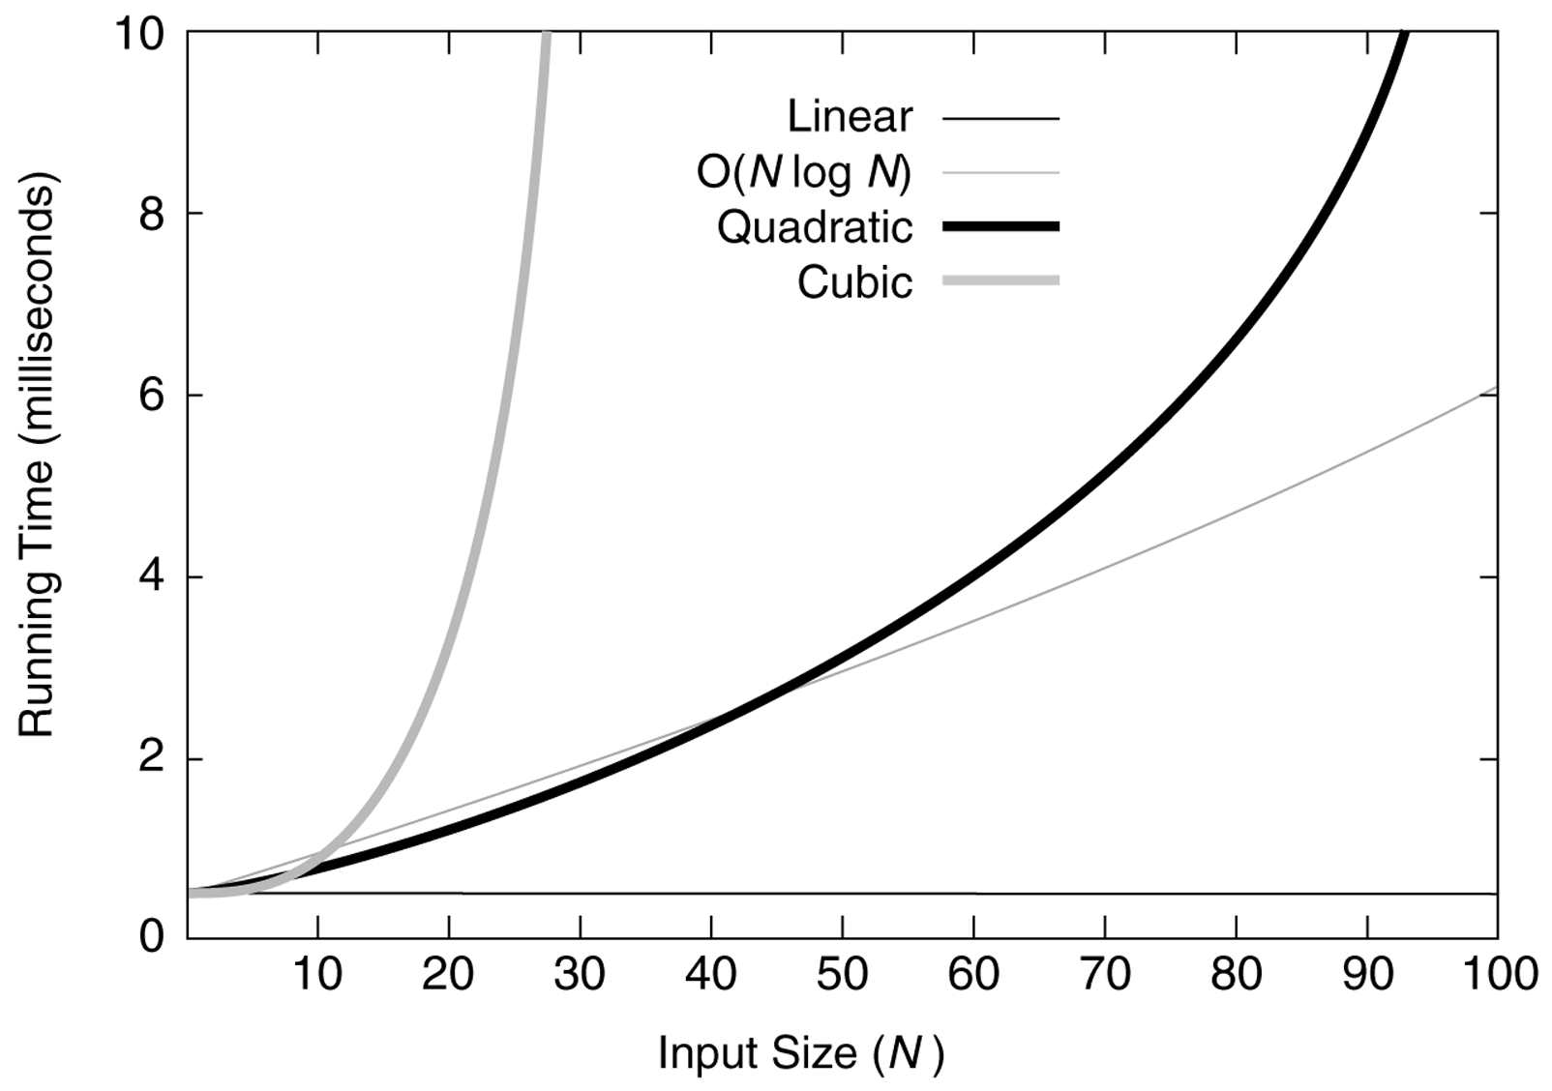
Figure 5.1
Running times for small inputs
Data Structures & Problem Solving using JAVA/2E Mark Allen Weiss © 2002 Addison Wesley

Slide 11
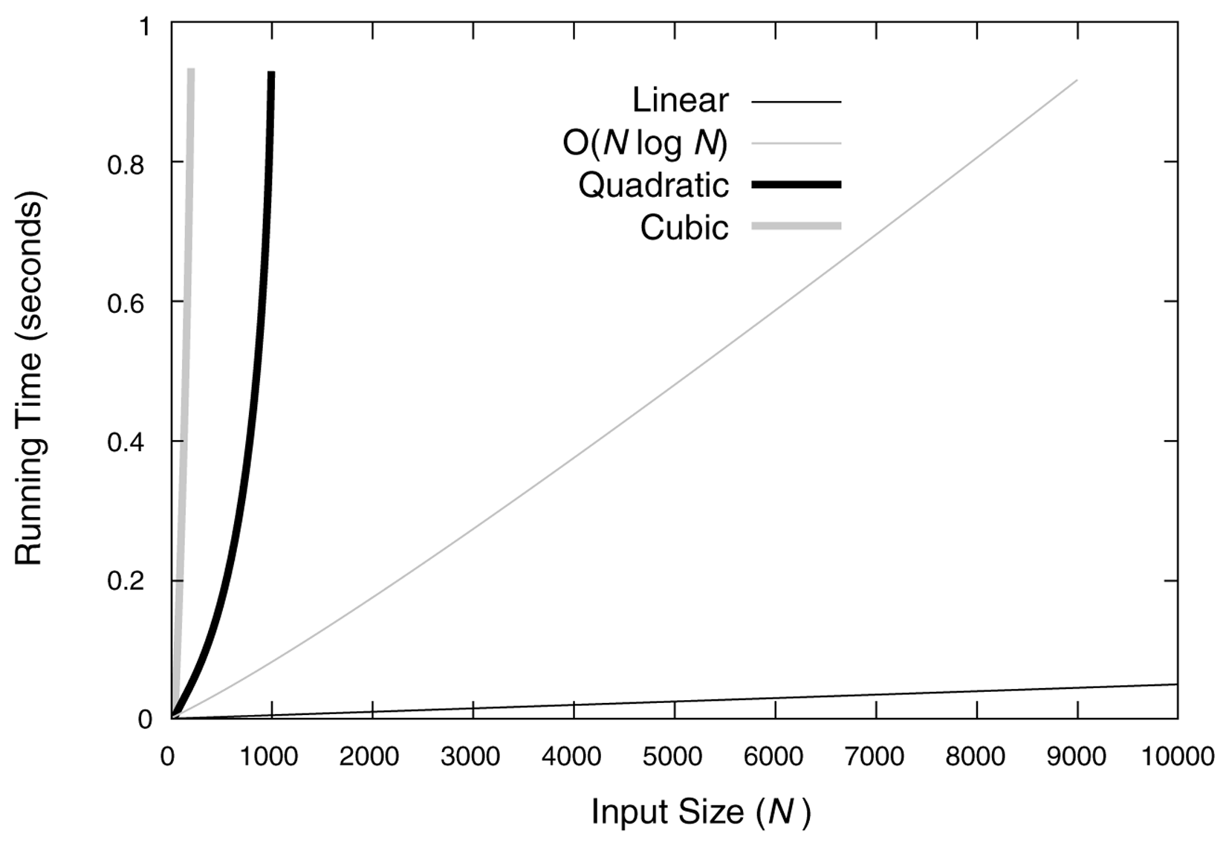
Figure 5.2
Running times for moderate inputs
Data Structures & Problem Solving using JAVA/2E Mark Allen Weiss © 2002 Addison Wesley

Slide 12
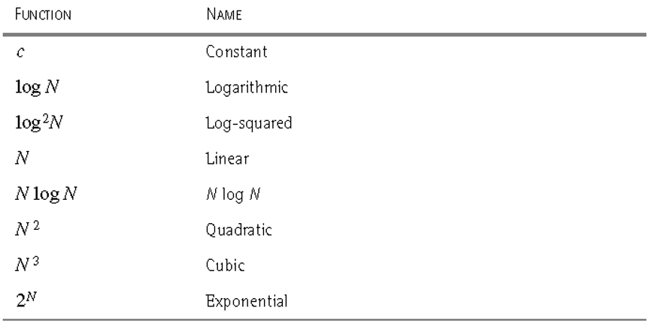
Figure 5.3
Functions in order of increasing growth rate
a.k.a "log linear"
Data Structures & Problem Solving using JAVA/2E Mark Allen Weiss © 2002 Addison Wesley

Slide 13
Asymptotic analysis
We only really care what happens when N (the size of a problem) gets large
Is the function basically linear, quadratic, etc. ?
For example, when n is large, the difference between n² and n² – 3 is negligible

Slide 14
Informal definition of big-Oh
As applied to run-time analysis
Run-time of the algorithm of interest on a worst-case input of size n is:
  at most a constant times blah, for large n
Example: run-time of the linear search algorithm on a worst-case input of size n is:
  O(n)
Alternatives to:
  Run-time: space required, …
  Algorithm of interest: Problem of interest
  Worst-case input: Average-case, best-case
  At most: At least => Ω and “exactly” (i.e. one constant for at least and another for at most) => Θ

Slide 15
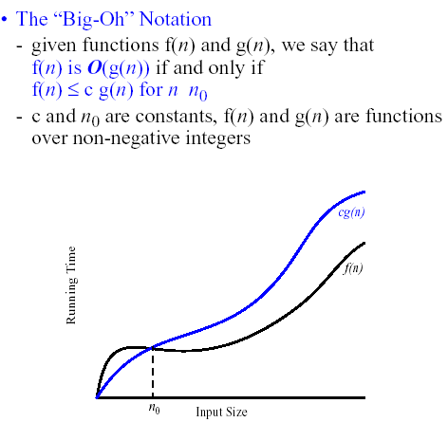
there exists a c such that
In this course, we won't be so formal . We'll just say that
f(N) is O(g(N) means that f(n) is eventually smaller than a constant times g(n).
≥
for all n >= n0
Q7

Slide 16
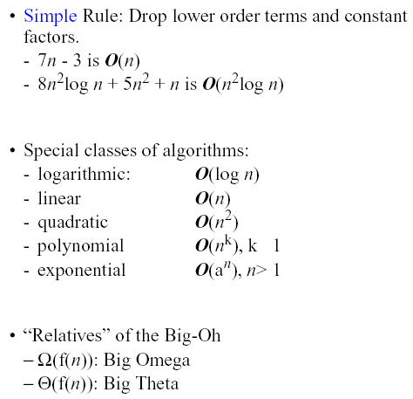
≥

Slide 17
Recap: O, Ω, Θ
f(N) is O(g(N)) if there is a constant c such that for sufficiently large N, f(N) ≤ cg(N)
  Informally, as N gets large the growth rate of f is bounded above by the growth rate of g
f(N) is Ω(g(N)) if there is a constant c such that for sufficiently large N, f(N) ≥ cg(N)
  Informally, as N gets large the growth rate of f is bounded below by the growth rate of g
  f(N) is Θ(g(N)) if f(N) is O(g(n)) and f(N) is Ω(g(N))
    Informally, as N gets large the growth rate of f is the same as the growth rate of g

Slide 18
Limits and asymptotics
consider the limit
What does it say about asymptotics if this limit is zero, nonzero, infinite?
We could say that knowing the limit is a sufficient but not necessary condition for recognizing big-oh relationships.
It will be all we need for all examples in this course.
Q8

Slide 19
Apply this limit property to the following pairs of functions
N and N²
N² + 3N + 2 and N²
N + sin(N) and N
log N and N
N log N and N²
Nª and N^{n}
a^{N} and b^{N} (a < b)
log_{a}N and log_{b}N (a < b)
N! and N^{N}
Q9
Notes:
D0 a few here, and suggest that they do the rest for homework

Slide 20
Big-Oh Style
Give tightest bound you can
  Saying that 3N+2 is O(N³) is true, but not as useful as saying it’s O(N) [What about Θ(N³) ?]
Simplify:
  You could say:
  3n+2 is O(5n-3log(n) + 17)
  and it would be technically correct…
  It would also be poor taste … and put me in a bad mood.
But… if I ask “true or false: 3n+2 is O(n³)”, what’s the answer?
  True!
  There may be “trick” questions like this on assignments and exams.
  But they aren’t really tricks, just following the big-Oh definition!

Slide 21
Examples / practice
Sorting and searching
  Why we study these
See project: SortingAndSearching
  Counting: Loops

