Slide 1
Session 3
CSSE 220 Object-Oriented Software Development
Implementing a class
  Implementing an interface
  Using documented stubs before coding
  Writing JUnit tests before coding
  Using fields

Slide 2
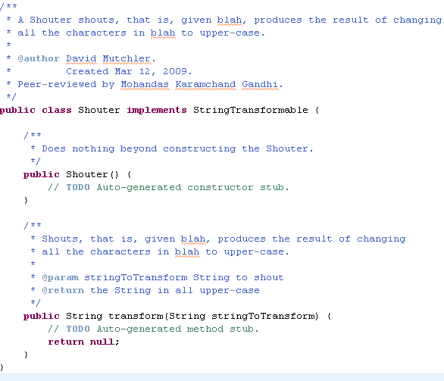
Shouter
Step 1: Create the Shouter class with documented stubs
Do you see:
What is a stub?
What is a
documented stub?
What must you document? (Answer: every public thing)
What is the form for a Javadoc?
What does “implements StringTransformable” mean? Why is it important?
What is the form of this class?
What is a constructor?
Questions on the above?
Did you get yours peer-reviewed?

Slide 3
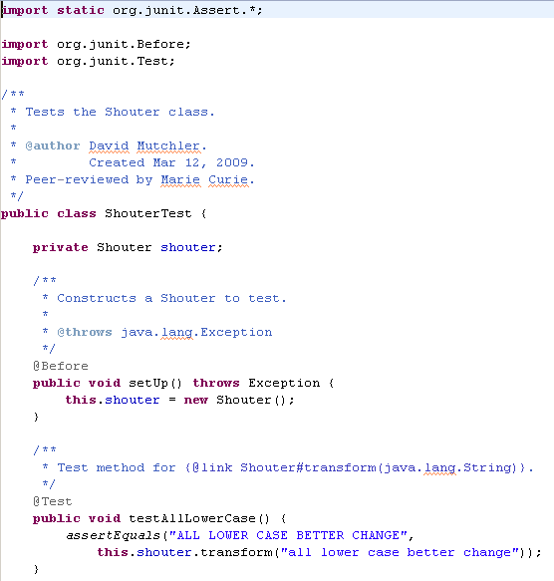
Shouter
Step 2: Write JUnit tests for the constructors and methods of Shouter
Do you see why:
We test only translate here?
There is a field for a Shouter object?
How setup initializes that field?
How assertEquals works?
Test cases continue on the next slides.

Slide 4
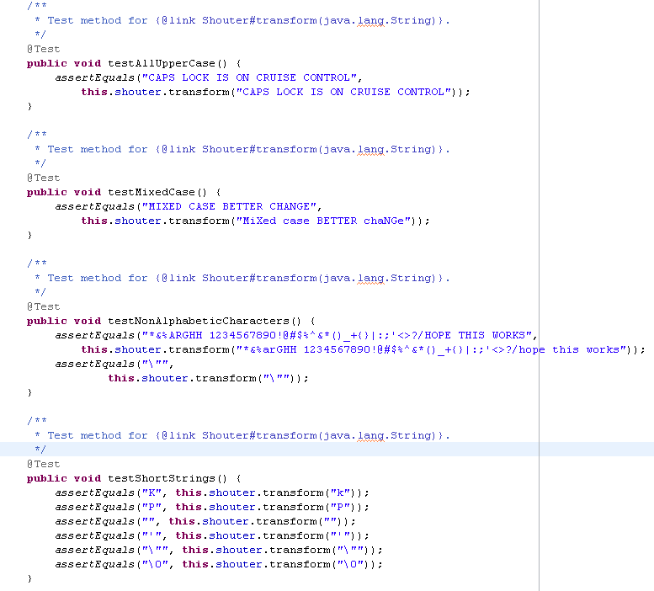
Shouter
Step 2: Write JUnit tests for the constructors and methods of Shouter
Do you see why:
These are good test cases?
One last test case – testing long Strings – is on the next slide.

Slide 5
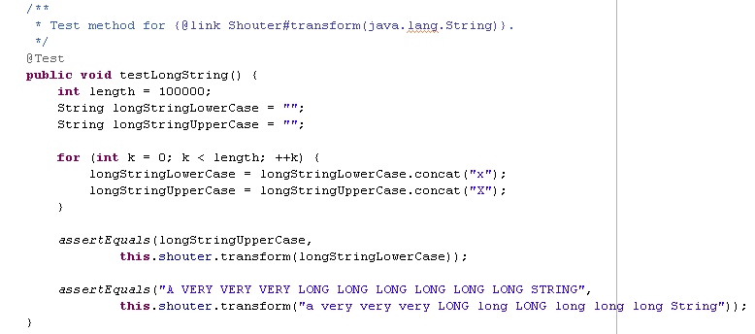
Shouter
Step 2: Write JUnit tests for the constructors and methods of Shouter
Do you see why:
How this uses concat and assignment to build long Strings?
We should perhaps test how long the method takes?
JUnit can do that, but we won’t take the time to do so today.
Questions on JUnit tests?

Slide 6
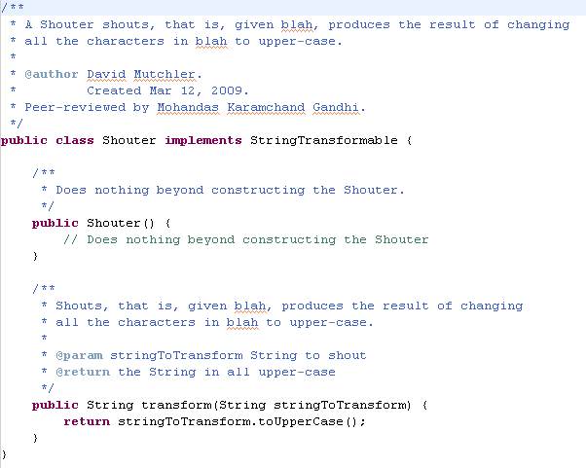
Shouter
Step 3: Implement the class, then test and debug code and/or tests.
Do you see:
Why implementing transform:
  starts with stringToTransform?
  Continues with a dot?
How you found the right method (toUpperCase) to call?
Why you don’t need a local variable in transform?
Why the constructor does nothing?
Why you should have the comment that it does nothing?

Slide 7
Fields
What are fields (aka member variables) of a class?
When does a class need fields?
  Example: TestShouter needs a field.
    What is the field?
    Why is it needed?
    How is it initialized?
  Example: Censor needs a field.
    What is the field?
    Why is it needed?
    How is it initialized?

