Slide 1
Review: Cohesion and Coupling, Mutable, Inheritance
Screen Layouts
Software methodologies – Extreme Programming
Object-Oriented Design – CRC Cards
- UML class diagrams
Notes:
Bring Email Client Project Requirements handout
ANGEL PIN: 6Z59J4
We'll talk about Hardy next time, because you can still use a late day until 8:05 tomorrow.
Exam 2 is two weeks from today.

Slide 2
Software
Development
Methods

Slide 3
Software Life Cycle
Analysis
Design
Software Development
Implementation
Testing
Deployment
Maintenance
Notes:
Briefly discuss what happens in each stage. Should be review from 120.
Big Java focuses on software development and so omits the maintenance stage.

Slide 4
Formal Development Processes
Standardized approaches intended to:
  Reduce costs
  Increase predictability of results
Examples:
  Waterfall model
  Spiral model
  “Rational Unified Process”
Notes:
Cover the material on formal processes quickly. The intent is just to show that we’re only working with a small slice of the possible approaches.

Slide 5
Waterfall Model
Analysis
Do each stage to completion
Then do the next stage
Design
Implementation
Testing
Pipe dream model?
Deployment
Notes:
- Pipe dream box is animated.
Waterfall just doesn’t work:
- Changes happen as we learn more about the problem domain (while working on the project).
- Customers want changes. If they didn’t want to change the system they would built it out of hardware.

Slide 6
Spiral Model
Schedule overruns
Scope creep
Repeat phases in a cycle
Produce a prototype at end of each cycle
Get early feedback, incorporate changes
Prototype
Analysis
Design
Deployment
Implementation
Testing
Notes:
Discuss how each wedge represents a phase of the development process.
- Spiral and prototype appearance is animated
- Risks callout animated: “We’ll get it right on the next cycle” attitude leads to schedule overruns.

Slide 7
Extreme Programming—XP
Like the spiral model with very short cycles
Pioneered by Kent Beck
One of several “agile” methodologies, focused on building high quality software quickly
Rather than focus on rigid process, XP espouses 12 key practices…
Notes:
- Cycles are often 1 day or 1 week, versus months in the spiral model.
- Kent coauthored JUnit (along with Erich Gamma, who was lead developer for Eclipse)

Slide 8
The XP Practices
Realistic planning
Small releases
Shared metaphors
Simplicity
Testing
Refactoring
Pair programming
Collective ownership
Continuous integration
40-hour week
On-site customer
Coding standards
When you see opportunity to make code better, do it
Use descriptive names
Q1
Notes:
The “extreme” in extreme programming is to turn the dial on all these practices “up to 11”. (Spinal Tap reference.)
Refer them to the book or on-line if they want more information. Just emphasize the key XP practices that we’re using.

Slide 9
What is good object-oriented design?
It starts with good classes…

Slide 10
Good Classes Typically
Often come from nouns in the problem description
May…
  Represent single concepts
    Circle, Investment
  Be abstractions of real-life entities
    BankAccount, TicTacToeBoard
  Be actors
    Scanner, CircleViewer
  Be utilities
    Math
Q2
Notes:
Discuss why the ‘er’s are highlighted for actors: actors == do-ers

Slide 11
What Stinks? Bad Class Smells
Can’t tell what it does from its name
  PayCheckProgram
Turning a single action into a class
  ComputePaycheck
Name isn’t a noun
  Interpolate, Spend
Q3

Slide 12
Analyzing Quality of Class Design
Cohesion
Coupling
Notes:
[outline slide]

Slide 13
Cohesion
A class should represent a single concept
Public methods and constants should be cohesive
Which is more cohesive?
CashRegister
CashRegister
double NICKEL_VALUE
double DIME_VALUE
double QUARTER_VALUE
void add(ArrayList<Coin> coins)
…
void add(int nickels, int dimes, int quarters)
…
Coin
double getValue()
Q4

Slide 14
Dependency Relationship
When one classes requires another class to do its job, the first class depends on the second
Shown on UML
diagrams as:
  dashed line
  with open arrowhead
CashRegister
void add(ArrayList<Coin> coins)
…
Coin
double getValue()
Q5
Notes:
Note CashRegister depends on Coin
But Coin does NOT depend on CashRegister

Slide 15
Coupling
Lots of dependencies == high coupling
Few dependencies == low coupling
Which is better? Why?
Q6
Notes:
Low coupling ➔ less brittle, can change one class without changing the others; can reason about one class without thinking about many others.

Slide 16
Quality Class Designs
High cohesion
Low coupling
Immutable where practical, document where not
Inheritance for code reuse
Interfaces to allow others to interact with your code

Slide 17
Object-Oriented Design
A practical technique

Slide 18
Object-Oriented Design
We won’t use full-scale, formal methodologies
  Those are in later SE courses
We will practice a common object-oriented design technique using CRC Cards
Like any design technique,
the key to success is practice

Slide 19
Key Steps in Our Design Process
Discover classes based on requirements
Determine responsibilities of each class
Describe relationships between classes
Q2
Notes:
We do all this before writing code. We might do more of it during a project if we get “stuck” while adding a feature.

Slide 20
Discover Classes
Based on Requirements
Brainstorm a list of possible classes
  Anything that might work
  No squashing
Prompts:
  Look for nouns
  Multiple objects are often created from each class → so look for plural concepts
  Consider how much detail a concept requires:
    A lot? Probably a class
    Not much? Perhaps a primitive type
Don’t expect to find them all → add as needed
Tired of hearing this yet?
Notes:
Handout requirements for sample project.
Give them a couple of minutes to read, then ask them to underline nouns, plural concepts.
Brainstorm possible classes on the board.

Slide 21
Determine Responsibilities
Look for verbs in the requirements to identify responsibilities of your system
Which class handles the responsibility?
Can use CRC Cards to discover this:
  Classes
  Responsibilities
  Collaborators

Slide 22
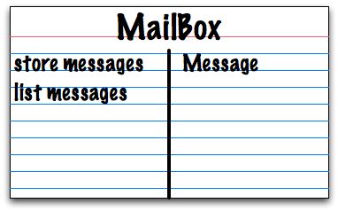
CRC Cards
Use one index card per class
Class name
Responsibilities
Collaborators
Q3

Slide 23
CRC Card Technique
Pick a responsibility of the program
Pick a class to carry out that responsibility
  Add that responsibility to the class’s card
Can that class carry out the responsibility by itself?
  Yes → Return to step 1
  No →
    Decide which classes should help
    List them as collaborators on the first card
    Add additional responsibilities to the collaborators’ cards

Slide 24
CRC Card Tips
Spread the cards out on a table
  Or sticky notes on a whiteboard instead of cards
Use a “token” to keep your place
  A quarter or a magnet
Focus on high-level responsibilities
  Some say < 3 per card
Keep it informal
  Rewrite cards if they get to sloppy
  Tear up mistakes
  Shuffle cards around to keep “friends” together
Notes:
Flip back to CRC Card Technique slide. Hand out index cards. Have the class work in groups of 3 (some 2 if it doesn't come out even). to do CRC cards for the sample. Make sure there are an even number of groups.
After some work time (15-20 minutes?), have the groups
exchange cards with another group. Give feedback to other group.
Do you understand the purposes of their classes.
If you made a UML diagram from their cards, do you think you'd get the same one they got?

Slide 25
Describe the Relationships
Classes usually are related to their collaborators
Draw a UML class diagram showing how
Common relationships:
  Inheritance: only when subclass is a special case
  Aggregation: when one class has a field that references another class
  Dependency: like aggregation but transient, usually for method parameters, “has a” temporarily
  Association: any other relationship, can label the arrow, e.g., constructs
NEW!
Notes:
Don’t sweat the differences too much. Get inheritance and interface implementation right. OK to use association arrows for the rest.

Slide 26
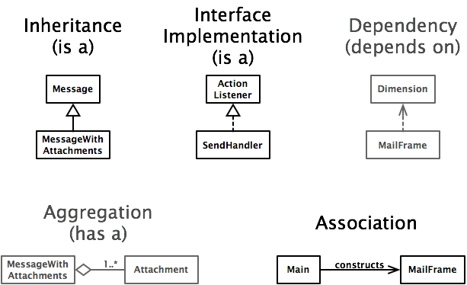
Summary of
UML Class Diagram Arrows
Q4
Notes:
Point out differences in line style and arrow heads/tails. Note that aggregation uses a special tail.
Again, don’t sweat the differences too much. Get inheritance and interface implementation right. OK to use association arrows for the rest.
Have groups of three draw UML diagrams either on white board or on chartpads. (I usually take the chart pads off the wall.)

