Slide 1

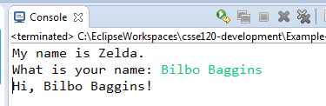
Input from the Console
print('My name is Zelda.')
print('Hi, ' + s + '!')
http://xkcd.com/1586/
s = input('What is your name: ')
This video shows how to do CONSOLE input.
A subsequent video does the same for FILE input.

Slide 2

Input from the Console
The input function displays its optional argument on the Console and waits for the user to:
Type a sequence of characters, and
Press the ENTER key.
The input function returns the sequence of characters that the user typed, as a string.
s = input('What is your name: ')
print('Hi, ' + s + '!')
Indicates that the program is still running. Here, waiting for user to type … and press ENTER.
The input function always returns a STRING.
The newline character corresponding to the ENTER key is NOT included in the string.

Slide 3
Input from the Console
Optional argument: a PROMPT that is printed on the Console
s = input('Continue? (y/n) ')
The input function always returns a STRING.
The newline character corresponding to the ENTER key is NOT included in the string.
The prompt usually includes a space at its end to help the user separate the prompt from what the user herself types.

Slide 4

Input from the Console
Use the int function to convert a STRING into its corresponding INTEGER
The input function always returns a STRING.
s = input('How old are you? ')
age = int(s)
if age >= 18:
<allow the user to vote>
age_in_months = 12 * age
Composition:
a function acting on the returned value from another function.
s = int(input('How old are you? '))

Slide 5
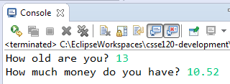
Input from the Console
Use the int function to convert a STRING into its corresponding INTEGER.
Use the float function to convert a STRING into its corresponding
FLOATING POINT number.
s = int(input('How old are you? '))
money = float(input('How much money do you have? '))
The input function always returns a STRING.

Slide 6
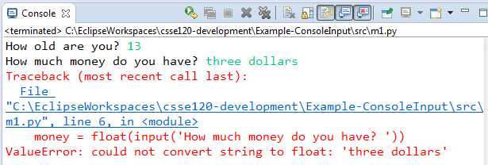
Input from the Console
The int and float functions ATTEMPT to convert their argument to a number
money = float(input('How much money do you have? '))
while True:
try:
money = float(input('How much money ...? '))
break
except ValueError:
print('Enter a NUMBER, like 12.52. Try again.')
print()
Another video shows how to HANDLE such EXCEPTIONS, like this:

Slide 7
Input from the Console
You can process the string that input returns
s = input('Hit? (y/n) ')
if s.strip().lower().startswith('y'):
is_hit = True
else:
is_hit = False
s = input('Hit? (y/n) ')
is_hit = s.strip().lower().startswith('y')
s = ' Hello, HOW r YoU?! \n Fine! \n\n '
s.strip() → 'Hello, HOW r YoU?! \n Fine!'
s = 'yes it does'
s.startswith('y') → True
s = 'nyyyyyyyy'
s.startswith('y') → False
s = ' Hello, HOW r YoU?!'
s.lower() → ' hello, how r you?!'

Slide 8
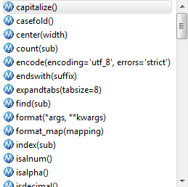



Input from the Console
You can process the string that input returns
s = input('Hit? (y/n) ')
is_hit = s.strip().lower().startswith('y')

Slide 9
Input from the Console: Summary
input to get input from the user via the Console
int to convert a STRING into its
corresponding INTEGER
float to convert a STRING into its
corresponding FLOATING POINT number
The input function always returns a STRING.
name = input('Enter your name: ')
age = int(input('How old are you? '))
money = float(input('How much money do you have? '))
Next videos show how to:
Do FILE input
Handle EXCEPTIONS that occur when doing input and other operations

