Slide 1
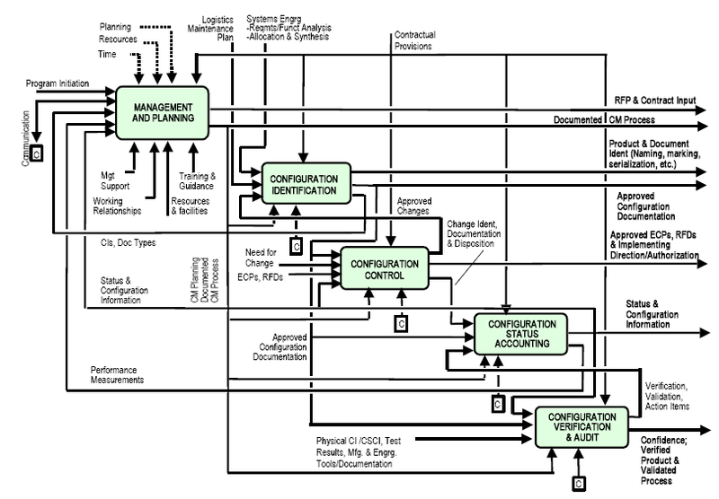

System Configuration Management
Right – Wikipedia’s IDEF0 image of the configuration management process. From http://en.wikipedia.org/wiki/Configuration_management.
EMGT 587
Wasson Ch 42
Steve Chenoweth

Slide 2
A few slides about this topic
It’s a system-wide accountability
  Thus, a Systems Engineer thing to do
  Fits in with system testing, acceptance testing, etc.
  Also fits with white-box testing of interfaces, etc.
An architectural activity
  Did we pick the right one?
  Do the interfaces work?
The development config also is an issue!
So is documentation…

Slide 3
Baselines
First one – approved requirements
Thereafter – configuration control = control of every piece of info or product that goes into the system.
Also includes managing expectations.
And the project setup – like communications.
Endless list of “items”

Slide 4
Issues – p 492
Configuration identification knowledge for most SEs typically comes from informal exposure via verbal discussions in meetings, on-the-job-training (OJT), and observation over many years.
Most engineers have little or no training in the principles of configuration management; most are selftaught through observation and knowledge of general CM standards.
By these means they feel able to proclaim themselves to be configuration experts.

Slide 5
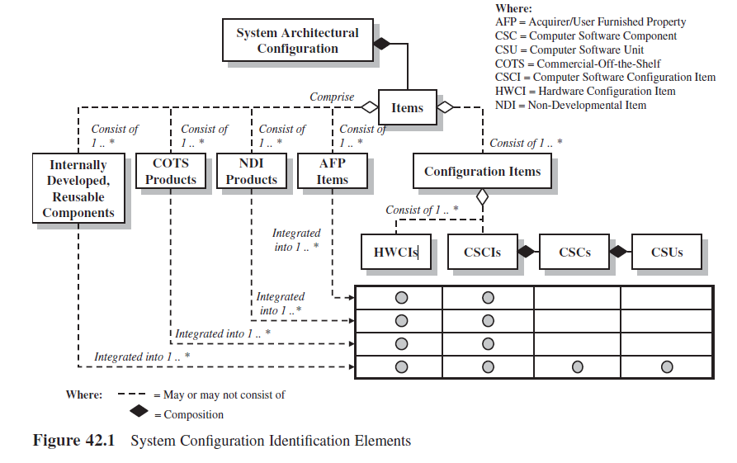
The world of configurations

Slide 6
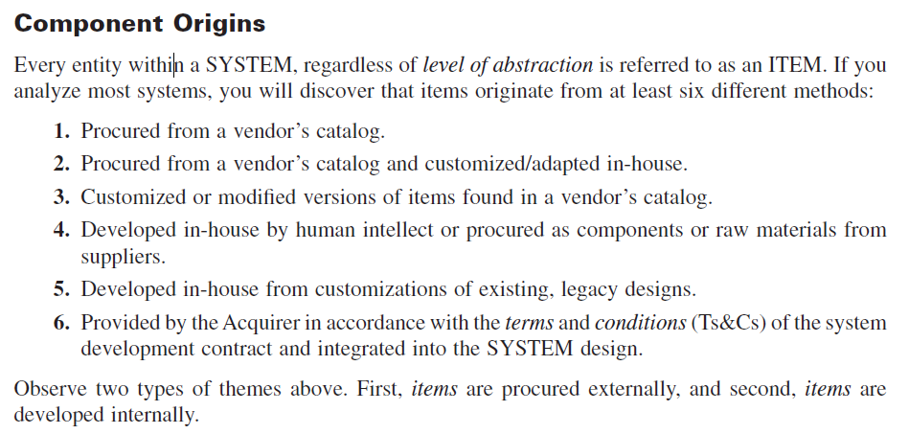
Where’s the info come from?
Notes:
From Wasson p 493

Slide 7
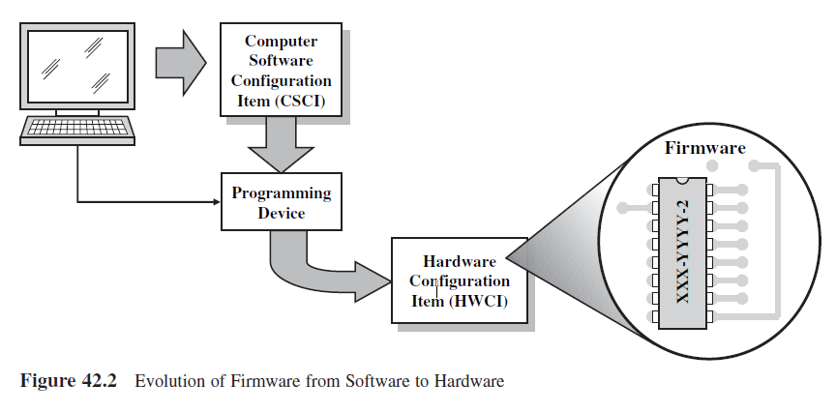
In long-lived products, stuff moves around…

Slide 8
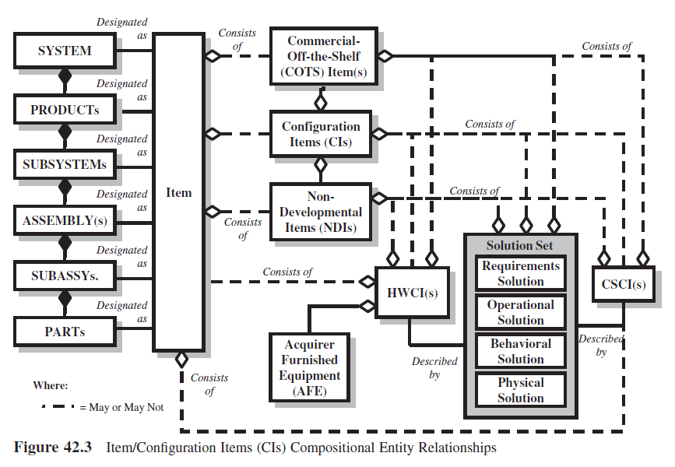
A typical config picture

Slide 9
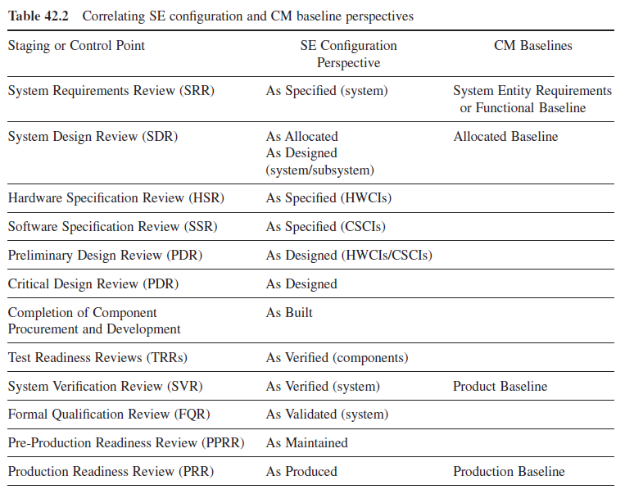
How many reviews to get it right?

