Slide 1


Risk Management
EMGT587
Something that should be fun to assess with your project!
Above – In assessing risks, technical people tend to focus on technical issues which have occurred to them, but the major risks for a product may be business-related – obstacles they don’t consider as often..
Notes:
Image from http://www.dailyspeculations.com/wordpress/?cat=251&paged=2.

Slide 2
Risk
Definition
Risk is the potential that something will go wrong as a result of one or a series of events.
Measured as the combined effect of the probability of occurrence and the assessed consequences of the occurrence.

Slide 3
Risk Management
Definition
Risk management is an organized method for identifying and measuring risk and for selecting and developing options for handling risk.
Basic Elements are:
Risk Assessment
Risk Analysis
Risk Abatement
Assessment
Risk
Analysis
Abatement

Slide 4
Risk Assessment
Risk assessment involves the ongoing review of technical design and/or program management decisions, and the identification of potential areas of risk.

Slide 5
Risk Analysis
Risk analysis includes analyzing the probability of events and the consequences associated with their occurrence.
Event → Cause → Effects → Risk level.
Tools Include
Network analysis, Fishbone, FMEA, Hazard Analysis, etc.

Slide 6
Risk Abatement
Planning for risk. Techniques and methods to reduce or control the risk.
Identify and monitor high risk items or areas more closely or frequently.

Slide 7
Areas of Risk
Project areas of risk can include:
Technical,
Schedule,
Resources,
Personnel,
Budget,
Political
Not meeting a design requirement

Slide 8

Risk Models
At the Project or System level
At the Component or Subsystem level
For the soda machine:
In an overall sense, is this a high risk project?
Where are the areas of high risk, which modules, what functionality ?

Slide 9
Risk Models- System Level
Quantitative models incorporating:
Probability of occurrence, P_{i}
Consequences of occurrence, C_{i}.
Models often tailored to circumstances.
Risk Factor R_{f} = P_{f} + C_{f} – P_{f}C_{f}
Defense Systems Management College model.

Slide 10
Risk Model
Risk Model Categories and Weights
Risk Analysis and Reporting

Slide 11
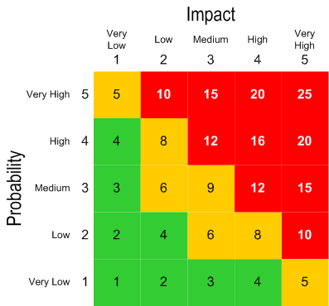
‘Probability/Consequence’ Approaches are Common

Slide 12
Example Project Design
System design uses off-the-shelf hardware with minor modifications to the software.
The design is relatively simple involving the use of standard hardware.
The design requires software of somewhat greater complexity.
The design requires a new database to be developed by a subcontractor.
The consequences of this items failure due to technical factors causes problems of a corrective nature, but the correction causes an 8% cost increase and a 2 month schedule slip.

Slide 13
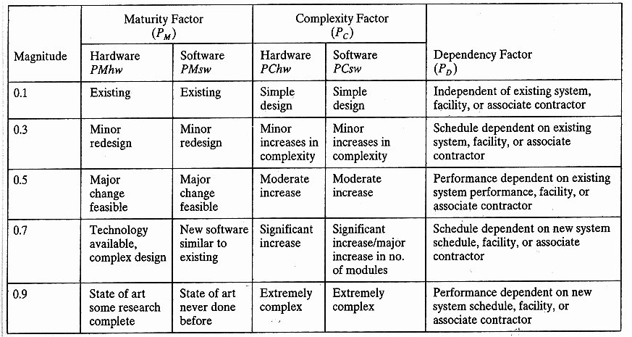
Risk Model Tables
P_{f} is the ‘probability of failure’ term

Slide 14
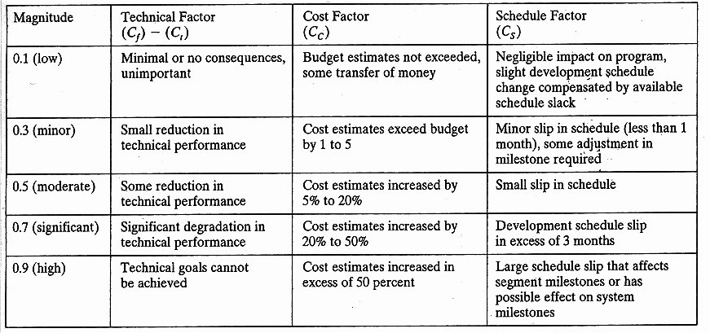
Risk Model Tables (cont)
Ct
C_{f} is the ‘consequence’ of the failure term

Slide 15
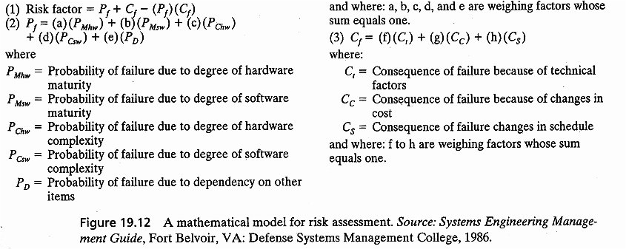
Risk Model Tables (cont)

Slide 16
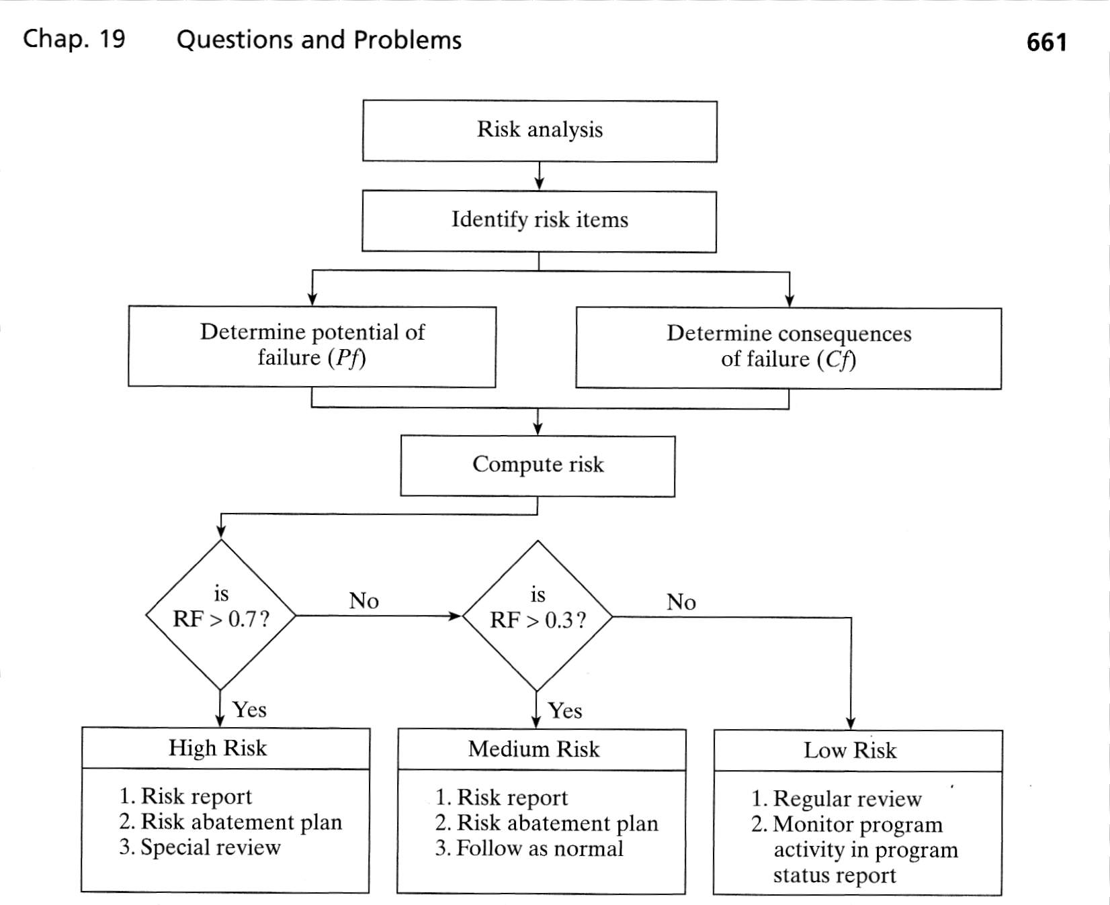
Risk Model Process/Decision

Slide 17
Example Project Design (cntd)
System design uses off-the-shelf hardware with minor modifications to the software.
The design is relatively simple involving the use of standard hardware.
The design requires software of somewhat greater complexity.
The design requires a new database to be developed by a subcontractor.
The consequences of this items failure due to technical factors causes problems of a corrective nature, but the correction causes an 8% cost increase and a 2 month schedule slip.

Slide 18
Calculations
 | Factors | Weights
PMhw | 0.1 | 0.2
PMsw | 0.3 | 0.1
PChw | 0.1 | 0.4
PCsw | 0.3 | 0.1
Pd | 0.9 | 0.2
Pf | 0.3
Ct | 0.3 | 0.4
Cc | 0.5 | 0.5
Cs | 0.3 | 0.1
Cf | 0.4
RF | 0.58
This is a Medium Risk
Project

Slide 19


Benefits of the Risk Model
Identify overall project risk.
Identify areas of the project for closer tracking and monitoring.

Slide 20
Risk Abatement-1
Accept, Assign, Eliminate, Reduce, or Control the Risk
Possible Actions:
Just live with it….
Assign to someone else (insurance) ..
Redesign the system for lower risk.
If risk concentrated in one subsystem, allocate it differently.
If risk spread throughout the system, concentrate it in a few.

Slide 21
Risk Abatement-2
Eliminate, Reduce, or Control the Risk
Possible Actions:
Increased management reporting and review,
Allocate more resources,
Adjust schedules,
Hire consultants or specialists,
Implement testing plan to identify causes,
Start special R&D activities,
Develop a ‘Plan B or fall-back’ plan.

Slide 22
Risk Management in Large-Scale Systems
Characteristics
Simultaneous Autonomy and Interdependence
Intended and Unintended Consequences
Long Incubation Periods
Risk Migration

Slide 23
Simultaneous Autonomy and Interdependence
Sub-systems function independently and are responsible for their own survival and growth.
Yet are linked with other systems.
Actions to reduce risk at the subsystem level might increase risk at the system level.

Slide 24
Intended and Unintended Consequences
Due to complexity, size, and interactions in systems and projects– decisions have intended and unintended consequences.
Decisions made with imperfect data and sometimes ‘negotiated’.

Slide 25
Long Incubation Periods
Accidents and disasters (failure to see risks) often have long incubation periods:
Events often signal danger during incubation period – but ignored or overlooked.
The longer unnoticed,
more difficult to recognized them,
more difficult to correct them.

Slide 26
Risk Migration
Long incubation periods present opportunities for risk to migrate to other subsystems and parts of the project.

Slide 27
Focus Items for Risk Mitigation
Organizational excellence at:
Communication
Make ‘autonomy and interdependence’ explicit.
Decision Making
Ownership, ‘buck stops everywhere’.
Culture
Oversight, strong norms, checks/balances.
Multiple authority structures.
Interfaces

Slide 28
Risk Maturity Levels

Slide 29
Exercise : Company X
Company X is a small entrepreneurial company, three years old, selling monitoring products and systems into an emerging industrial and technical market. The company faces a decision to select a product development direction for the next generation of the companies’ product lines. Two major directions and product platforms have been proposed and are being considered.
See the case writeup for more details (→the doc file in Week08 stuff).

Slide 30
Exercise : Company X
What are the risk scores for each option?
Where are areas of high risk?
What would a risk management plan look like for each option (develop an outline) ?

