Slide 1

Just a bit on Wasson Ch 50 – Reliability, Availability, Maintainability
Steve Chenoweth
EMGT 587
Or, It’s doomsday, did you have any plans?

Slide 2

Some key concepts Wasson has…
Compensating provision – what were those plans, just in case?
Delay time – The wait while nothing is getting fixed.
End effect – The consequence of a failure mode, at the highest level.
Latent defects – Everything in software?
Right - Famous cartoon by Jack Davis (b. 1926)
“Go ahead and putt, it'll be a few minutes before the shock wave reaches us.”

Slide 3
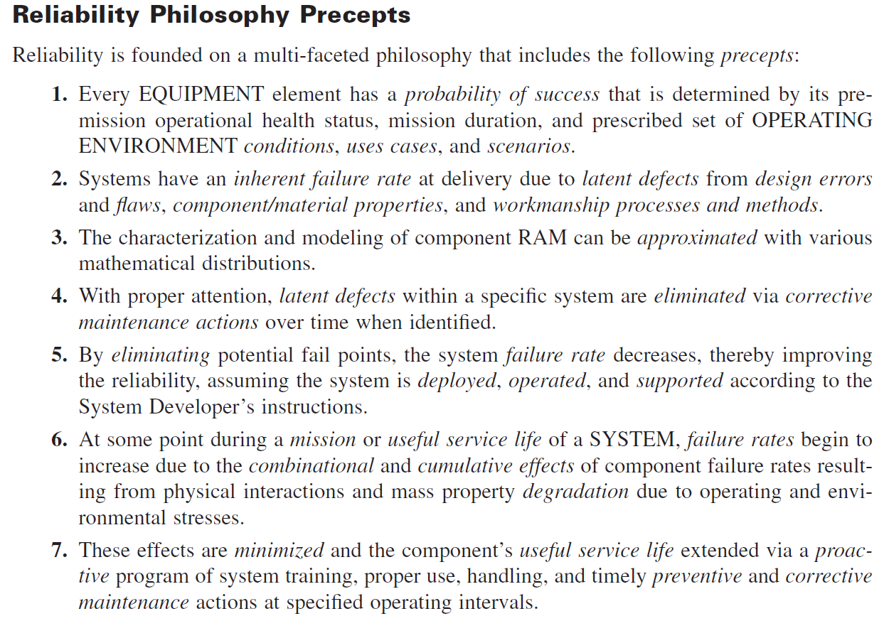
A little intro on Reliability…

Slide 4
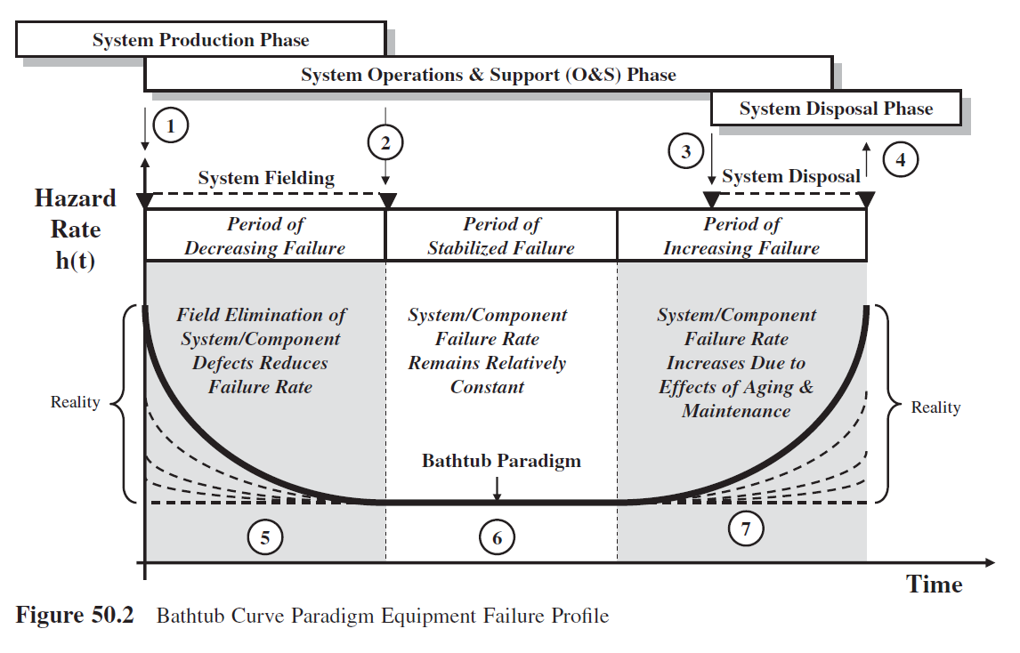
To be continued next time…
We’ll get to the ways to manage design for Reliability, Availability, and Maintainability.
For now, you should know the “Bathtub Curve” – It’s on the homework:

