Slide 1
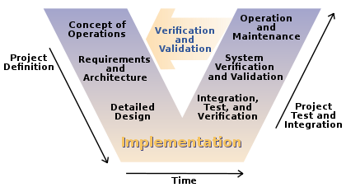

Just a bit on Wasson Ch 24 – System Development Workflow Strategy
Steve Chenoweth
EMGT 587

Slide 2
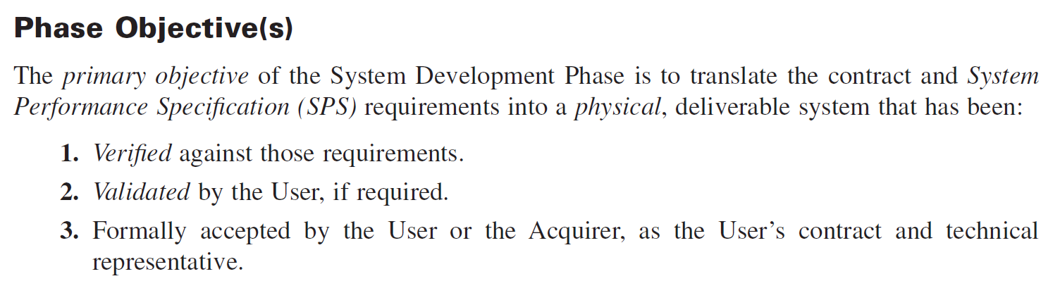
Ok, this is most of the work…
But the Systems Engineer mostly monitors what’s going on!
As you can see, they tend to get butterflies…

Slide 3
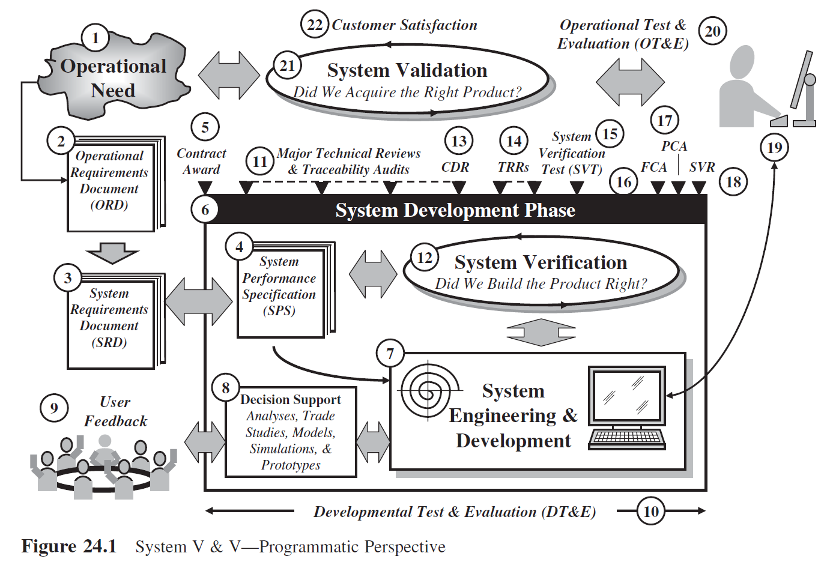

Slide 4
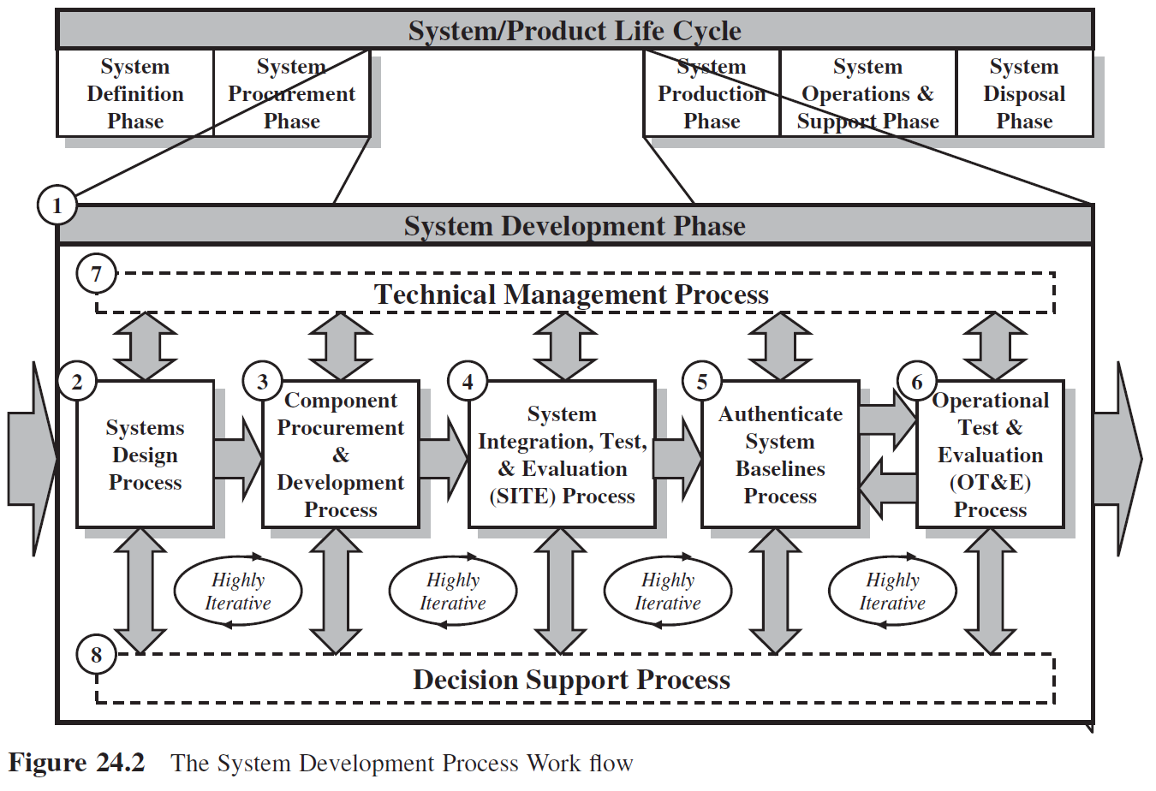

Slide 5
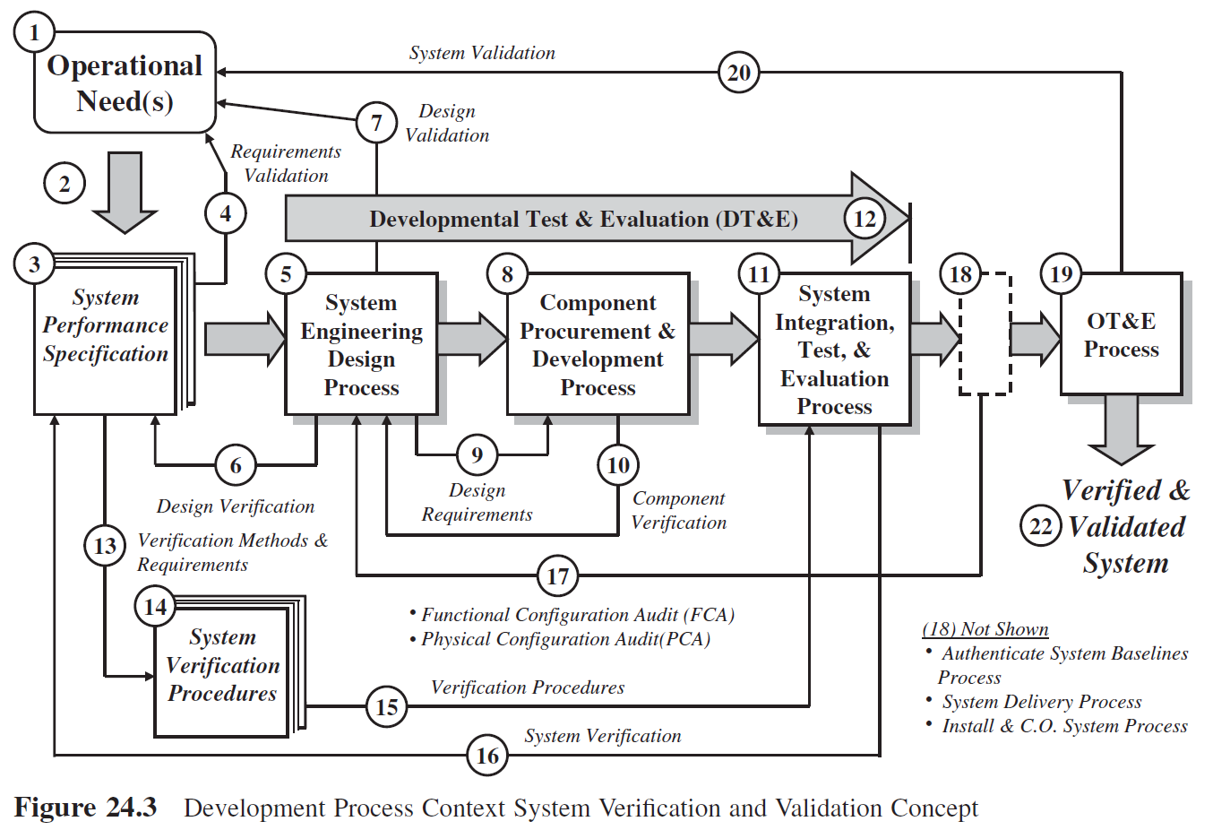

Slide 6
