Slide 1
Systems Engineering Project - Pizza Vending Machine
Project Presentation Team 1
Winter 11/12
EMGT587
Systems Engineering
Department of Engineering Management
Rose-Hulman Institute of Technology

Slide 2
Structure
Project Team
What is a Pizza Vending Machine?
Operational Scenarios
External Systems Diagram
Sample Requirements
Functional Architecture
Physical Architecture
State Transition Diagram
Interfaces
Risk
Qualification

Slide 3

1. Project Team
Project Team 1 - Pizza Vending Machine | Rose-Hulman Institute of Technology
Robert Hoerning, Jonathan Nibert, Philipp Jonigkeit, John Hollingshead
Notes:
„quasikomplementär“ - schön.

Slide 4
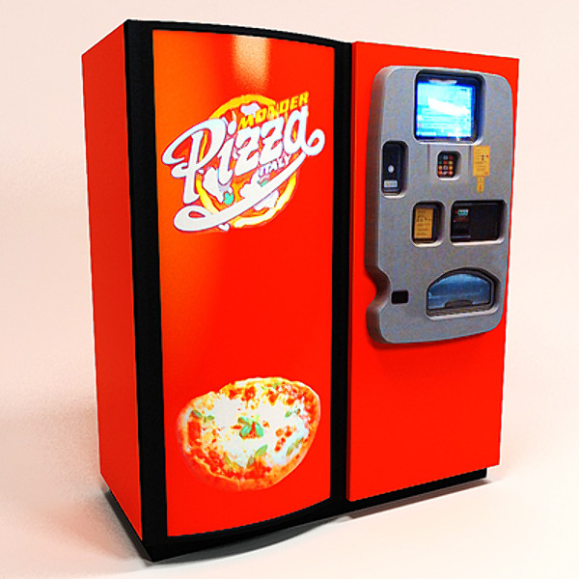
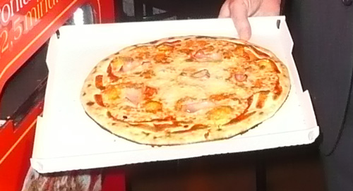
2. What is a Pizza Vending Machine?
Pizza Vending Machine
[Figure 2]
[Figure 1]
Works like a conventional vending machine
Customer can choose his favourite kind of pizza
Pizza is ready in 120 seconds

Slide 5
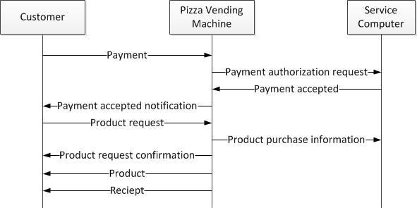
3. Operational Scenarios
Scenario #1: Vending Scenario

Slide 6
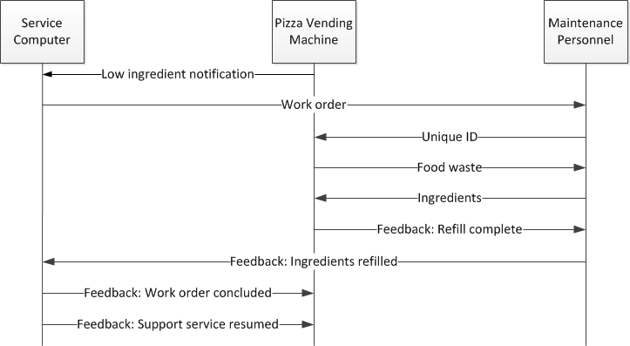
3. Operational Scenarios
Scenario #2: Maintenance – Ingredient Replenishment and Cleaning

Slide 7
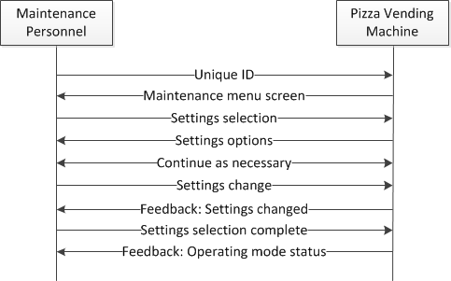
3. Operational Scenarios
Scenario #3: Maintenance – Settings

Slide 8
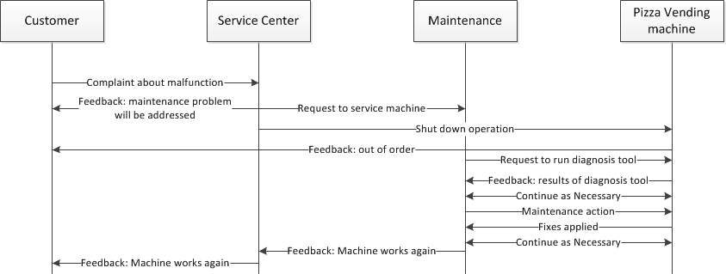
3. Operational Scenarios
Scenario #4: Customer Complaint

Slide 9
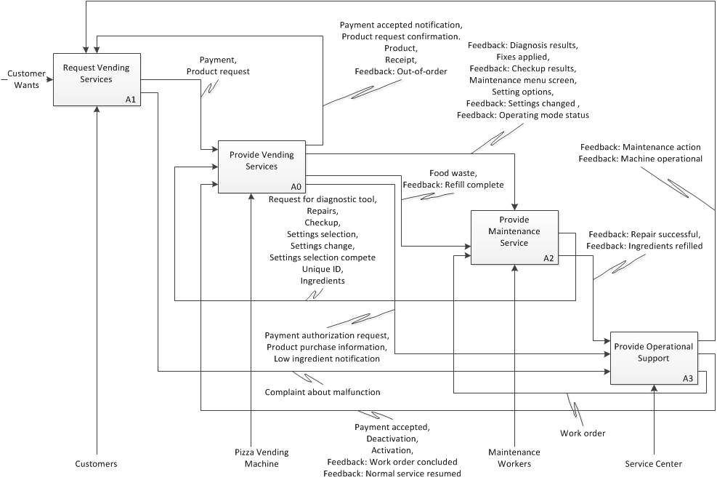
4. External Systems Diagramm
Notes:
Durchmesser 8 cm, h₀ bis 5 cm , Δh bis 4,5 cm

Slide 10
5. Sample Input/Output Requirements
Input / Output Requirements for Operations
Input Requirements for Operations
The machine shall accept cash (legal tender) of the region in which it is operating.
Output Requirements for Operations
The machine shall provide an acknowledgement of funds received to the customer.
External Interface Requirements for Operations
The machine shall interface with the internet to provide communication with the service center.
Functional Requirements for Operations
The machine shall remain in operating state until the machine is unlocked by a maintenance operator.

Slide 11
5. Other Sample Requirements
System-wide / Technology Requirements for Operations
The machine shall follow the UL Standard No. 541 for refrigerated vending machines and UL Standard No. 923 for Cooking Appliances.
Trade-off Requirements
Power-Cost Trade-offs
The power output level directly relates to the costs for heating. The relative weights of the power and cost requirement are .75 and .25, respectively.
Qualifications Requirements for Operations
The machine shall provide the pizza to the customer within a temperature range of 140 to 150 degrees Fahrenheit.

Slide 12
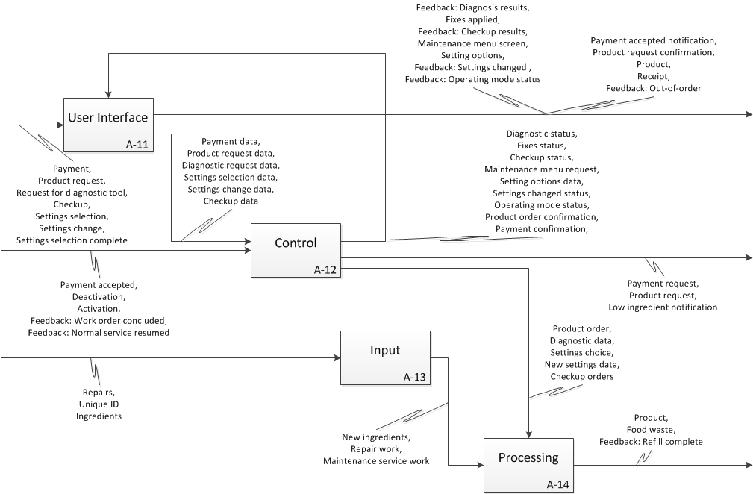
6. Functional Architecture
blabla
blabla
Asdasd
PHIL

Slide 13
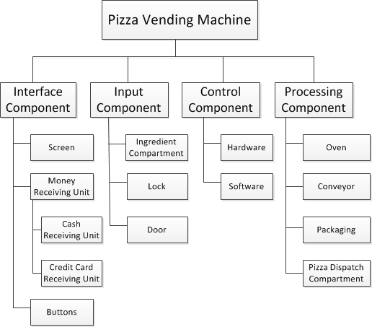
7. Generic Physical Architecture

Slide 14
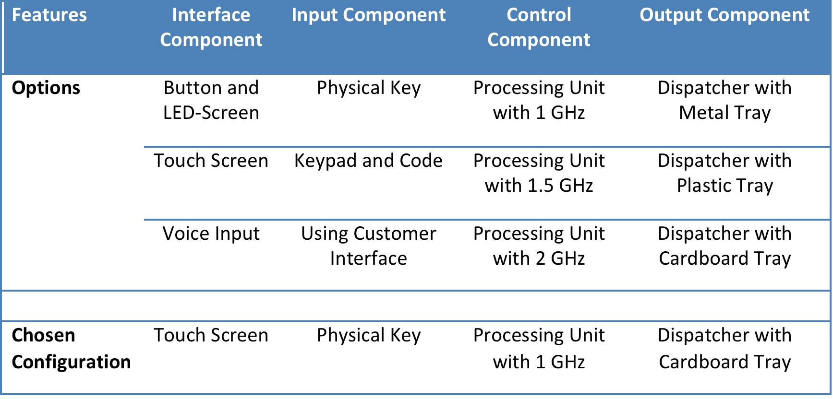
7. Instantiated Physical Architecture

Slide 15
8. State Transition Diagram
blabla
blabla
Asdasd
PHIL

Slide 16
9. Interfaces
Functional or Physical Element | Signals | Input or Output | Frequency | Key Interface Attributes | SOA | Physical Description
Physical input | Payment | Input | As needed | Physical and electrical | Cash receiver/ dispenser | Magnetic strip reader and cash receiver/dispenser
Physical input | Ingredients | Input | As needed | Physical | Ingredient compartments and ingredient level sensors | Ingredient compartments
Control | Deactivation | Input | On command | Electrical | Microcontroller | Logic circuitry
Control | Activation | Input | On command | Electrical | Microcontroller | Logic circuitry
Control | Ingredients refilled message | Input | On command | Electrical | Microcontroller | Logic circuitry
User interface | Product request | Input | As needed | Physical | User interface | Interface button
Processing | Payment | Output | On command | Physical | User interface | Interface screen
Processing | Product | Output | As needed | Physical | Oven and mechanical processing | Box handling and product door mechanism
User interface | Settings change feedback | Output | On command | Optical | User interface | Interface screen
User interface | Product request confirmation | Output | As needed | Optical | User interface | Interface screen

Slide 17
10. Risk
Item/Function | Failure Mode | Effects | S | O | D | RPN | Current Controls
Oven | Thermometer fails | Damage to oven components; | 9 | 3 | 2 | 54 | Current sensing and timer for heating element to shut off
 |  | Fire
Controller | Loss of communication with server | Unable to process payments; | 3 | 6 | 3 | 54 | Periodic handshake between server and unit to ensure check communication status, temporarily deactivates unit if handshake fails
 |  | Unable to send unit status
Oven | Ingredient level sensors fail to signal low level | Unit generates product with missing ingredient(s) | 5 | 3 | 6 | 90 | Routine maintenance based on unit usage to check ingredient levels
Controller | Loss of communication with User Interface | Unable to process payments; | 4 | 2 | 4 | 32 | Diagnostic tool
 |  | Unable to process product request
Oven | Ingredient dispensing quantity sensors fail | Unit generates product with missing/too little/too much ingredient(s) | 5 | 3 | 3 | 45 | Redundant sensor system to check amount after dispensing

Slide 18
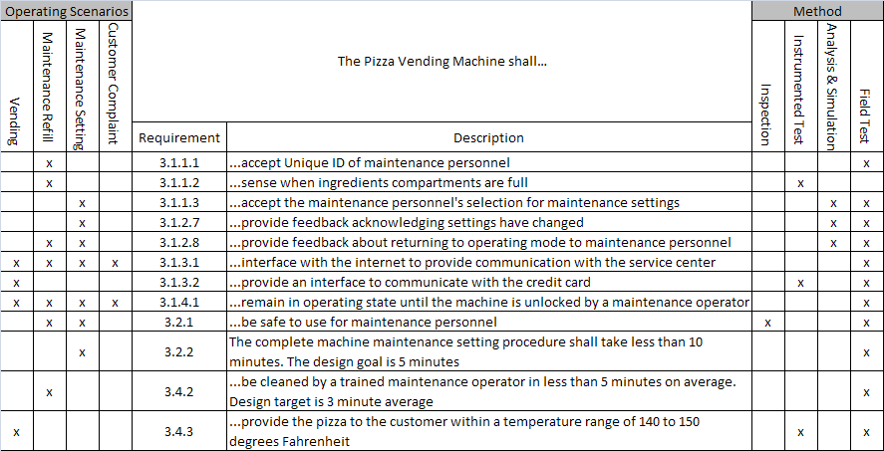
11. Qualification

Slide 19
12. Sources
Sources of pictures:
[Figure 1]: http://www.turbosquid.com/3d-models/pizza-vending-machine-3d-model/453595 (Access 1/10/12)
[Figure 2]: http://slice.seriouseats.com/archives/2009/03/lets-pizza-italian-italy-pizza-vending-machine.html (Access 1/10/12)

