Slide 1
Last quiz question…

Slide 2
Chapter 1: roadmap
  1.1 what is the Internet?
  1.2 network edge
    end systems, access networks, links
  1.3 network core
    packet switching, circuit switching, network structure
  1.4 delay, loss, throughput in networks
  1.5 protocol layers, service models
  1.6 networks under attack: security
  1.7 history
Notes:
2
End here…

Slide 3

How do loss and delay occur?
packets queue in router buffers
packet arrival rate to link (temporarily) exceeds output link capacity
packets queue, wait for turn
packet being transmitted (delay)
A
B
packets queueing (delay)
free (available) buffers: arriving packets
dropped (loss) if no free buffers

Slide 4
Four sources of packet delay
1. nodal processing:
  check bit errors
  determine output link
  microseconds or less
2. queueing
  time waiting at output link for transmission
  depends on congestion level of router
  Microseconds to milliseconds
3. transmission
A
4. propagation
B
1. nodal
processing
2. queueing

Slide 5
Four sources of packet delay
transmission
A
propagation
B
nodal
processing
queueing
d_{nodal} = d_{proc} + d_{queue} + d_{trans} + d_{prop}
d_{proc}: nodal processing
check bit errors
determine output link
typically < msec
d_{queue}: queueing delay
time waiting at output link for transmission
depends on congestion level of router

Slide 6
Four sources of packet delay
transmission
A
propagation
B
nodal
processing
queueing
d_{nodal} = d_{proc} + d_{queue} + d_{trans} + d_{prop}
d_{trans}: transmission delay:
L: packet length (bits)
R: link bandwidth (bps)
d_{trans} = L/R
d_{prop}: propagation delay:
d: length of physical link
s: propagation speed in medium (~2x10⁸ m/sec)
d_{prop} = d/s
d_{trans} and d_{prop}
very different
* Check out the Java applet for an interactive animation on trans vs. prop delay
Notes:
6

Slide 7
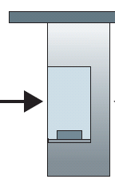
Caravan analogy
100 km
100 km
ten-car
caravan
toll
booth
toll
booth
cars “propagate” at
100 km/hr
toll booth takes 12 sec to service car (bit transmission time)
car~bit; caravan ~ packet
Q: How long until caravan is lined up before 2nd toll booth?
time to “push” entire caravan through toll booth onto highway = 12*10 = 120 sec
time for last car to propagate from 1st to 2nd toll both: 100km/(100km/hr)= 1 hr
A: 62 minutes

Slide 8
Caravan analogy (more)
100 km
100 km
ten-car
caravan
toll
booth
toll
booth
suppose cars now “propagate” at 1000 km/hr
and suppose toll booth now takes one min to service a car
Q: Will cars arrive to 2nd booth before all cars serviced at first booth?
A: Yes! after 7 min, 1st car arrives at second booth; three cars still at 1st booth.

Slide 9
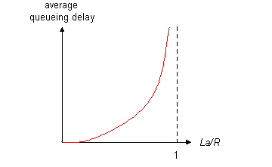

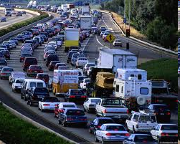
Queueing delay (revisited)
R: link bandwidth (bps)
L: packet length (bits)
a: average packet arrival rate
average queueing delay
traffic intensity
= La/R
La/R ~ 0: avg. queueing delay small
La/R -> 1: avg. queueing delay large
La/R > 1: more “work” arriving
than can be serviced, average delay infinite!
La/R ~ 0
* Check out the Java applet for an interactive animation on queuing and loss
La/R -> 1

Slide 10
“Real” Internet delays and routes
what do “real” Internet delay & loss look like?
traceroute program: provides delay measurement from source to router along end-end Internet path towards destination. For all i:
  sends three packets that will reach router i on path towards destination
  router i will return packets to sender
  sender times interval between transmission and reply.
3 probes
3 probes
3 probes

Slide 11
“Real” Internet delays, routes
traceroute: gaia.cs.umass.edu to www.eurecom.fr
3 delay measurements from
gaia.cs.umass.edu to cs-gw.cs.umass.edu
1 cs-gw (128.119.240.254) 1 ms 1 ms 2 ms
2 border1-rt-fa5-1-0.gw.umass.edu (128.119.3.145) 1 ms 1 ms 2 ms
3 cht-vbns.gw.umass.edu (128.119.3.130) 6 ms 5 ms 5 ms
4 jn1-at1-0-0-19.wor.vbns.net (204.147.132.129) 16 ms 11 ms 13 ms
5 jn1-so7-0-0-0.wae.vbns.net (204.147.136.136) 21 ms 18 ms 18 ms
6 abilene-vbns.abilene.ucaid.edu (198.32.11.9) 22 ms 18 ms 22 ms
7 nycm-wash.abilene.ucaid.edu (198.32.8.46) 22 ms 22 ms 22 ms
8 62.40.103.253 (62.40.103.253) 104 ms 109 ms 106 ms
9 de2-1.de1.de.geant.net (62.40.96.129) 109 ms 102 ms 104 ms
10 de.fr1.fr.geant.net (62.40.96.50) 113 ms 121 ms 114 ms
11 renater-gw.fr1.fr.geant.net (62.40.103.54) 112 ms 114 ms 112 ms
12 nio-n2.cssi.renater.fr (193.51.206.13) 111 ms 114 ms 116 ms
13 nice.cssi.renater.fr (195.220.98.102) 123 ms 125 ms 124 ms
14 r3t2-nice.cssi.renater.fr (195.220.98.110) 126 ms 126 ms 124 ms
15 eurecom-valbonne.r3t2.ft.net (193.48.50.54) 135 ms 128 ms 133 ms
16 194.214.211.25 (194.214.211.25) 126 ms 128 ms 126 ms
17 * * *
18 * * *
19 fantasia.eurecom.fr (193.55.113.142) 132 ms 128 ms 136 ms
trans-oceanic
link
* means no response (probe lost, router not replying)
* Do some traceroutes from exotic countries at www.traceroute.org

Slide 12
Packet loss
queue (aka buffer) preceding link in buffer has finite capacity
packet arriving to full queue dropped (aka lost)
lost packet may be retransmitted by previous node, by source end system, or not at all
buffer
(waiting area)
A
packet being transmitted
B
packet arriving to
full buffer is lost
* Check out the Java applet for an interactive animation on queuing and loss

Slide 13
Throughput
throughput: rate (bits/time unit) at which bits transferred between sender/receiver
  instantaneous: rate at given point in time
  average: rate over longer period of time
server, with
file of F bits
to send to client
link capacity
R_{s} bits/sec
link capacity
R_{c} bits/sec
server sends bits
(fluid) into pipe
pipe that can carry
fluid at rate
R_{s} bits/sec)
pipe that can carry
fluid at rate
R_{c} bits/sec)
Notes:
F bit file received in T seconds by host B, gets an average throughput of F/T

Slide 14
Throughput (more)
R_{s} < R_{c} What is average end-end throughput?
R_{s} bits/sec
R_{c} bits/sec
R_{s} > R_{c} What is average end-end throughput?
R_{s} bits/sec
R_{c} bits/sec
bottleneck link
link on end-end path that constrains end-end throughput
Notes:
MP3 file = 32 million bits
Rs = 2 Mbps
Rc = 1 Mbps
Transfer time (without considering other factors) 32 seconds

Slide 15
Throughput: Internet scenario
per-connection end-end throughput: min(R_{c},R_{s},R/10)
in practice: R_{c} or R_{s} is often bottleneck
R_{s}
R_{s}
R_{s}
R
R_{c}
R_{c}
R_{c}
10 connections (fairly) share backbone bottleneck link R bits/sec
Notes:
BUT if
Rs = 2Mbps
Rc = 1 Mbps
R = 5 Mbps
10 connections splits R into 0.5Mbps = 500 Kbps

Slide 16
Chapter 1: roadmap
  1.1 what is the Internet?
  1.2 network edge
    end systems, access networks, links
  1.3 network core
    packet switching, circuit switching, network structure
  1.4 delay, loss, throughput in networks
  1.5 protocol layers, service models
  1.6 networks under attack: security
  1.7 history
Notes:
16

Slide 17
Protocol “layers”
Networks are complex,
with many “pieces”:
  hosts
  routers
  links of various media
  applications
  protocols
  hardware, software
Question:
is there any hope of organizing structure of network?
…. or at least our discussion of networks?

Slide 18
Organization of air travel
ticket (purchase)
baggage (check)
gates (load)
runway takeoff
airplane routing
ticket (complain)
baggage (claim)
gates (unload)
runway landing
airplane routing
airplane routing
a series of steps

Slide 19
Layering of airline functionality
ticket (purchase)
baggage (check)
gates (load)
runway (takeoff)
airplane routing
ticket (complain)
baggage (claim
gates (unload)
runway (land)
airplane routing
ticket
baggage
gate
takeoff/landing
airplane routing
airplane routing
airplane routing
departure
airport
intermediate air-traffic
control centers
arrival
airport
layers: each layer implements a service
  via its own internal-layer actions
  relying on services provided by layer below

Slide 20
Why layering?
dealing with complex systems:
explicit structure allows identification, relationship of complex system’s pieces
  layered reference model for discussion
modularization eases maintenance, updating of system
  change of implementation of layer’s service transparent to rest of system
  e.g., change in gate procedure doesn’t affect rest of system
layering considered harmful?

Slide 21
Internet protocol stack
application: supporting network applications
  FTP, SMTP, HTTP
transport: process-process data transfer
  TCP, UDP
network: routing of datagrams from source to destination
  IP, routing protocols
link: data transfer between neighboring network elements
  Ethernet, 802.111 (WiFi), PPP
physical: bits “on the wire”
application
transport
network
link
physical

Slide 22
ISO/OSI reference model
presentation: allow applications to interpret meaning of data, e.g., encryption, compression, machine-specific conventions
session: synchronization, checkpointing, recovery of data exchange
Internet stack “missing” these layers!
  these services, if needed, must be implemented in application
  needed?
application
presentation
session
transport
network
link
physical
Notes:
International Organization for Standardization (ISO)
Open Systems Interconnection late 70’s

Slide 23
Encapsulation
source
message
M
application
transport
network
link
physical
segment
H_{t}
M
H_{t}
datagram
H_{n}
H_{n}
H_{t}
M
frame
H_{l}
H_{n}
H_{t}
M
link
physical
switch
destination
H_{n}
H_{t}
M
network
link
physical
M
application
transport
network
link
physical
H_{l}
H_{n}
H_{t}
M
H_{n}
H_{t}
M
H_{t}
M
H_{n}
H_{t}
M
H_{l}
H_{n}
H_{t}
M
router

Slide 24
Chapter 1: roadmap
  1.1 what is the Internet?
  1.2 network edge
    end systems, access networks, links
  1.3 network core
    packet switching, circuit switching, network structure
  1.4 delay, loss, throughput in networks
  1.5 protocol layers, service models
  1.6 networks under attack: security
  1.7 history
Notes:
24

Slide 25
Network security
field of network security:
  how bad guys can attack computer networks
  how we can defend networks against attacks
  how to design architectures that are immune to attacks
Internet not originally designed with (much) security in mind
  original vision: “a group of mutually trusting users attached to a transparent network” ☺
  Internet protocol designers playing “catch-up”
  security considerations in all layers!

Slide 26
Bad guys: put malware into hosts via Internet
malware can get in host from:
  virus: self-replicating infection by receiving/executing object (e.g., e-mail attachment)
  worm: self-replicating infection by passively receiving object that gets itself executed
spyware malware can record keystrokes, web sites visited, upload info to collection site
infected host can be enrolled in botnet, used for spam. DDoS attacks

Slide 27
Bad guys: attack server, network infrastructure
Denial of Service (DoS): attackers make resources (server, bandwidth) unavailable to legitimate traffic by overwhelming resource with bogus traffic
1. select target
2. break into hosts around the network (see botnet)
3. send packets to target from compromised hosts
target

Slide 28
Bad guys can sniff packets
packet “sniffing”:
  broadcast media (shared ethernet, wireless)
  promiscuous network interface reads/records all packets (e.g., including passwords!) passing by
A
C
src:B dest:A payload
B
  wireshark software used for end-of-chapter labs is a (free) packet-sniffer

Slide 29
Bad guys can use fake addresses
IP spoofing: send packet with false source address
A
C
src:B dest:A payload
B
… lots more on security (throughout, Chapter 8)

Slide 30
Chapter 1: roadmap
  1.1 what is the Internet?
  1.2 network edge
    end systems, access networks, links
  1.3 network core
    packet switching, circuit switching, network structure
  1.4 delay, loss, throughput in networks
  1.5 protocol layers, service models
  1.6 networks under attack: security
  1.7 history
Notes:
30

Slide 31
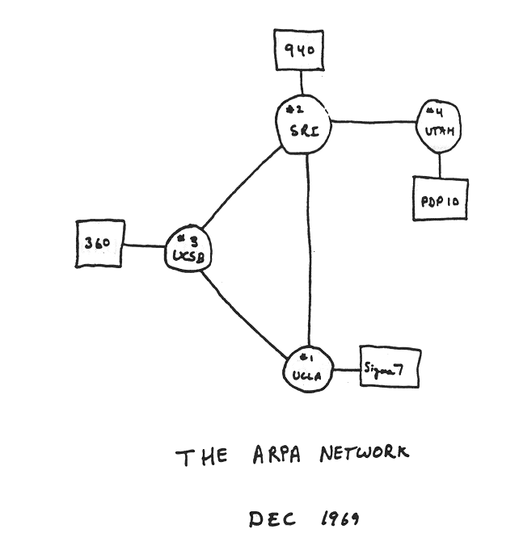
Internet history
1961-1972: Early packet-switching principles
1961: Kleinrock - queueing theory shows effectiveness of packet-switching
1964: Baran - packet-switching in military nets
1967: ARPAnet conceived by Advanced Research Projects Agency
1969: first ARPAnet node operational
1972:
  ARPAnet public demo
  NCP (Network Control Protocol) first host-host protocol
  first e-mail program
  ARPAnet has 15 nodes
Notes:
Packet switching for sharing computers geospacially… was bursty

Slide 32
Internet history
1972-1980: Internetworking, new and proprietary nets
1970: ALOHAnet satellite network in Hawaii
1974: Cerf and Kahn - architecture for interconnecting networks
1976: Ethernet at Xerox PARC
late70’s: proprietary architectures: DECnet, SNA, XNA
late 70’s: switching fixed length packets (ATM precursor)
1979: ARPAnet has 200 nodes
Cerf and Kahn’s internetworking principles:
  minimalism, autonomy - no internal changes required to interconnect networks
  best effort service model
  stateless routers
  decentralized control
define today’s Internet architecture

Slide 33
Internet history
1980-1990: new protocols, a proliferation of networks
1983: deployment of TCP/IP
1982: smtp e-mail protocol defined
1983: DNS defined for name-to-IP-address translation
1985: ftp protocol defined
1988: TCP congestion control
new national networks: Csnet, BITnet, NSFnet, Minitel
100,000 hosts connected to confederation of networks

Slide 34
Internet history
1990, 2000’s: commercialization, the Web, new apps
early 1990’s: ARPAnet decommissioned
1991: NSF lifts restrictions on commercial use of NSFnet (decommissioned, 1995)
early 1990s: Web
  hypertext [Bush 1945, Nelson 1960’s]
  HTML, HTTP: Berners-Lee
  1994: Mosaic, later Netscape
  late 1990’s: commercialization of the Web
late 1990’s – 2000’s:
more killer apps: instant messaging, P2P file sharing
network security to forefront
est. 50 million host, 100 million+ users
backbone links running at Gbps

Slide 35
Internet history
2005-present
~750 million hosts
  Smartphones and tablets
Aggressive deployment of broadband access
Increasing ubiquity of high-speed wireless access
Emergence of online social networks:
  Facebook: soon one billion users
Service providers (Google, Microsoft) create their own networks
  Bypass Internet, providing “instantaneous” access to search, emai, etc.
E-commerce, universities, enterprises running their services in “cloud” (eg, Amazon EC2)

Slide 36
Introduction: summary
covered a “ton” of material!
Internet overview
what’s a protocol?
network edge, core, access network
  packet-switching versus circuit-switching
  Internet structure
performance: loss, delay, throughput
layering, service models
security
history
you now have:
context, overview, “feel” of networking
more depth, detail to follow!

