Slide 1
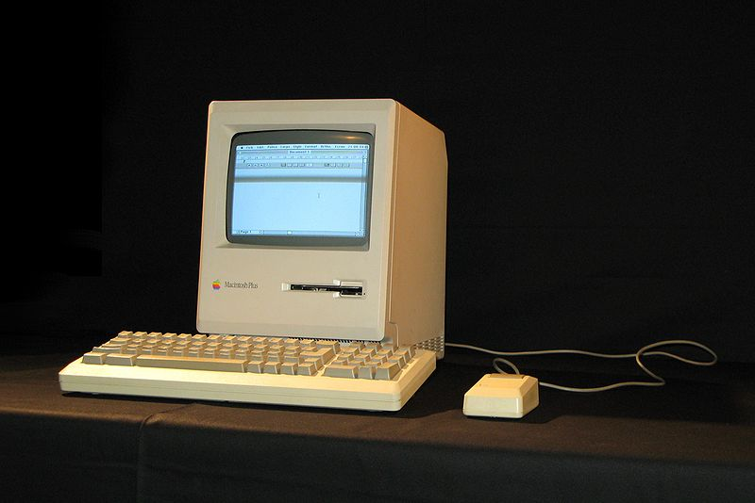

Plus-Delta Feedback
Macintosh Plus, 1986, $ 2599. 1 MB of RAM standard.
CSSE371 – Fall, 2013
Sections 1 & 2
Overall – Half the classes responded
Thanks!
Delta airlines app for smartphones.

Slide 2
Plusses
+
Your thoughts - consolidated
More of your thoughts
Get what we’re learning.
Lots of new stuff on requirements.
Just-in-time learning of concepts.
Enlightening project.
Learned design process
Managing software projects.
Junior project.
Homeworks effective.
Group project skills.
Teamwork.
Team works well.
Able to keep up.
Quizzes and readings work well.
Quizzes are easy.
Dealing with customers!
Learning about people.
Structure of the course.
Professional skills.
Daily quizzes outside class.
Good deadlines for the work.
Replicating real world problems – very valuable.
Quick response:
Regarding waterfall and learning mostly about requirements, and only one process for that in 371 –
  The more complex ones require you to know more things immediately, not so easy to employ in first-time learning
  Most CSSE faculty go by the “Shu Ha Ri” rule – the first time, get people good at using a single method before showing all the choices.
See for example Shu-Ha-Ri at Alistair Cockburn’s site http://alistair.cockburn.us/Shu+Ha+Ri.

Slide 3
Deltas
Δ
Your thoughts - consolidated
More of Your Thoughts
Doing similar things on homework and project.
Homework and quizzes unrelated to project.
Slides are not well documented.
Slides give away the answers.
Slides aren’t explanatory enough. Just bullet points.
Some quiz questions just ask for definitions.
Don’t like the light-hearted quiz questions.
Why didn’t we get to pick team members?
Groups and features chosen at random?
Some of the work fits certain teams better than others.
What’s more important – making a good project or writing repetitive documents?
Overlapping deadlines coming up in schedule?
Why are we doing other things besides requirements?
Feels like we’re not making meaningful progress on the project (just paper work).
Why not do quizzes in class?
Quizzes too easy & too many.
Two quizzes in one day – too many.
We also talk about the readings in class. Unnecessary.
We never talk about quizzes or material in class.
Material is glossed over in class.
I have never paid attention in class.
Need daily quizzes in class to enforce this.
Team members aren’t working.
Too much time going over weekly schedule. Could be spent working on project.
Need more team work time in class.
Don’t get why we can’t use complete framework like Ruby.
Teams don’t have any interaction between them. The five groups are too separated.

Slide 4
Additional thoughts to improve 371
>
Your thoughts - consolidated
More of your thoughts
Class time to meet with PM once a week.
Class would go better if the groups had separate, smaller projects.
Give class choices of project.
Use “improving Moodle” as the project.
Use class time to meet with your team and other teams.
Having people rate themselves on their expertise doesn’t work (as a basis for team structure).
Allow for suggestions before implementation.
More time to discuss design alternatives with client.
Develop a class-wide composite prototype, without things that clash with other groups.
It’s kind of a self-study course.
Make HW’s available well ahead of due date.
Make daily quizzes due at end of day, not before class. That way, people could ask about ones they didn’t get.
Some questions on quiz are hard to interpret.
Class should be structured differently for one big project.
Condense the slides and present a summary in class.
Have a specific activity to work on in each class.
Don’t have both feature teams and special teams like back end.
The special teams working on multi-team interactions is one of the strong points of the course.
Have guest lecturers.
Bring food.

Slide 5
And, about the team member reviews
Your thoughts?
My thoughts (from Sep 23):
What would a good system be, for managing and stimulating team participation?
Your alternatives to “everyone reports to Steve who distributes combined info back” – see last slide!
  Maybe “anonymous” feedback isn’t that great?
  You want these things from your team:
  Positive interdependence: Team members rely on each other to achieve the common goal.
  Face-to-face interaction: Team members do most of the work together. They provide assistance, encouragement and feedback to the other team members.
  Individual accountability and personal responsibility: Each team member is responsible for doing his/her share of the work, and is expected to master all necessary material.
  Interpersonal and small-group skills: Team members use effective communication and conflict-management skills.
  Group processing: Team members set common goals, reflect on team accomplishments and make adjustments as necessary.

Slide 6

A modest proposal:
Jonathan
Swift
This week, your team comes up with a means to manage/stimulate team participation.
Propose that to me by email by Wednesday.
If I approve, it replaces the existing feedback system.
Ideas so far – see next slide –

Slide 7
Some team ideas for peer feedback
A. We’ve come up with the following way to score team-member performance:
We are going to score performance directly on the proportion of tasks completed out of those assigned (i.e. Tasks completed / tasks assigned) on a per-member basis
In the case of anomalous tasks, such as ones we underestimate the size of, so long as the whole team, or a majority agrees, the task will be removed from that individual and added to a communal “pool” of team-sized/team-scale tasks, this pool is not counted in individual performance
Any other rules we may amend, but for now we feel this is sufficient
B. If someone has a problem with someone else they are expected to say something about it. If, they don’t than team will continue function the exact same way.
C. We would like to use the evaluation form again that you had created with 2 alterations:
  1. Either remove the statement about anonymity or actually make it anonymous
  2. Change the weighting
    a. With the current form, a person who is rated as doing exactly what is expected of them still fails the evaluation. They should at least get an A and those who go above and beyond should get bonus points, or people who do the proper amount of work should get a B and those who go above and beyond should get an A.

