Slide 1
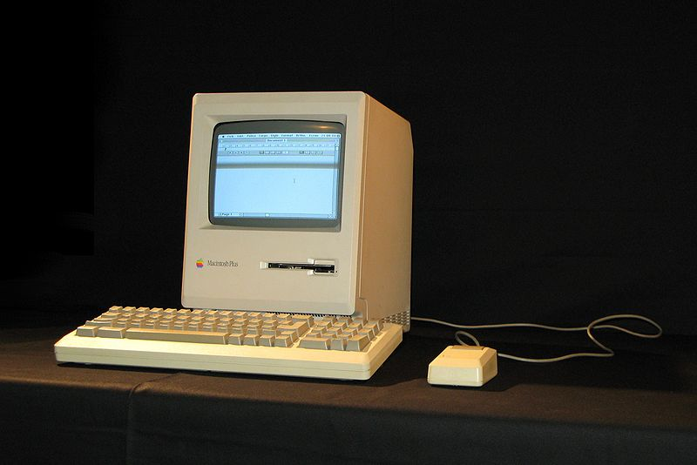

Plus-Delta Feedback
Macintosh Plus, 1986, $ 2599. 1 MB of RAM standard.
CSSE371 – Fall, 2012
Sections 1 & 2
Overall – 15 people responded
Thanks!
Delta airlines app for smartphones.

Slide 2
How do you feel the material in 371 has future value for you?
Your thoughts - consolidated
More of your thoughts
Leads to success in software development
  Experience working with others doing the non-coding side
  Good, requirements are important in real life
Learn one way of doing requirements well (use cases)
Skill at producing prototypes.
I can be more aware of risks and potential failures my project will face.
The processes and skills learned here will make relearning or applying it in the future much easier.
I feel like the material we cover is important, and has a future value, but so far it feels contrived. We spend a lot of time in 372 talking about all these cool development methodologies, but all we do in 371 seems to be waterfall.
I feel that some of it will be relevant in the future (e.g. use cases and different techniques to communicate with a non-tech-savvy client), though some of it (all the different various diagramming techniques) I feel may not be useful as a matter of preference, since we have covered different ways to address these.
Quick response:
On the last two comments, above:
Regarding waterfall and learning only one process in 371 –
  The more complex ones require you to know more things immediately, not so easy to employ in first-time learning
  Most CSSE faculty go by the “Shu Ha Ri” rule – the first time, get people good at using a single method before showing all the choices.
See for example Shu-Ha-Ri at Alistair Cockburn’s site http://alistair.cockburn.us/Shu+Ha+Ri.

Slide 3
Things that are going well toward that end, in 371
Your thoughts - consolidated
More of Your Thoughts
The group project. Group work. I rather like my team.
The various class activities that we have to do in groups that I cannot plan for. The spontaneous nature of those activities serve to teach a lot.
It's doing a good job of exposing me to many different techniques that different people use.
I like the interesting methods described
Learned about [long list]
The activities that we do in class. They aid in learning some of the techniques involved in defining requirements.
The class is structured well.
Organization
Steve's attitude
Group activities
Different scenarios
Amount of homework
The homework to some point is useful.
The quizzes and lecture slides are probably the most useful.
The requirements text is very useful and not too terrible to read.
The interaction design text, however seems very unnecessary to me. Everything I have read in it should be common sense (basic social skills for example).
The slide shows and the readings have been useful.
I like the breadth of information being covered.
The in-class activities help us learn how to apply the concepts, and give us time to practice the topics.
I feel that use cases are incredibly important, and I like how they have been getting covered extensively.

Slide 4
Things you would like to see change about 371, to help improve on that value
Your thoughts - consolidated
More of your thoughts
In-class exercises and the conversations that surround it are silly. It’s common sense.
Inverted classroom. It is leading to extra work.
I feel like we don't have time to ask questions in class.
The reading assignments – a lot of them, and scattered.
Lectures should expand [even more] on what’s in the quizzes.
I don’t read the book – need to lecture on that and do quizzes in class.
Things on exam which were only in readings and slides, not discussed.
Exam was ambiguous but I could have done it without attending class.
Exam should have more exercises and less essay.
Did badly because I didn’t know exam structure ahead of time.
More simulations
Quick responses
Some people like this learning style and some don’t, or simply aren’t used to it.
Our experience is that the more you do this stuff, the better you are at it. Makes sense to start with easy problems in class, and actually spend time doing them.
I will do everything I can to encourage you to do the readings, build on that in class.
You now know my exam style, but:
I’ll also be happy to make more problems on the next one, fewer essays.

Slide 5
New ways of doing things we could explore in 371
Your thoughts - consolidated
More of your thoughts
The lectures could discuss more on the concept and get away more from the slides.
More freedom in developing our own design/reqs/etc. instead of following a rigid format.
Doing an actual small whole-class project (do each step and learn different things each day) in addition to the normal small group projects. But if it's too much, that's okay because it's not a big deal.
Case studies and the discussions about them seem more useful, so more of that would be better.
Less of the made up scenarios and more real world situations.
Class should go back to a standard classroom.
More time for in-class group work, which is what I could really use.
Each project group should interview other project groups
I would like to hear from real PMs
Focus more of class on activities centered around the specific junior projects.
I would like potentially a brainstorming thing, where we can crowd-source some ideas within the class, though I feel this might be more applicable for Sriram's section since they are all on the same project but (guess) different sub-components, while our class would have to waste time explaining the specifics before we could get good ideas.

