Slide 1
CSSE 371 – Exam 2 Review
This is a summary of topics to expect on the exam.
Now with answers!

Slide 2
General themes
As requested, we’ll have more things like problems.
Also some short-answer questions, over topics where that’s the only way to see what you know!
Fair game sources – the two books, lecture slides, quizzes, class discussion, case studies, homeworks and your projects.
Closed book, with one hand-written, double-sided sheet of notes.

Slide 3
Specific sources – from the books & lectures, etc.
Case study – The CONFIRM failure
ID book
  Ch 8 – Data analysis
  Ch 1 – What is interaction design?
  Ch 12 – 13 – Evaluate and decide
  Ch 14 – Usability testing
  Ch 15 – Analytical evaluation
  Ch 2 – Conceptual modeling
Requirements book
  Ch 23 – 24 – Ambiguity in requirements
  Ch 25 – 26 – Requirements to Implementation
  Ch 15 – 19 – Organizing requirements
  Ch 27 – 29 – Managing change and quality
How to use the Usability Lab!
Project and HW - Writing test cases from use cases and QA scenarios.

Slide 4
Non-exhaustive examples of problems
The following are typical of the kinds of problems to expect.
They aren’t necessarily the real problems!
They give you an idea of the depth of knowledge expected in some of the topic areas.

Slide 5
1
It’s easy to be more moral in retrospect. The CONFIRM developers obviously violated the ACM Code of Ethics rule 1.3, to “Be honest and trustworthy.” At the time, however, there always was a glimmer of hope that the system would succeed. Describe what criterion you would use in such a situation, to decide when to take extraordinary measures and try to communicate the situation to some higher level person, like the customer or an executive in charge of your project.
Notes:
Attributes of a good answer:
Refer to the code cited and/or your obligations to your profession.
Clarify your relationship to the person you might report the problem to.
Identify team-related problems that could occur as a result – like getting fired by the boss you went around!
Note the specifics you might use in deciding the timing, such as your own opinion of the likelihood the project will succeed, and your basis for knowing that.

Slide 6
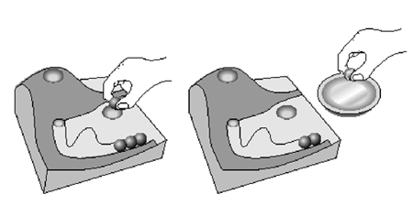
2
In the “marble answering machine” of Ch1 in the IDE book, incoming voice messages are represented by marbles. The user can grasp and then drop these to play the message or dial the caller automatically. Describe the design principles that are used, and the resulting advantages and disadvantages of this design.
Notes:
Attributes of a good answer:
Clarifying where necessary how the machine works, from having read the chapter.
Discussing the “natural analogy” between dropping marbles in something and making things happen with the answering machine.
Describing specifically the different positions of the two holes, which makes sense in terms of what you want to do. I.e., the marbles represent messages, so the one within the bounds of the “message terrain” would play back the message.
Note possible disadvantages, like losing marbles onto the floor, or not being sure if dropping a marble in one of the holes makes you lose your marbles!

Slide 7
3
You have two possible prototypes for your GUI for a system. One uses command lines and the other uses direct manipulation. Describe how you would set up an experiment, using our Usability Lab, which would help you decide which interface is best.
Notes:
Attributes of a good answer:
The answer should be focused on making this distinction, and not just about how to set up the lab generally.
It should look like a set of instructions, with steps shown.
It should talk in experimental language, like proposing a hypothesis and the procedures necessary to prove or disprove it.
It should identify the problem of deciding what subjects do what, in the experiment. Like, do the same subjects always do one way first, then the other?
It should note something about the two interface styles, like that the command line probably requires more recall, and thus is designed for regular or expert users. This needs to be considered in the experiment.

Slide 8
4
You have this testability scenario for your system:
Source: Unit tester
Stimulus: Performs unit test
Artifact: Component of the system
Environment: At the completion of the component
Response: Component has interface for controlling behavior, and output of the component is observable
Response Measure: Path coverage of 85% is achieved within 3 hours
Write one test case that could be done to verify if the system does this, and explain why this covers a lot of the desired territory.
Notes:
Attributes of a good answer:
The test case should follow a standard-looking test case format.
It should propose some reasonable-sounding test that might measure how fast testing of the system by a unit tester can occur.
It should note what’s within the measured test time, or not. E.g., is “deciding what components to test” a part of what’s measured? Probably not.
It should talk about measuring the test time somehow.
The answer should mention that this is just one of several test cases needed to conclude “85% coverage within 3 hours” as an average, or else include the multiple activities required to get a percentage as an answer.
The answer should note how to enable deciding if the result meets the response measure criteria or not.

Slide 9
5
Here’s an actual requirement from a prior team’s project. Describe how you would improve on the clarity of that requirement. Rewrite it (assuming you know the specifics needed to do that), to show what you mean:
Administrators will have the same actions as users, but with fewer restrictions. Administrators will be able to add/edit/remove public pages, which will take minimal time, depending on the content to be entered.
Notes:
Attributes of a good answer:
A good answer would include both discussion of how to improve this statement, and also an actual rewrite.
A good sample rewrite would have a reference to the “same action as users” (i.e., where that is described).
It would be followed by a description of how to add/edit/remove, or perhaps reference the use cases for these.
It would reference where “public pages” are.
It would be specific about what “minimal time” is.
It would clarify what “depending on the content to be entered” means.

Slide 10
6
How can you solve the orthogonal problem?
(I would expect an even better answer than the brief one you put on the Week 5, Day 2 Quiz. There are several slides in the lecture for that day that relate to this problem.)
Notes:
Attributes of a good answer:
You should note that this is a difficult problem, because both the requirements and your solution are seen from different perspectives by different stakeholders. What’s directly related to requirements for one stakeholder could be orthogonal to requirements for another stakeholder.
Your answer would note that a part of the problem is that “use cases” relate to just action between the users and the system being developed. So, showing how other things must work to satisfy requirements may require other tools. The other requirements might be internal to the system, like an algorithm, or between this system and other systems. In other words, you should mention that other kinds of representation or modeling can be done, like state diagrams.
It also would point out that OO design, typical of most systems, means picking through use cases and other requirements, looking for important nouns and verbs (likely classes and their methods, respectively). This is essentially a “cross-cutting” activity, and thus an orthogonal one, versus how the requirements are expressed.
It would note that quality attributes like performance, security and reliability are essentially cross-cutting, because they involve the whole system. These need to be solved by having an architecture (overall design) which enables them.
It would say that the essential solution of OO is to make the system “look like the real world” as much as possible. This also makes it more clear that the system you are building is solving the requirements, even if you have to make your OO model by restructuring what you found in use cases.
It would say that having use cases does mostly help solve the problem, because at least use cases describe flows of behavior, instead of being itemized one-line requirements as is traditionally done in engineering.

Slide 11
7
Your project has the following risks identified:
Making the mobile portal work. It is critical to the system, but only medium in likelihood of failure.
Getting the client’s server to work with the same software as our server. It’s a high priority issue, long term, but very likely to succeed.
Creating a Wiki to exchange information with the customer’s technical people. This is low priority, because we can always do email. But we are likely to be able to do it.
Draw the risk matrix for this project, putting the number of each risk, in the appropriate place.
Notes:
Attributes of a good answer:
You would decide the importance / impact and probability of occurrence of each of these three, based on interpreting what’s said about them.
You would draw a matrix like the ones you now do in your weekly status reports, showing where each one goes in that matrix.
Likely that # 1 is “medium probability” and “high impact.”
Likely that # 2 is “low probability” and “high impact.”
Likely that # 3 is “low probability” and “low impact.”

Slide 12
8
Rose-Hulman is very big on learning through doing. However, your client may want to supplement this experiential learning with other means. For your project system, describe additional ways that new users might learn to use the system.
Notes:
Attributes of a good answer:
You should note something about what your system will be, as the basis for making a decision on this.
You also should note any known preferences of users and of the client, or the fact that you don’t yet know those preferences.
You should refer to at least one other way of providing help. “Experiential” means trying things to see how they work. Alternatives include many things! For example, users can get help in several ways – perhaps just by hovering the mouse over a button, or getting auto-complete when the type, etc.
You should note something about when the other means are preferred. For example, there are situations where “experiential” might actually be dangerous – like trying things which could damage data or the system.

Slide 13
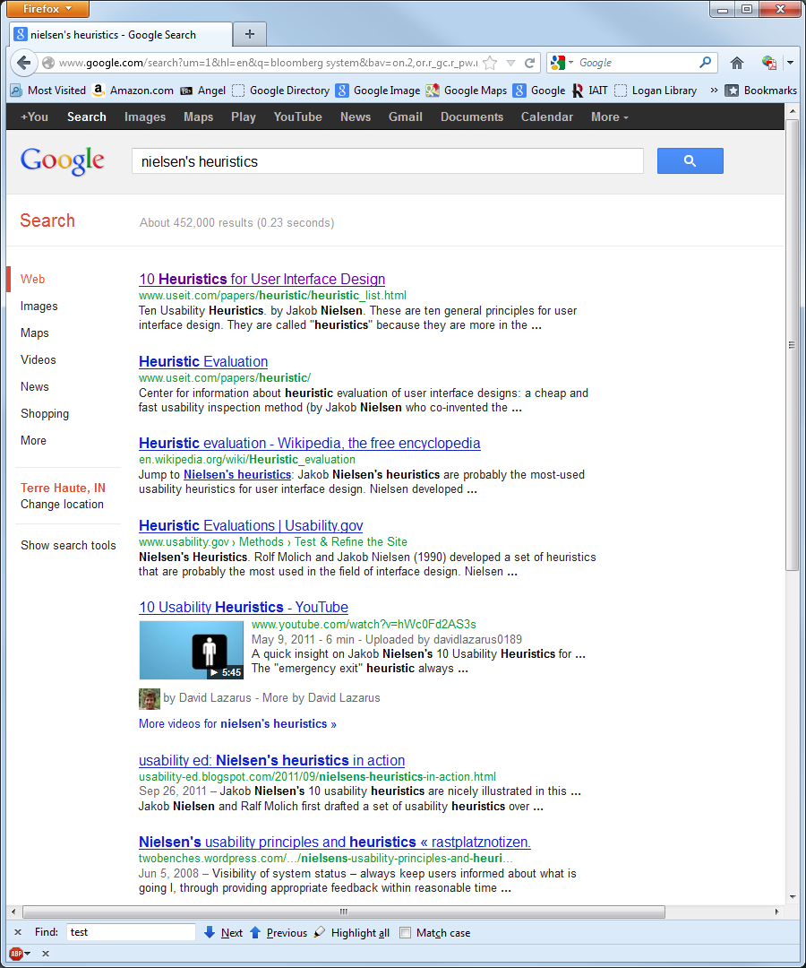
9
Here’s the page of Google search results, when searching for “Nielsen’s heuristics.” Use Nielsen’s heuristics to evaluate the interface design.
Notes:
This problem probably assumes you brought along Nielsen’s heuristics on your page of notes!
Using those heuristics, numbered 1 - 10, here are some attributes of a good answer:
Status - There’s not much to worry about here. You click on things, and you go on to the linked web page! There’s a search window at the bottom, which is a different mode of operation with its own status indicators.
Match with the real world – Hard to say what the real world is, other than the few things that depict different kinds of options, such as going to an alternative kind of search or jumping to YouTube.
User control and freedom – The user is limited to the choices given, but they also can type in something new to search for.
Consistency and standards – Google is almost THE standard for searching. Everyone knows the blue underlined text is hot links, for example.
Error prevention – It’s not really shown here, but Google asks “did you mean?” if you make a likely spelling error.
Recognition vs recall – This all looks like recognition! However, the recall has to be done in thinking of what to type to get the right page of choices to show up.
Flexibility and efficiency of use – This search results format lets you find many different kinds of things, and most people can learn how to use it.
Aesthetic and minimalist design – Google once was known for being minimalist. Lately, they’ve added more features, like the list of alternative types of search down the left side.
Recovery from errors – Usually easy – if you go to the wrong website, you hit the Back button.
Help and documentation – The text under each link is really “help”!

Slide 14
10
Suppose you want to convince your vice president that she should institute “change control boards” for your development organization. What are the top 3 arguments you would include in your elevator speech about CCB’s?
Notes:
This is from Ch 27 – 29 in Leffingwell’s book. See slide 13 of the lecture on that.
A good answer most likely would cover these three points:
A CCB gives a central place to decide what features and fixes go into each release of the product. Less chance of different groups delivering a non-coherent set of changes that have reduced value because they don’t reinforce each other.
A CCB also has a relationship with marketing and/or customers, so knows what features and fixes have the highest value to them.
The CCB can help keep out changes that destabilize the system – typically changes that some group wants but which have unknown impacts on other parts of the system.

