Slide 1
System Sequence Diagram
Chandan Rupakheti & Steve Chenoweth
Week 5-3a

Slide 2
Today
Organizing Requirements
System Sequence Diagrams
Work on demos for tomorrow

Slide 3
Interaction Diagrams
The term interaction diagram is a generalization of two more specialized UML diagrams types (covered in CSSE 374)
  Sequence Diagram
  Communication Diagram
System Sequence Diagram is a specialized form of sequence diagram, which depicts interaction between various actors and the system

Slide 4
Modeling Behavior from a System Perspective
A Use Case Scenario is an ordered series of operations (functions) that Actors invoke on the System
Notes:
System operations are functions gleaned from Ucs
More effective when UCs are simple and complete

Slide 5
SSD Notation
Actor: An Actor is modeled using
the ubiquitous stick figure symbol
Object: is represented as a
rectangle which contains the
name of the object underlined
:Actor1
:System
Notes:
Actor: An Actor is modeled using the ubiquitous stick figure symbol
Object: is represented as a rectangle which contains the name of the object underlined
System treated as black box
Objects are instances of classes and since the “system” is instantiated, it is shown as an object
Later on, we will look at Sequence Diagramming in more detail.

Slide 6
SSD Notation (continued)
Lifeline: is depicted as a vertical dotted line extending from an object that identifies the existence of the object over time
Message: modeled as horizontal arrows between activations, indicate the communications between objects
messageName(argument)

Slide 7
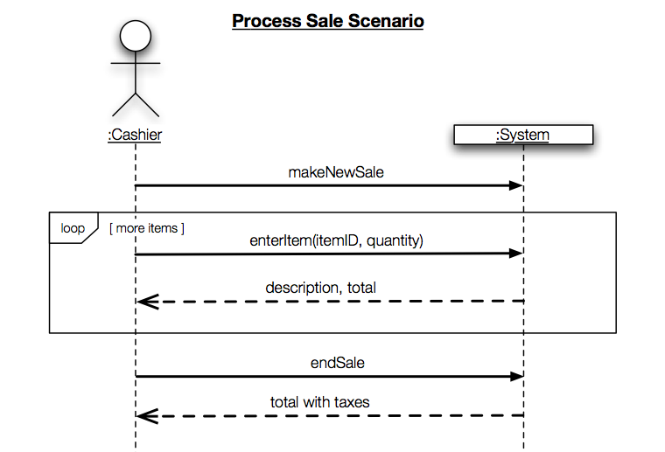
SSD Notation: An Example
External Actor
System as a Black Box
“:” implies instance
Interaction Frame
Message w/
Parameters
Guard
Return Values
Q1

Slide 8
Relating UC and SSD
Note not all arrows are
functions… some just
events or information!
Notes:
Draw a line representing the system as a black box
Identify each actor that directly operates on the system and draw a life line for each such actor
From the use case, identify the (external) system events that each actor generates and draw a horizontal arrow with accompanying text from source to destination on the diagram.
For clarity, you can include the use case text to the left of the diagram
***Callout: Note not all arrows are functions… some just events or information

Slide 9
Why Draw an SSD?
Software systems react to three things:
  External input events (a.k.a., system events) from actors
  Timer events
  Faults or exceptions
SSD captures system behavior: a description of what a system does, NOT how it does it
Helps transitioning towards design models from use-case model by clarifying details in use-cases
Q2
Notes:
External input events are also known as: System events
When to create SSDs? Just draw them for the scenarios in the next iteration
Useful for:
Understanding external interface
Understanding collaboration with existing systems
Documenting system architecture
SSDs show system behavior, a description of what a system does without explaining how it does it.

Slide 10
How-to “Tips” on Creating SSDs
Show one scenario of a use case
Show events as intentions, not physical implementation
  e.g., enterItem (not scanItem)
  e.g., presentCredentials, (not enterPassword)
Start system event names with verbs
Can model collaborations between systems
Notes:
Generally just main success scenario, if alternative is important, then add another SSD
- For example, main POS system and tax calculating service
- Details of return values, arguments

Slide 11
Practice Exercise – DVD Rental
UC1: Customer rents videos
  Preconditions: Customer has a membership, has selected videos they want, and made system aware of their choices.
  Actor: Customer (self-service/remote), or store associate (in store)
Main flow:
  Actor indicates to rent first item (e.g., clicking "rent" on a networked device, or scanning it physically in a store)
  System verifies immediate availability, and waits to make next option
  Actor indicates they are done selecting
  System shows total, prompts for payment
  Actor selects method of payment, entering additional data if needed (e.g., credit card number)
  System verifies the payment has gone through, schedules the goods for rental (e.g., sets up a window to click on to view the video remotely, or tells the store clerk where to find the DVD)
Q3

Slide 12
Next … Project Work!
Work on demos for your client meeting tomorrow!
Git Environment
  You can use Eclipse for GUI-based interface
  http://www.eclipse.org/egit/

