Slide 1
ECE554 Instrumentation
Transducer Demonstrations

Slide 2
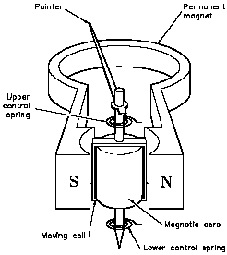
1. D’Arsonval DC Ammeter Movement
Discussed and displayed earlier in class

Slide 3
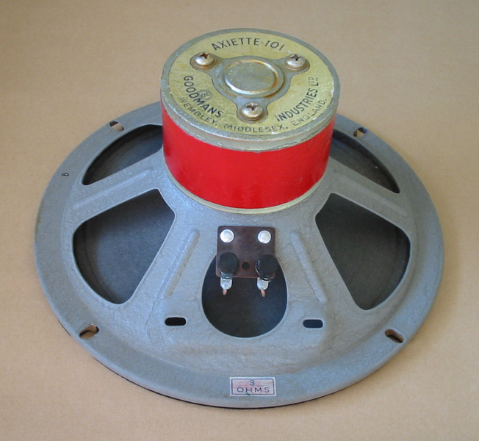
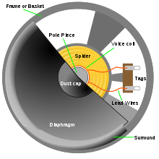
2. Dynamic Loudspeaker/Microphone

Slide 4
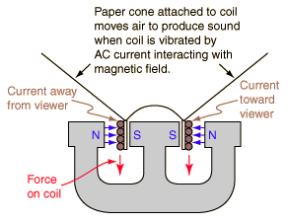
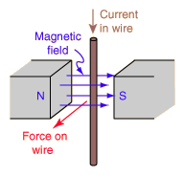
Loudspeaker Structure
Loudspeaker operation based on
F = qu x B = IL x B
Where F is force exerted on wire of directed length L immersed in a magnetic field B, and q is the charge of a particle moving with velocity u. “x” is the vector cross product operation, where
A x B =|A| |B|sin(θ)
where θ is the angle between vectors A and B, and the direction of the cross product is in the direction implied by the right hand threaded screw rule.
F = IL x B exerted by permanent magnet on speaker’s “voice coil” forces voice coil to move the entire paper cone downward, displacing nearby air. Voice coil stops moving when the magnetic force is balanced by the restoring force exerted by the paper cone suspension ring “spring”. Doubling current I doubles voice coil displacement, reversing current reverses the coil displacement. Exciting voice coil with an sinusoidal voltage source creates a sinusoidal air pressure wave (SOUND!!!)

Slide 5
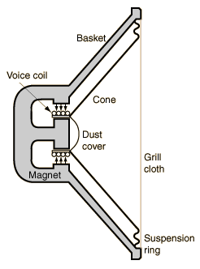
Loudspeaker Basics
An enormous amount of engineering work has gone into the design of today's dynamic loudspeaker.
A light voice coil is mounted inside a VERY NARROW air gap, so that it can move freely inside the rather intense magnetic B field of a strong permanent magnet.
The speaker cone is attached to the voice coil and its is attached with a “springy” flexible mounting to the outer ring of the speaker support.
Because there is a definite "home" or equilibrium position for the speaker cone and there is elasticity of the mounting structure, there is inevitably a free cone resonant frequency like that of a mass on a spring.
This undesired resonant frequency can be controlled to some degree by adjusting the mass and stiffness of the cone and voice coil, and it can be damped and broadened by the nature of the construction, but this resonant frequency is always there, and it emphasizes audio frequencies in the vicinity of resonance.
Part of the role of a good speaker enclosure is to minimize the impact of this resonant frequency.

Slide 6
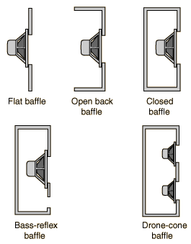
Role of the Loudspeaker Enclosure
The production of a good high-fidelity loudspeaker requires that the speakers be enclosed because of a number of basic properties of loudspeakers.
Just putting a single dynamic loudspeaker in a closed box will improve its sound quality dramatically. (It keeps negative pressure wave developed on back side of cone from cancelling the positive pressure wave developed on the front side of the cone!)
Modern loudspeaker enclosures typically involve multiple loudspeakers with a crossover network to provide a more nearly uniform frequency response across the audio frequency range.
Other techniques such as those used in bass reflex enclosures may be used to extend the useful bass range of the loudspeakers.

Slide 7
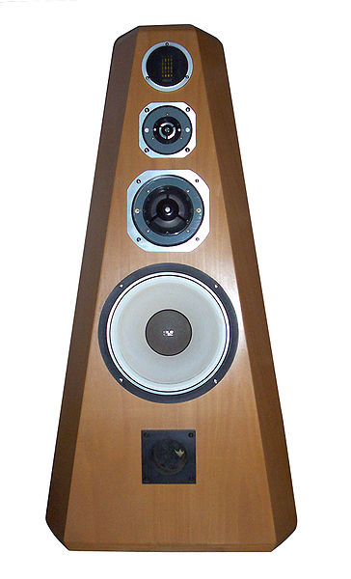
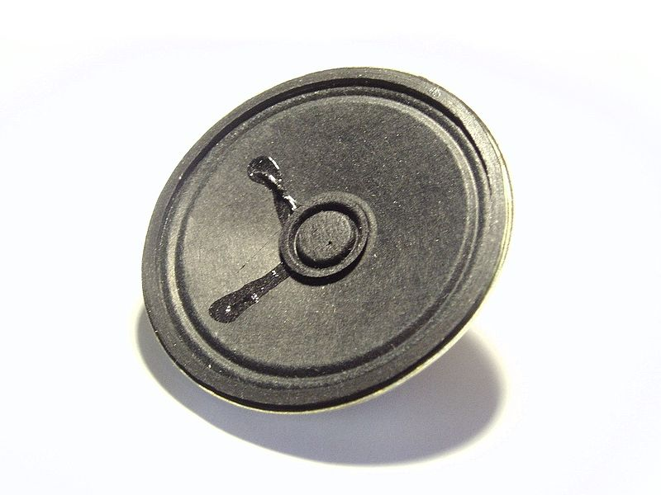
Expensive multiple loudspeaker enclosure featuring high frequency “tweeter”, mid-frequency, and bass frequency speakers with bass reflex port.
Inexpensive 3.5” Loudspeaker used in inexpensive radios

Slide 8
Demo 2a. Loudspeaker Resonant Frequency Measurement
Connect loudspeaker to a battery and observe cone displacement from equilibrium. Reverse battery and verify that cone displaces in opposite direction from its equilibrium position.
Connect loudspeaker to audio sine wave generator and vary frequency to determine frequency range of audible hearing.
Find resonant frequency of loudspeaker.
Touch speaker with finger and see if resonant peak shifts and/or broadens.

Slide 9
Demo 2b. Audio Doppler Shift
  Doppler Speed Measurement – Consider a loudspeaker connected to a sine-wave oscillator of frequency “Fsource”. Then if the velocity of the loudspeaker relative to the listener, Vsource = 0 is zero, (or Vsource/Vsound = 0) the listener hears frequency Fsource, since Fsource wavefronts will pass over the listener every second.
  But if the loudspeaker is moving away from the listener at a speed Vsource equal to 100% the speed of sound (Vsource/Vsound = 1), then the listener hears a frequency = 0, since no wavefronts will pass over the listener.
  If the loudspeaker moves away from the listener at a speed Vsource = 50% the speed of sound, (Vsource/Vsound = ½), then only Fsource/2 wavefronts will pass over the listener per second.

Slide 10
  From the above discussion, it should be clear that the frequency heard by the listener, Flistener, is given by
  Flistener = Fsource – Fsource(Vsource/Vsound).
  The source frequency Fsource is said to by “Doppler frequency shifted” by
  –Fsource(Vsource/Vsound)

Slide 11
  If the loudspeaker is moving toward the listener, rather than away from the listener, then Vsource is negative, making the Doppler frequency shift positive, and now the listener hears a higher frequency.
  Example: Given that in air the velocity of sound is Vsound = 13080 in/sec, and assuming that Fsource = 1 kHz, then if Vsource = 10 f/s away from the listener, then
  Flistener = 1kHz - 1kHz(10*12)/13080
  = 1 kHz – 9.1Hz = 990.9 Hz
  or if the loudspeaker moves toward the listener at 10 ft/sec (now the velocity is negative), the listener hears the frequency
  Flistener = 1kHz - 1kHz(-10*12)/13080
  = 1 kHz + 9.1Hz = 1009.1 Hz

Slide 12
Doppler Speed Measurement Demonstration
Spin speaker emitting 1 kHz tone around head. Students will hear Doppler shift going up and down as speaker comes toward them and then away from them. Of course the person twirling the speaker will not hear any Doppler shift.
Try to match the highest Doppler shifted frequency heard by the students by varying the frequency of the function generator once the speaker is stationary. Then calculate approximate speed of speaker as it was coming toward students using:
Frequency Heard = 1kHz + 1kHz*(Velocity_fps*12)/13080

Slide 13
Demo 2c. Loudspeaker used as a “Dynamic Microphone”
Lorentz magnetic force equation
F = q u x B
predicts that there is a force (called the motional electromotive force) on the (negatively charged) conduction electrons in the (upward moving) loudspeaker coil wire that tends to cause a current to flow that is proportional to the up/down coil velocity.
DEMO:
Connect loudspeaker to oscilloscope.
Measure the peak value of the open-circuit output voltage from a loudspeaker acting as a dynamic microphone in response to typical speech volume 1 ft from the person who is speaking.

Slide 14
Demo 2d. Magnetic Pickup – Faraday’s Law of Induction
B field
Surface Area “S”
+ v(t) -
Note the minus sign in the equation above has been absorbed into the sign convention in the figure above, so v(t) = +dΦ/dt, that is, if the B field is increasing in strength, v(t)will be positive, but if it is decreasing in strength, v(t) will be negative. Also note that the faster the field changes, the stronger v(t) will be picked up. Only a moving magnet can be detected in the vicinity of a pickup coil! Verify this with magnet and a pickup coil connected to oscilloscope! Applications: Bicycle tachometer, credit card reader (must swipe card “fast”, as they say at gas stations!)

Slide 15
Demo #3. Strain Gage “Scale”
  Two bonded strain gages glued to top and two gages glued to bottom of cantilevered beam. Measure unstrained (nominal) resistance value, Ro, of both top and bottom stain gage.
  By how much does top gage resistance change when the beam is (moderately) bent downward (without causing any permanent deformation of the beam)? Verify this is an R + DR element.
  By how much does bottom gage resistance change when the beam is (moderately) bent downward (without causing any permanent deformation of the beam)?
  Demo of strain gage force transducer (scale) used in a two-active arm bridge circuit. Use a potentiometer for the right arms of the bridge. Adjust it in order to “balance the bridge” so the bridge output voltage is zero at when there is zero weight placed on the beam.
  Use above circuit as a “scale” to measure weight of objects which are placed at end of beam. Does the scale appear to be linear? Use 3 identical weights, put on 1, then 2 and finally 3 weights. Observe change in bridge output voltage is approximately linear.

Slide 16
Demo Scale

Slide 17
Demo #4. Linear Variable Differential Transformer (LVDT) Displacement Transducer
  Structure of homemade LVDT.
  What is the purpose of the powdered iron slug?
  Normally an LVDT slug does not touch coil form, so it can move freely, but this slug is “threaded” so it can be adjusted with a plastic “tuning” wand.
  Calculation of self-inductance of LVDT primary.
  L = (N²) μ(Area/length), where N=11 turns, length=0.5 cm, Diameter = 0.7 cm, μ = 500*4*pi*10⁻⁷ H/m. Then L = 117 microHenrys.
  Excitation frequency = 1 MHz, so impedance of primary XL = 2*pi*f*L = 735 ohms, does NOT greatly load down the generator (Rout = 50 Ohms).

Slide 18
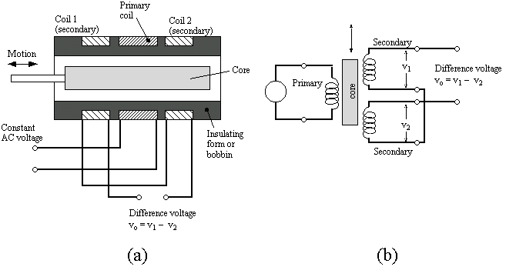
1 MHz, 1Vpp

Slide 19
1. Connect 1MHz sine generator to primary coil of LVDT, and oscilloscope at output terminals. Connect external trigger of scope across primary winding, so the phase of the output can be observed (either 0 degrees for positive displacements or 180 degrees for negative displacements).
2. Adjust core position using plastic tuning wand until output is zeroed.
3. Taking one full turn of the wand at time, observe the amplitude of the 1 MHz output voltage. Do this for several turns. Note the amplitude increases in uniform steps, indicating that the LVDT is a linear transducer.
4. Now go back to the zero position and this time turn in the opposite direction. Note the 180 degree phase shift (upside down sine wave).
5. Taking one turn at a time, observe the amplitude of the 1 MHz output voltage. Do this for several turns. Note the output increases in uniform steps.

Slide 20


Demo #5. Variable Capacitor Transducer
Air variable capacitor transducer - transduces angular displacement into a change in capacitance.
No contacts to wear or become “noisy” as with potentiometer, but its sensing circuit is more complex.
At maximum capacitance:
Plate area = 2.5 cm^2, Plate spacing = 0.15mm, Number of capacitors in parallel = 4
Calculate the value of C.
Now measure the actual value of C. Cmeasured = ___________
C = 59 pF

Slide 21
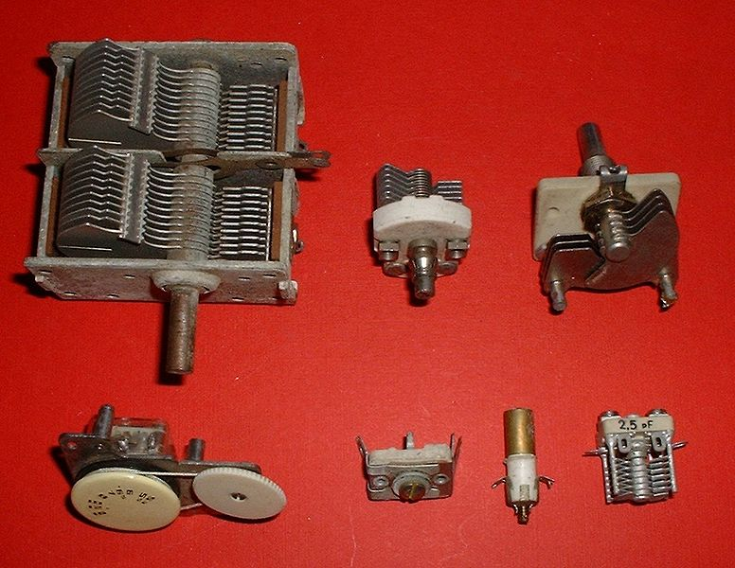

Slide 22
Demo #6. Piezoelectric Transducer
Piezoelectric Sound Transducer (Piezobuzzer)
  Structure and transduction of transient mechanical displacements.
  Display pulse response of Piezo buzzer on oscilloscope. X(t) = Au(t) – Au(t – To)
  Estimate peak voltage
  Estimate time constant
  Connect to 10 V sine wave generator, and vary frequency. Can you determine self-resonant frequency of piezo buzzer?

Slide 23
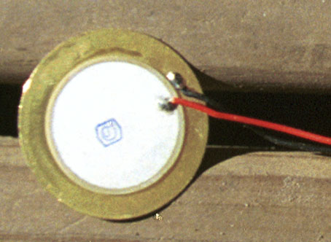
Typical Piezobuzzer Element

Slide 24
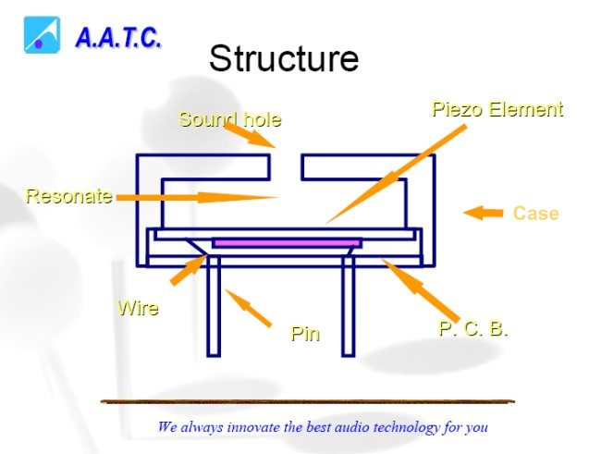
Right pin connects to metalized electrode on bottom surface of (blue) piezo ceramic element. Left pin connects to metal diaphragm that pushes the air and is bonded to the top surface of the piezo element. As piezo element expands/contracts with positive/negative voltage applied across the pins, the metal diaphragm is curled up and down as shown on the next slides.

Slide 25
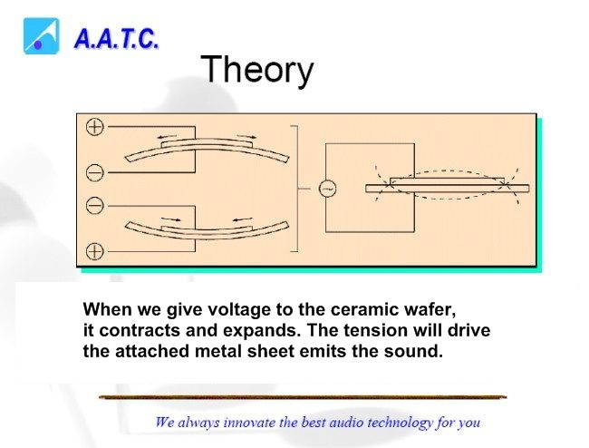

Slide 26
Demo #7 40 kHz Ultrasonic Transducer
Ultrasonic transducer operation at resonance using separate transmitter / receiver units.
Same unit can act as transmitter or receiver!
Connect 10 V peak sine wave generator to one transducer, and connect scope across other transducer. First Demonstrate transmissive case, aiming one at the other and slowly varying frequency about 40 kHz – note the sharp resonance. Why the double-humped response?
Reflective case. Investigate reflective mode where beam from one must be reflected off an object to be received by the other.
Application: Continuous-wave ultrasonic intrusion alarm; Pulsed wave (echo ranging) radar (electronic tape measure).

Slide 27
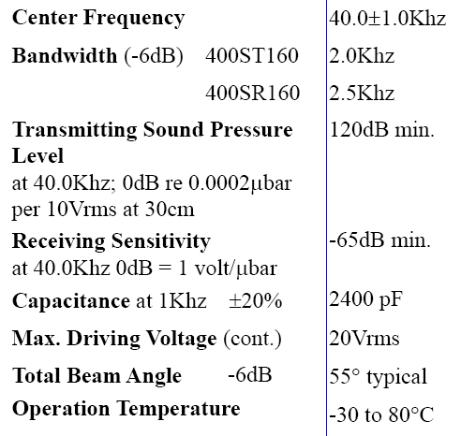
PROWAVE 400ST160 40 kHz Air Piezoelectric Transducer

Slide 29
Demo #8 Continuous Wave Intrusion Alarm / Velocity Measurement
In a 40 kHz ultrasonic motion detection system, the composite signal received at the receiving transducer consists of the sum of two component 40 kHz signals. The second component is the reflected wave received from nearby stationary objects – this wave arrives with constant amplitude and phase. The first component is the reflected wave from an object moving directly toward the location of the transmitting and receiving transducers. This first wave arrives with nearly constant amplitude, but it varies in phase, since it has been reflected from a moving object moving with velocity Vobject. Because the phase of the first component varies with respect to the second, the composite 40 kHz waveform’s amplitude will vary as the phase relationship between the two components goes “in and out of phase” with each other.

Slide 30
Stationary
Object
(Room Wall, etc.)
40 kHz
Oscillator
40 kHz Transmitter
Moving Object
Vobject
Direct Path
To
Scope
Total signal received by 40 kHz receiver is sum of two sine waves. One is a steady 40 kHz sine wave with a constant phase (due to the sine wave resulting from direct wave and reflections from stationary objects). The other is a 40 kHz sine wave with a slowly varying phase (due to the wave reflected from the moving object.)
40 kHz Receiver

Slide 31
The received wave from the moving object has amplitude A and its phase shifts continuously with time, and the combined received waves from the stationary objects has amplitude B with fixed phase shift.
As time progresses, the two components of the received wave will constructively and destructively interfere, and so the amplitude of the overall received 40 kHz wave will pass through successive maxima (amplitude A + B) and minima (amplitude A – B).
One complete amplitude variation cycle of the received wave amplitude (maximum-to-minimum-to-maximum) corresponds to the phase of the first component shifting through 2π
=>

Slide 32
One complete cycle of variation of the interference pattern corresponds to the object moving through a distance of one-half wavelength w.r.t. the ultrasound send/receive site, since the total path length difference traveled (down and back) is 1 wavelength. For a sound wave at 40 kHz,
λ = Vsound / f = (13080 in/s) / (40,000 1/s) = 0.327 inches.
If the amplitude of the received composite wave is found to pass through N minima in one second (an N Hertz “amplitude envelope” was observed on the 40 kHz signal using an oscilloscope), then the speed of the moving object is
Vobject = N*(0.327 / 2) inches/second
Can the direction of travel (away or towards the observation site) be determined from the “minima counting” measurement described above?

Slide 33
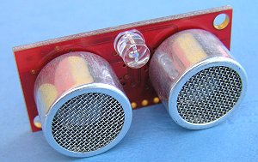
Demo #9 40 kHz Echo Ranging (Radar, Sonar)
40 kHz
Tone Burst
Function
Generator
40 kHz Transmitter
Target
Object
Direct Path
To
Scope
The 40 kHz burst (1 ms, or 40 cycles long) is
reflected from the object. The receiver picks up the direct path pulse and also the pulse reflected from the target. The delay “To” between the direct pulse and the reflected pulse is measured. Note “To” represents down AND back time. The distance to the object is therefore
L = Vair*(To / 2) where Vair = 13,080 in/s (Vwater = 58,500 in/s)
40 kHz Receiver

Slide 34
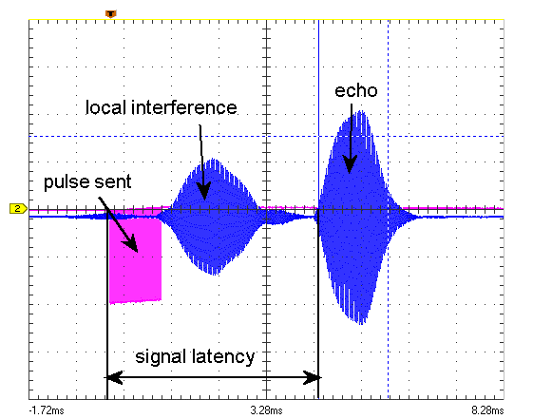
Agilent Function Generator Setup for 40 kHz Tone Burst (1 ms duration), repeated every 50 ms
Set function generator to deliver sine wave
Set frequency of sine wave to 40 kHz
Set amplitude of sine wave to 10 Vpp
Hit BURST button
  # Cycles = 40
  Burst Period = 50 ms
Press Output Button
Sample Oscilloscope Output
To

Slide 35
Quartz crystal used in feedback path between output and input terminals (collector and base terminals) of a BJT (inverting) amplifier. Crystal provides feedback (with 180 degree phase inversion) at its mechanically resonant frequency. Conditions for oscillation around a circuit loop: (1) loop gain > 1, (2) loop phase shift = n*360 degrees. There is already a 180 degree phase shift in an inverting amplifier. Crystal provides the additional 180 degrees of phase shift at its resonant frequency.
Demonstration #10 Piezoelectric Crystal Oscillator
Quartz crystal used in feedback path between output and input terminals (collector and base terminals) of a BJT (inverting) amplifier of a digital inverter biased into its active region.
Crystal provides feedback (with 180 degree phase inversion) at its mechanically resonant frequency.
Conditions for oscillation around a circuit loop:
(1) loop gain > 1
(2) loop phase shift = n*360 degrees.
There is already a 180 degree phase shift in an inverting amplifier.
Crystal provides the additional 180 degrees of phase shift at its resonant frequency.

Slide 36
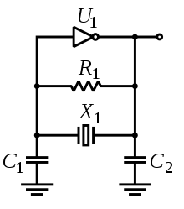
Demo #10a 5 MHz CMOS Inverter (74HC04) Crystal Oscillator
Vo(t)
Vo
Vo=Vi
Load line established by biasing resistor R1, biases inverter into its analog amplifying region
Vi
U1 = 74HC04 (Vdd = 5 V), R1 = 10 Megohm, X1 = 5 MHz Crystal
C1 = C2 = 30 pF

Slide 37
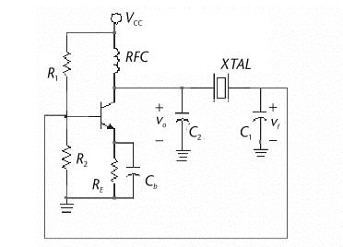
Demo #10b 5 MHz BJT Crystal Oscillator
Vo(t)
Vcc = 5 V, R1 = R2 = 560 ohm, RE = 1kohm, RFC = 10 uH, Cb = 0.1 uF
C1 = C2 = 30 pF, XTAL = 5 MHz, Antenna wire may be added at the collector of the BJT.

Slide 38
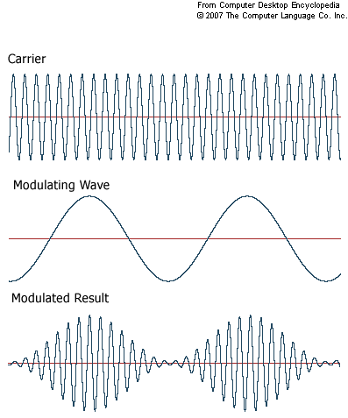
Demo #10c AM (Amplitude Modulating 5 MHz BJT Oscillator)
We can amplitude modulate the 5 MHz carrier wave produced by the crystal oscillator by varying the 5 V dc power supply up and down at an audio rate. This is done by placing an ac source in series with the dc power supply. In this demo, I will simply add “dc offset” to a 1 kHz sine wave produced by the function generator, and replace the dc 5V supply with this dc offset, 1 kHz function generator output.
5 MHz
1 kHz
AM
Amplitude of carrier wave varied up and down at 1 kHZ audio rate

Slide 39
Demo #11. Thermocouple Junction Demo
  Nichrome/Copper thermocouple made by twisting copper wire and toaster wire together.
  Measure DC voltage when both junctions at room temperature.
  Measure DC voltage when one junction at room temperature and other at match flame temperature.
  Switch junctions and repeat.
  Measure DC voltage when both junctions at match flame temperature.

Slide 40
Demo #12. Thermistor Demo
  Measure approximate resistance of the thermistor demonstrated in class at room temperature (25 deg C).
  Resistance at body temperature (35 deg C)
  When a lit match is held under it (500 deg C)
  Reminder of theory of operation of a thermistor:
    Why does its resistance fall with increasing temperature?
    Why does the thermistor's resistance vs. temperature curve saturate (level off) at high temperatures?

Slide 41
Demo #13. PN Junction Diode Thermometry
What change in forward junction voltage would you expect if an (electrically insulated) diode junction (initially at room temperature, 25 degrees C) is brought up to body temperature? Assume a forward junction current of 1 mA
Answer: Vd(room temp) – [(2 mV/deg C) * 10 degrees rise]
Put small-signal diode in series with 10 V and 10 kohm resistor so that approximately 1 mA flows through the diode and measure
  Fwd Bias Junction Voltage at 25 C (room temp) = _________
  Fwd Bias Junction Voltage at 35 C (body temp) = __________
  Observed change in Fwd Bias Junction Voltage per degree C rise = _________

Slide 42
Demo #14. Blackbody Radiation (Light Bulb / Variac)
Color of bulb changes from red to orange to white to blue as the bulb filament voltage is gradually increased.
What is the approximate filament temperature when bulb has reddish tint? (Eqn 2.26: T = 2898/lambda_microns => T = 2898/(0.7 microns) = 4,140 K.
When bulb has bluish tint? T = 2898/0.4 microns = 7,245 K.

Slide 43

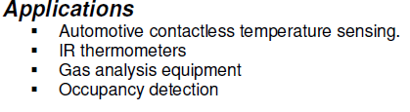
Demo #15. Thermopile Far Infrared Detector
Thermopile detectors are capable of operating over a wide band of wavelengths, but this thermopile detector uses a LPF window material that is opaque to shorter, visible wavelengths, but transparent to longer infrared wavelengths.

Slide 44
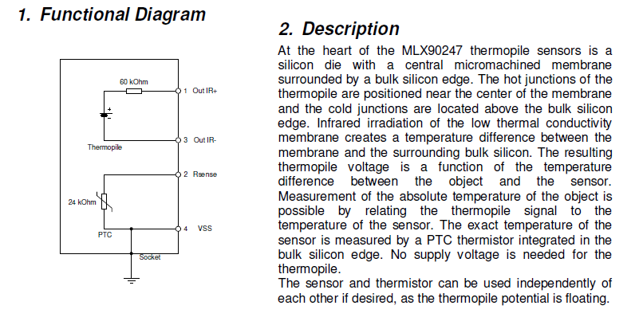

Slide 45
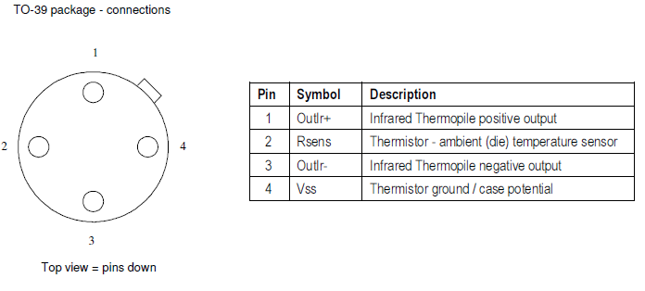
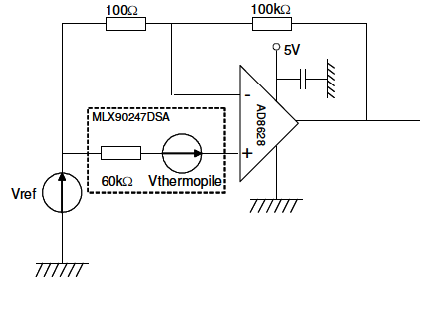
  Voltage generated when aimed at a person 1 foot away. _______
  Voltage when aimed at an inanimate object 1 foot away. _______

Slide 46
Differential IR detectors for use in IR intrusion alarm
Two IR detectors (wired in series opposing fashion) aimed at 45 degree angles to each other.
Background temperature can rise and fall (day -> sunset -> night -> dawn), but the difference between the two IR detector voltages remains zero, since both detectors generate the same voltage.
However, when an IR source (perhaps a human intruder?) moves into the field of view of one detector, but not the other, then the difference voltage becomes non-zero, and the alarm is tripped!

Slide 47
Demo #16. Cadmium Sulfide Photocell Demo
  CdS photocell structure – doped bulk Cds semiconductor laid out in zig-zag on ceramic substrate, exposed to light through transparent window.
  Resistance in no light = _______
  Resistance in weak (room) light = _______
  Resistance in strong light (flashlight beam) = _____
  Reminder of theory of operation of this cell.
  Assuming that the band gap of CdS is 1 eV, why can’t it be used to measure radiation in the far infrared region, say for wavelengths on the order of 10 microns? (Recall lambda = 1240 nm / band_gap_eV.)
  Why is its response nonlinear?
  How does the structure and theory of operation of the CdS cell relate to that of the thermistor?

Slide 48
Demo #17. Light Emitting Diode (LED)
  Light Source – LED forward biased to its maximum allowable forward current (10 mA)
  LED used as photodiode (reverse biased, with current sensed as voltage drop across series resistor)
  Measured reverse-bias current
  no light = __________ µA
  weak light = ________ µA
  strong light = _______ µA
  LED used as photovoltaic (solar) cell.
  Voltage at anode w.r.t. cathode of LED
  no light = _________ V
  weak light = ________ V
  strong light = _______ V. (What appears to be the voltage limit?)
  Color discrimination using Red and Green LEDs
  Demonstration of more efficient practical photovoltaic cell.

Slide 49
Demo #18. Phototransistor / Fiber Optic Cable
  Sensitivity vs. response time for R = 1 kohm and R = 20 kohm (Use strobe light to measure.)
  Fiber Optic Cable with screw-in LED and Sensor modules.
  Fiber Optic Displacement/Force Sensor
  LED/Phototransistor Bar Code Scanner

Slide 50
Demo #19. Adjustable Neutral Density Filter
Two Polaroid films one rotated with respect to the other to get varying attenuation.
Adjustable light attenuator often needed in photography of bright scenes.
Sunglasses to reduce glare (reflections) off of objects. The reflected light is often polarized.
LCD displays --- liquid crystal segment can be switched between two different states of polarization by a small electric field. To prove this, rotate Polaroid sunglass lens rotated in front of digital watch display.

Slide 51
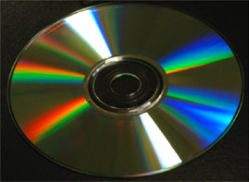
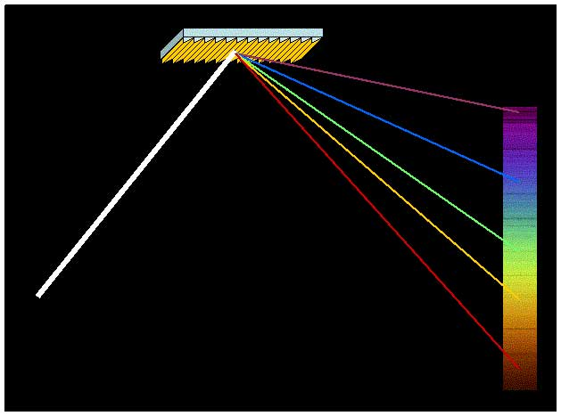
Demo #20. Diffraction Grating
Used in tunable optical BPF to separate light of different wavelengths.
Demonstrate by shining flashlight on CD or DVD in dark room. The reflected light will be resolved into a spectrum that can be displayed on wall of room.
Observe first and second order spectra.

Slide 52
Demo #21. Convex Lens Focal Length
Experimental measurement of focal length of double convex lens using laser pointer.
The principle used is that parallel rays perpendicular to the lens will all pass through the lens and be directed through the focal point on the other side of the lens.
If lens is exactly 1 focal length away from the screen, parallel rays WILL CONVERGE to a point, regardless of the point that the parallel ray hits the lens.
If lens is too close to the screen (less than a focal length from the screen), parallel rays will NOT converge to a point, but rather will move in the direction the parallel ray moves.
If lens is too far from the screen (greater than a focal length from the screen), parallel rays will NOT converge to a point, but rather will move OPPOSITE TO the direction in which the parallel ray moves.

Slide 53
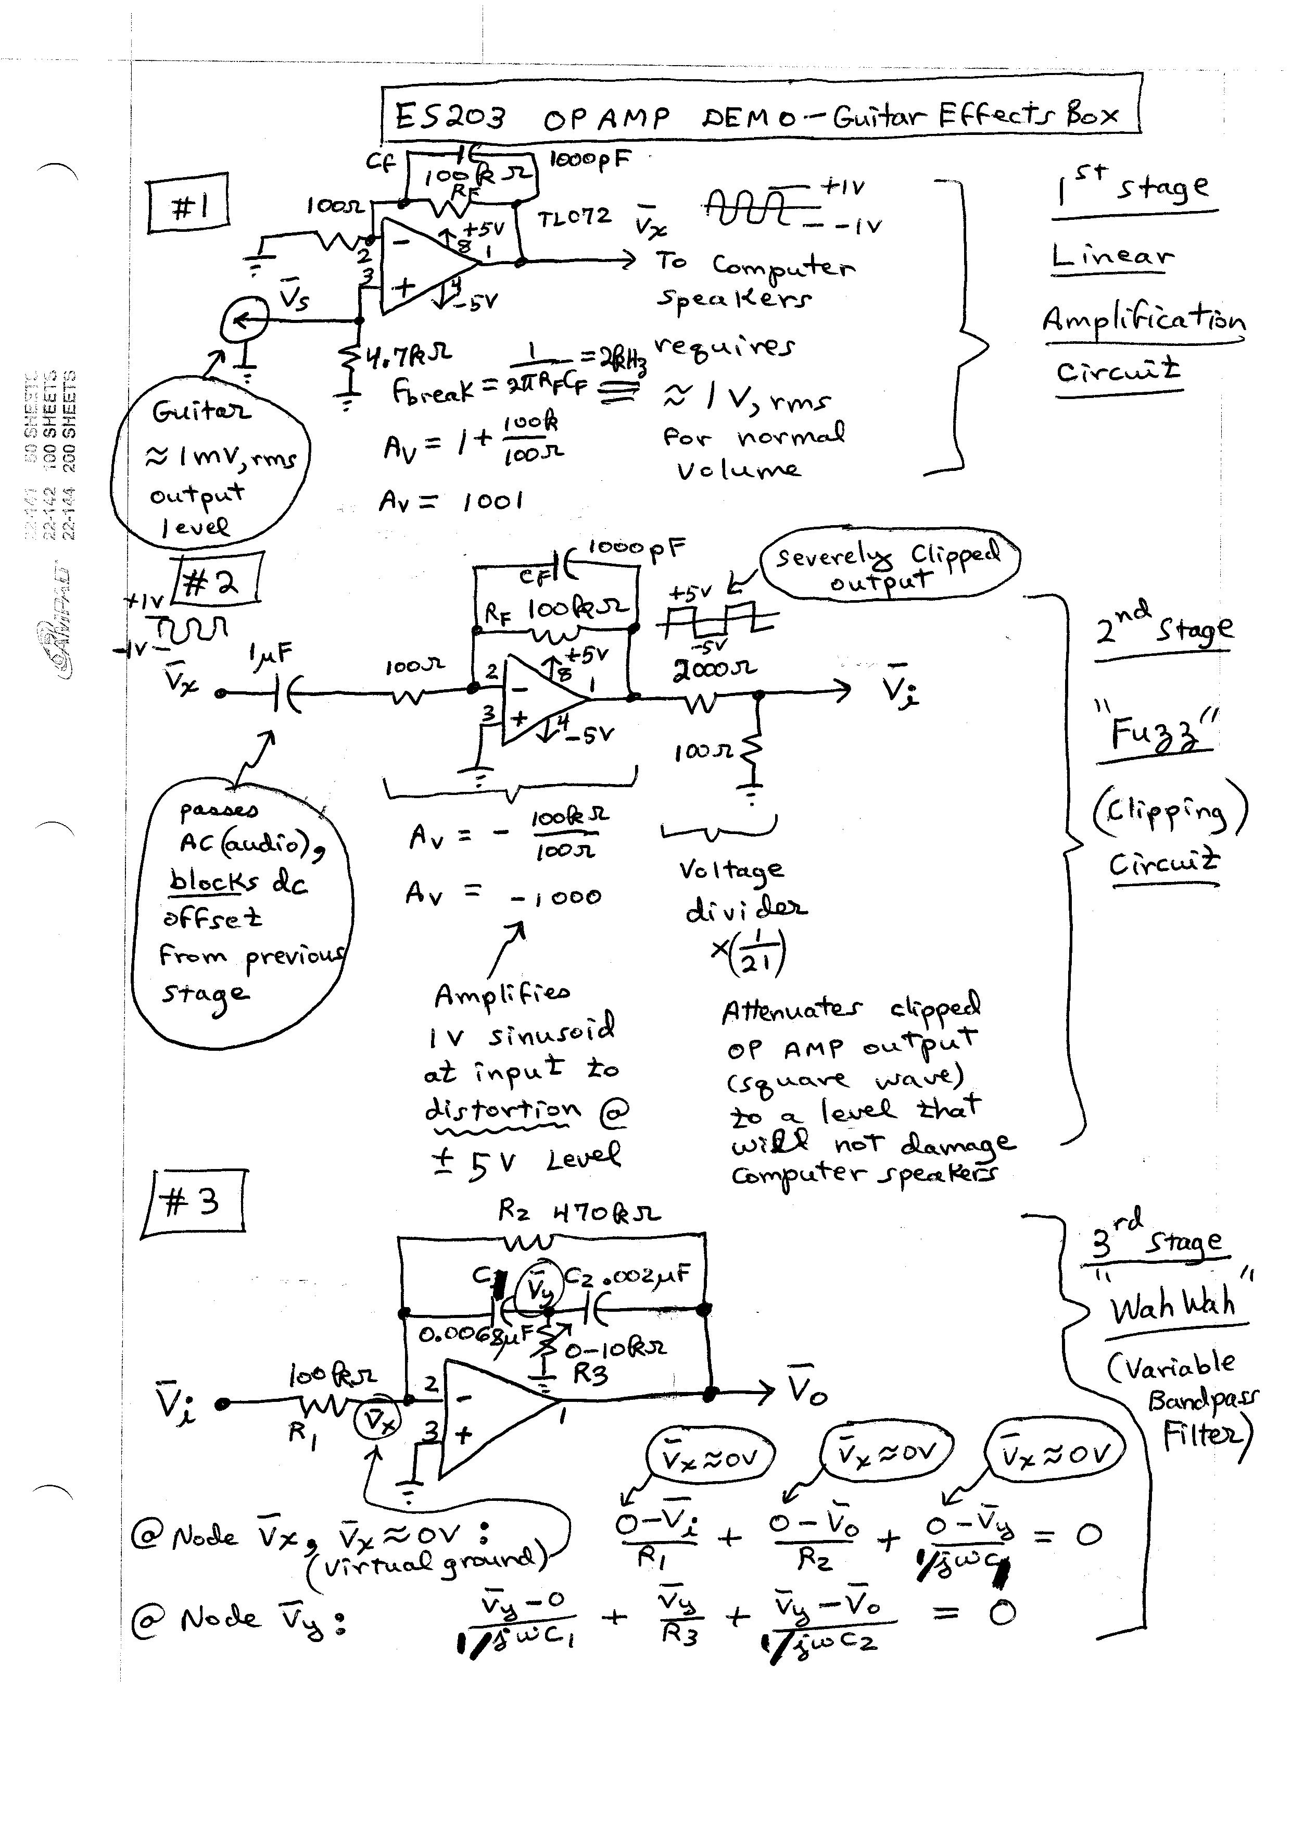
Demo #22. Guitar Effects (Fuzz and Wah)
Part A. OP AMP Noise and Linear, Non-distorting Amplifier
Remove Cf to hear random “white” noise (mostly above 2 kHz break frequency) generated in this first high gain amplifier stage.
Experiment with connecting “Common” to “Ground” terminals on dc power supply.

Slide 54
Fuzz Tone – Waveform distorted by clipping. Sharp Edges add higher harmonics to output waveform, also notes are SUSTAINED.

Slide 55
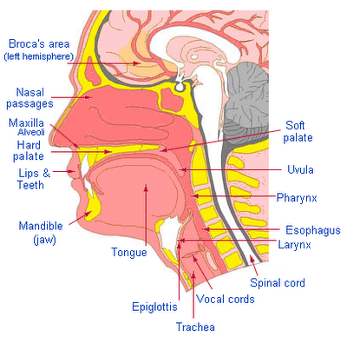
Human Vocal Tract Physiology

Slide 56
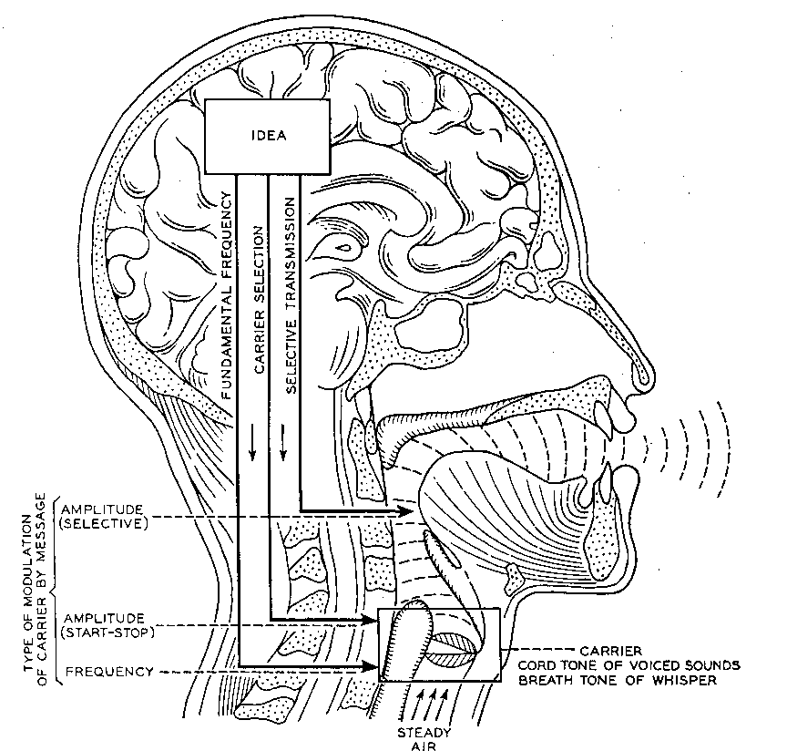

Slide 57
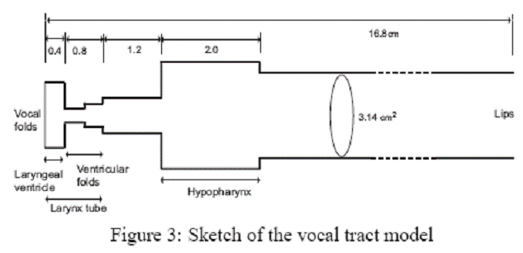
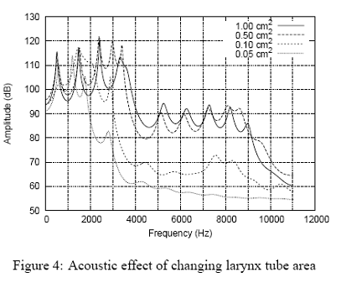
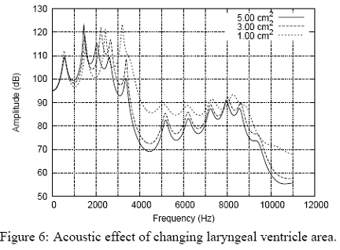
Five-Tube Vocal Tract Model (Vocal Tract Modeled as Organ Pipes!)

Slide 58
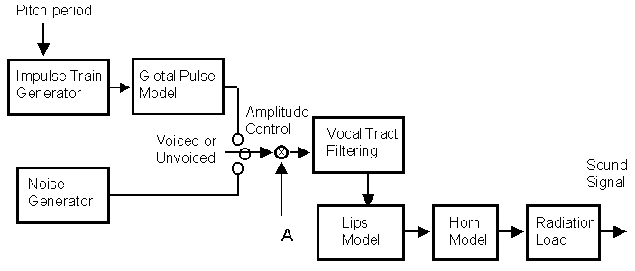
Model of Vocal Tract
Pitch period (impulse train) is generated by putting vocal cords together and making them vibrate. Vocal cords generate a relatively low frequency impulse train (This frequency varies as we change the intonation of our speech, but let us say it is 100 Hz) with nearly constant harmonic amplitudes (100 Hz, 200 Hz, 300 Hz, 400 Hz…. N*100 Hz) This harmonically rich waveform is filtered by the vocal tract (using 2 or 3 resonances or formant BPF filters) which emphasize several different groupings of harmonics in the impulse train generated by the vocal cords in order to form all characteristic vowel (voiced) sounds: Long A , Long E, Long I, Long O, Long U, short A, short E, short I, short O, short U, O-umlaut, U-umlaut, etc. Whispered speech is created by separating the vocal cords so they do not vibrate, but rather cause air turbulences that form random “white noise” which is then filtered by the vocal tract.

Slide 59
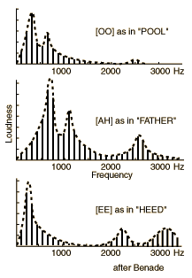
Example of the use of Vocal Tract Resonances to create characteristic vowel sounds. Each vowel sound is produced from the SAME 100 Hz vocal cord impulse train. The different vowel sounds are created by passing the impulse train through the vocal tract where the speaker varies different dimensions of the vocal tract (see the 5-pipe model) as different vowel sounds are spoken. The placing of these passbands (formant frequencies) determines the specific vowel sound that is heard by the listener!

Slide 60
Variable Bandpass Filter – “Crybaby Wah Wah”
Resistor R3 varies passband over audio spectrum.
CdS cell used for R3 to make WahWah Light Variable

Slide 61
