Slide 1
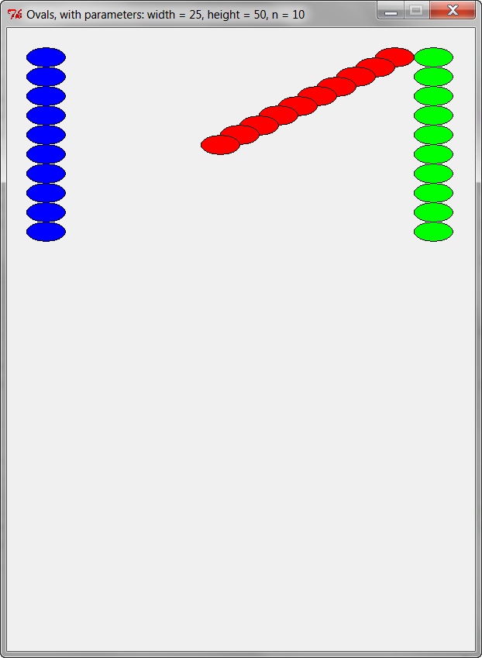
The Accumulator Pattern
Summing: Add up (“accumulate”), e.g.
      1² plus 2² plus 3² plus … plus 1000²
  Variation: Form a product (instead of sum), e.g.
      1 × 2 × 3 × ... × 1000
Counting: Count, e.g.
      how many integers from 1 to 1000
      have a positive cosine
Graphical accumulation, e.g. pictures like these:

Slide 2
The Accumulator Pattern for summing, acted out
Using a loop to compute 1² plus 2² plus 3² plus … plus 1000²
total starts at zero
Loop 1000 times:
total becomes what it was + next item to add to total
We add in 1² (which is 1), so ...
We add in 2² (which is 4), so ...
We add in 3² (which is 9), so ...
We add in 4² (which is 16), so ...
We add in 5² (which is 25), so ...
We add in 6² (which is 36), so ...
and so forth
total starts at 0
total becomes 1
total becomes 5
total becomes 14
total becomes 30
total becomes 55
total becomes 91
...

Slide 3
The Accumulator Pattern for summing, in Python
This summing version
of the Accumulator Pattern,
applied to this problem of summing squares,
is written in Python like this:
total starts at zero
Loop 1000 times:
total becomes what it was + next item to add to total
Use a range expression in a for loop
Use a variable, which we chose to call total, and initialize that variable to 0 before the loop
total = 0
for k in range(1000):
total = total + (k + 1) ** 2
Inside the loop, put:
total = total + ...
Lousy mathematics, but great computer science! Read = as “becomes”.
After the loop ends, the variable total has as its value the accumulated sum!

Slide 4
The Accumulator Pattern – for Counting
Motivating Example:
Suppose that you want to count how many of the integers from 1 to 1000
have a positive cosine
cosine(1) is about 0.54, so we have one integer that has a positive cosine so far
cosine(2) is about -0.42, so Nope, its cosine is not positive
cosine(3) is about -0.99, so Nope, its cosine is not positive
cosine(4) is about -0.65, so Nope, its cosine is not positive
cosine(5) is about 0.28, so we have another integer that has a positive cosine, that makes 2
cosine(6) is about 0.96, so we have another integer that has a positive cosine, that makes 3
cosine(7) is about 0.75, so we have another integer that has a positive cosine, that makes 4
cosine(8) is about -0.15, so Nope, its cosine is not positive
cosine(9) is about -0.91, so Nope, its cosine is not positive
cosine(10) is about -0.84, so Nope, its cosine is not positive
cosine(11) is about 0.004, so we have another integer that has a positive cosine, that makes 5
etc

Slide 5
The Accumulator Pattern – for Counting
Motivating Example:
Suppose that you want to count how many of the integers from 1 to 1000
have a positive cosine
How would you modify this summing code to accomplish the above?
Answer:
total = 0
for k in range(1000):
total = total + (k + 1) ** 2
total = 0
for k in range(1000):
total = total + (k + 1) ** 2
total = total + (k + 1) ** 2
count = 0
if math.cos(k + 1) > 0:
count = count + 1

Slide 6
The Accumulator Pattern for summing/counting, in Python
The summing version of the Accumulator Pattern, applied to this problem of summing squares, is written in Python like this:
The counting version of the Accumulator Pattern,
applied to this problem of counting how many
integers have positive cosines, is written in Python
like this:
Use a range expression in a for loop
total = 0
for k in range(1000):
total = total + (k + 1) ** 2
Use a variable, which we chose to call total/count, and initialize that variable to 0 before the loop
Inside the loop, put:
total = total + ...
count = count + 1
Lousy mathematics, but great computer science! Read = as “becomes”.
count = 0
for k in range(1000):
if math.cos(k + 1) > 0:
count = count + 1
After the loop ends, the variable total has as its value the accumulated value!

Slide 7
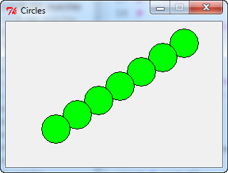
The Accumulator Pattern – for Graphical Accumulation
window = zg.GraphWin('Circles', 300, 200)
x = 250
y = 30
for k in range(7):
center = zg.Point(x, y)
circle = zg.Circle(center, 20)
circle.setFill('green')
circle.draw(window)
x = x – 30
y = y + 20

Slide 8
total = 0
for k in range(1000):
total = total + (k + 1) ** 2
The Accumulator Pattern
count = 0
for k in range(1000):
if math.cos(k + 1) > 0:
count = count + 1
window = zg.GraphWin('Circles', 300, 200)
x = 250
y = 30
for k in range(7):
center = zg.Point(x, y)
circle = zg.Circle(center, 20)
circle.setFill('green')
circle.draw(window)
x = x – 30
y = y + 20
Use a range expression in a for loop
Use a variable and initialize that variable to something before the loop
Inside the loop, put: variable = variable + ...
After the loop ends, the variable has as its value the accumulated value!

