Slide 1
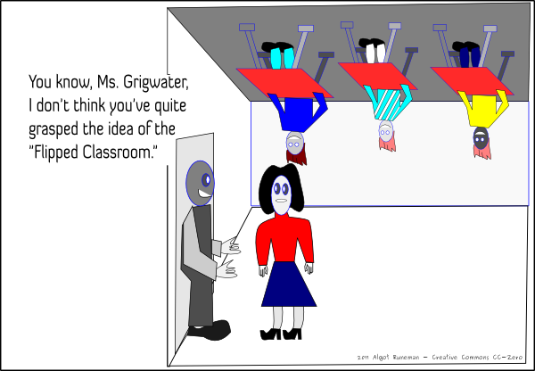
The Flipped Classroom

Slide 2
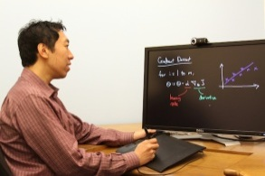

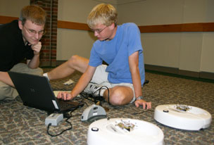

The Flipped Classroom
Shallow learning – in class
Deep learning – in class
Thanks to
Algot Runeman, flipped_classroom.png from http://runeman.org
/bettynbob
Deep learning – outside class
Shallow learning – outside class
Traditional approach:
In class:
  Instructor lectures.
  Students take notes.
After class:
  Students do homework exercises
Flipped approach:
Before class:
  Students interact with videos/reading, taking notes and doing short quizzes.
In class:
  Students do exercises and projects, asking questions and getting one-on-one help
See flipped-learning.com (and many other places) to learn more about flipped learning. Also, Sugata Mitra’s 2013 TED talk is a good start toward understanding the revolution under way in education: www.ted.com/talks/sugata_mitra_build_a_school_in_the_cloud.html.

Slide 3
Flipped Learning in CSSE 120 - FAQ
Where do I find the videos to watch before class?
  Answer: the course website www.rose-hulman.edu/class/csse/csse120
What’s this quiz thing associated with the videos?
  Answer: each session has one or more quizzes associated with them.
  Get the quiz from the same place you get the video.
  You can do the quiz:
    As you want the video
    After you watch your video
    Before you watch the video
    Any of those approaches can work – experiment to see
    what works best for you.
  Print out the quiz and write your answers on the paper copy,
  or write your answers into the electronic document – your choice.
  Bring the completed quiz to class.
There are questions in the quiz whose answers I don’t know.
What should I do?
  Answer: Bring your questions to class.
  Each class session will begin with:
  “What questions do you have about the videos or the quiz?”
  Don’t expect to get a deep understanding of the material from the videos and quizzes – the deep learning occurs via the exercises you do in class!
I didn’t have time to watch the videos for today’s session. Should I still come to class?
  Answer: Yes.
  In class, when the others begin the exercises, you will need to watch the videos and do the quiz.
    Bring headphones or borrow a pair from us.
  The quiz is your admission ticket for the exercises.
Do I have to memorize everything in the video?
  Answer: No.
  Make notes from the videos as you see fit.
  Use the quizzes to help you see the “key ideas”.
  Bring your questions to class.
Can I fast-forward through the video, or rewind it to watch it again, or watch it at double-speed ...?
  Answer: Sure. Do whatever is best for your own learning.
  Use the quiz as your guide for whether or not you are “getting the idea” from a video.
Will I finish the in-class exercises in class?
  Answer: Some students will, but others will need additional time outside of class to finish. In that case, student assistants are available to help you OUT of class as well.

