Slide 1
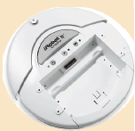
Your First Robot program
For the Create robot
In Python
Based on the create module (library), originally developed by Zach Dodds at Harvey Mudd
import new_create
import time
def main():
port = 4
robot = new_create.Create(port)
robot.go(10, 90)
time.sleep(4.0)
robot.stop()
sensor = new_create.Sensors.distance
v = robot.getSensor(sensor)
print(v)
robot.shutdown()
Connects to a Create robot using the given COM port
Start the robot moving:
  At 10 cm/sec forwards
  While spinning 90 degrees/sec counterclockwise
Sleep 4 seconds (while the above motion continues), then stop.
Specify a sensor (here, the distance sensor that says how far the robot has moved linearly since you last asked), then get and print the current value of the sensor.
Always have your program execute this at its end!

