Slide 1
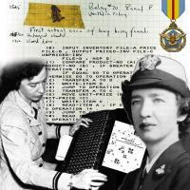
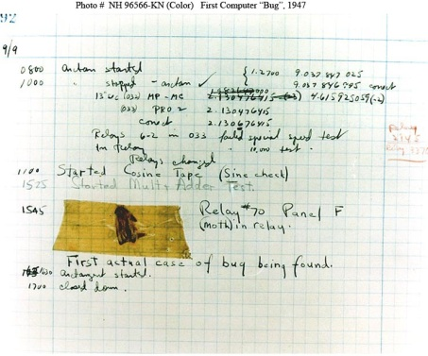
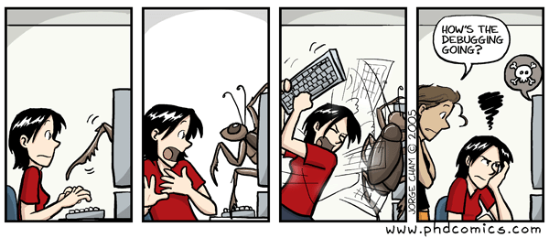
Debugging
What coders (programmers) do to find
the errors (“bugs”) in their own programs
  “Bugs” – Admiral Grace Hopper, developer of the world’s first compiler, once found that her program failed because a dead moth was inside the computer. The phrase stuck!
  Debugging versus Testing:
    Debugging: Done by the coder
    while producing the code.
    Testing: Done after the code is
    produced, often by someone
    other than the coder.

Slide 2
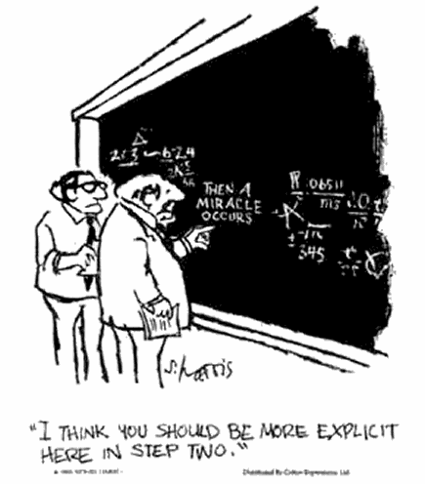
Debugging is hard!
Bugs are run-time errors – that is, they are semantic errors (the program did not do what you intended), not syntactic errors (the program has an error in its notation that makes it impossible to run)
Bugs are hard to find and fix because:
  Programs are big; finding the place where the bug
  is introduced may require examining many lines of code.
  The bug may be an error that is spread across many
  lines of code.
  The bug may be intermittent – the evidence of the bug
  may come and go depending on the inputs, the state of
  the system, and much more.
  Frequently the programmer doesn’t even notice the existence of the bug!

Slide 3
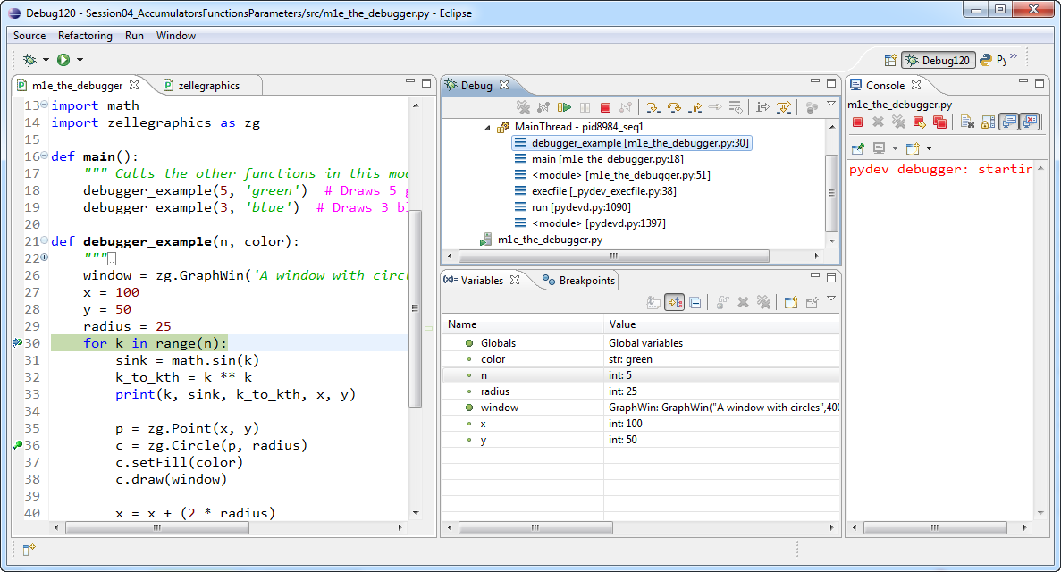
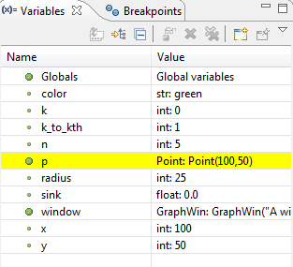
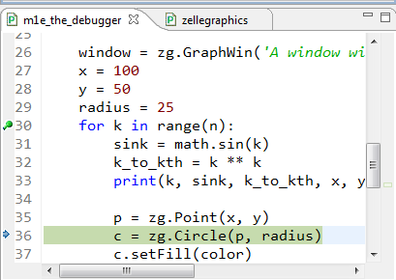
The Debugger
Debuggers: Tools that help with debugging, by allowing you to:
Run the program
to a “breakpoint” that you set
Step through the program, line by line
See the values
of the variables
as you do so

Slide 4
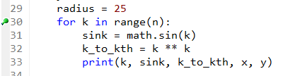

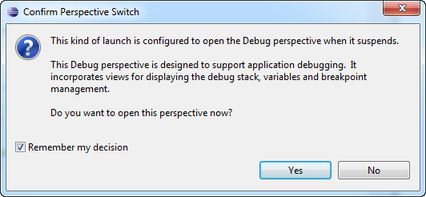
Starting the Debugger
Set breakpoints by double-clicking on the gray bar
to the left of the line numbers
  Double-clicking on a breakpoint removes it
Run in the Debugger by selecting the “Bug” symbol
to the left of the usual “Run” symbol
  The first time it asks if you want to enter the Debug perspective in this situation. Check the box (“Remember my decision”) and select Yes.
I double-clicked here to put a breakpoint at line 30. The program will stop at that line
(just before that line runs) in the Debugger.

Slide 5
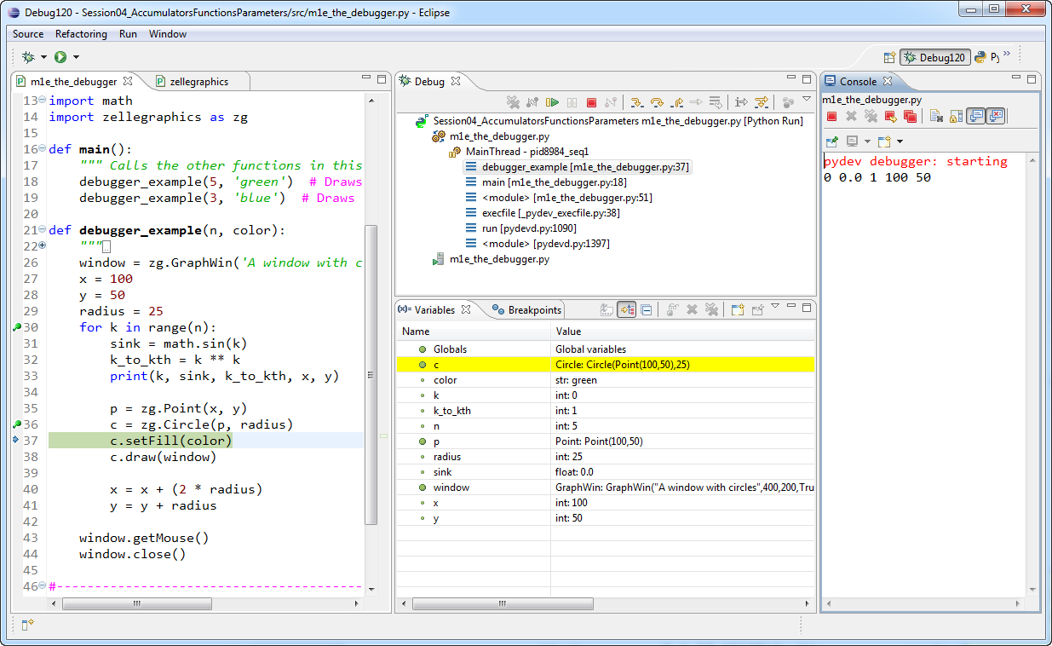
The Debug perspective
The Debug perspective shown in this and the subsequent slides has been simplified from the default Debug perspective.
The controls for running in the Debugger are here
Restart a Debug run here
This window controls which variables are shown – by default, the variables in the current function
Your program is here, with indicators showing the line that is currently being executed
This is the usual Console window for print statements
This window shows the values of the variables, highlighting changes as the program runs

Slide 6

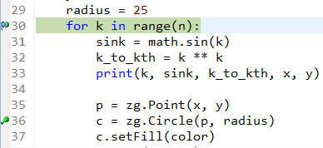



Running in the Debugger
The Debugger pauses the program
at the first breakpoint that it encounters
  It stops before it has run that line
  The blue arrow shows the place where the program
  is currently paused, and that line is highlighted as well
You can set or remove breakpoints at any point during the run
  By double-clicking on the gray bar next to the line
Run to the next breakpoint by using the green-arrow (“Resume”) button
If you want to stop the run, use the red-square (“Terminate”) button
If you want to re-run the program, use the “Bug” button again
I added another breakpoint at line 36v

Slide 7



Stepping in the Debugger
The program stops at your first breakpoint
  It stops before it has run that line
  The blue arrow shows the place where the program
  is currently paused, and that line is highlighted as well
The control bar
allows you to:
  Step Into – run the next statement of the program
    If the statement is a function call, the Debugger enters that function
  Step Over – run the next statement of the current function
    If the statement is a function call, enter that function, do its stuff, and return from the function (thus “stepping over” that function call)
  Step Return – run all the remaining statement in the current function and returning to the point at which the function was called
  Resume – i.e., run to the next breakpoint

Slide 8
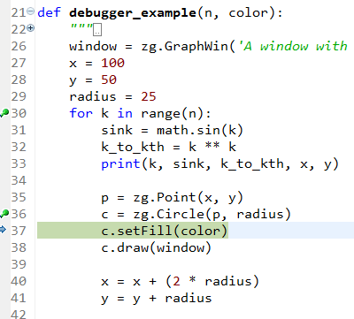
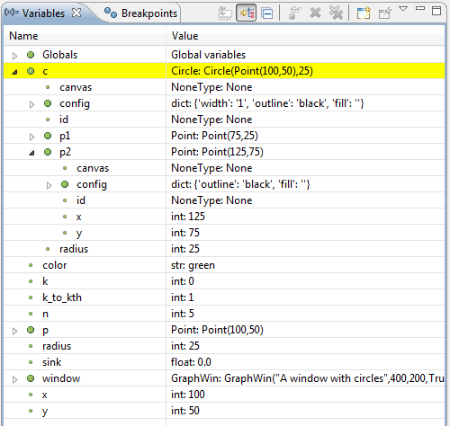
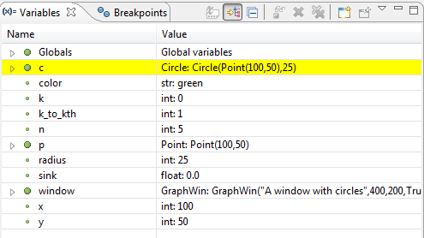
Examining variables in the Debugger
The Variables window shows variables and their values
  At the point at which the program is paused
  Variables in the current function are shown
    Selecting a different function in the call stack shows its variables
This example shows variables when the program is paused at line 37
The variable c was modified since the previous pause-point, so c is highlighted
The window identifies the type of the variable
The window typically shows the value of an object by showing some of its fields.
You can expand variables to see their fields. In the example to the right, I have expanded c (the Circle), then expanded its field p2 (a Point).
See http://pydev.org/manual_adv_debugger.html if you want to learn more about the Pydev debugger.

