Slide 1
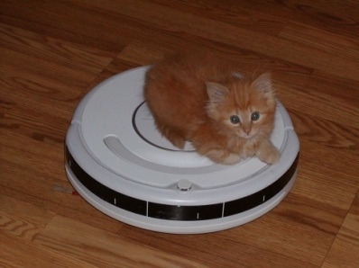
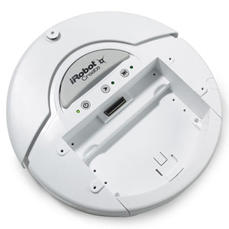
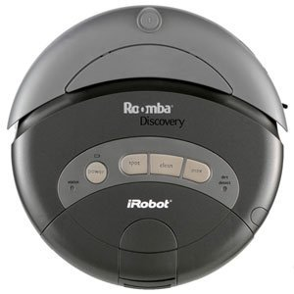
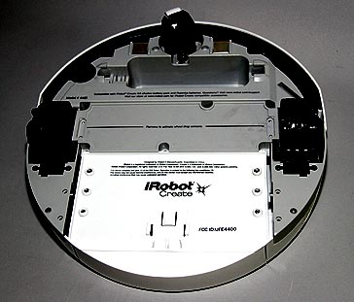
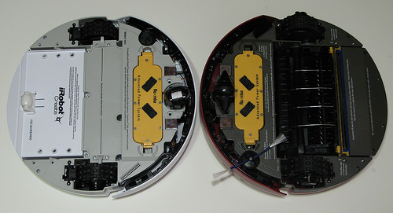
The Create robot, by iRobot
Same as the 4000 series of the Roomba vacuum cleaner, but:
  Without the vacuum
  With a port that gives easy access to the robot’s “brain”
Students: These slides present important background information, but are NOT something to memorize

Slide 2
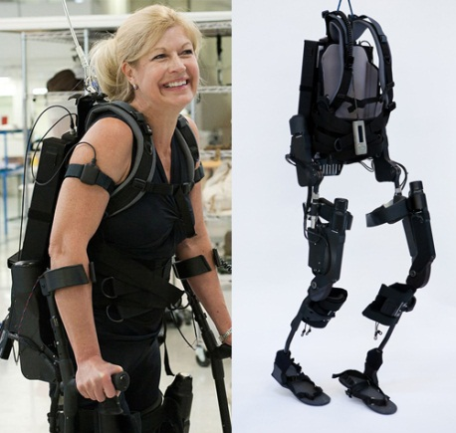
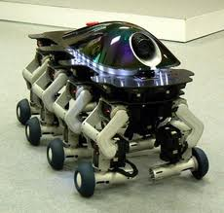
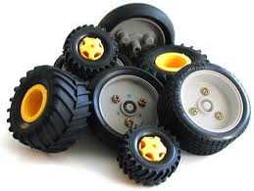
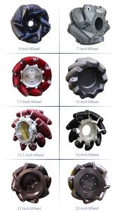

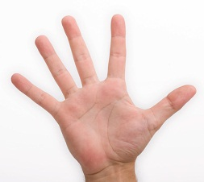
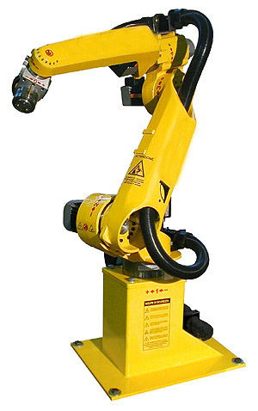
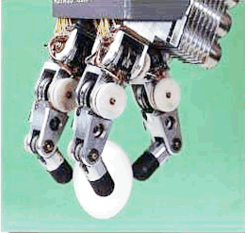
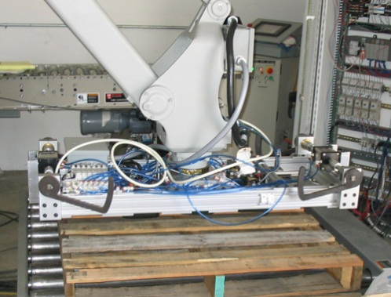
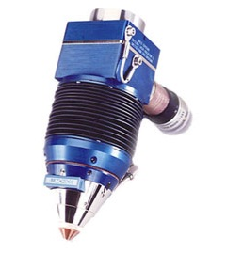

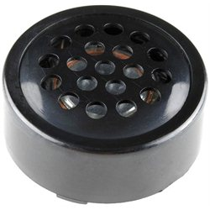
Robot hardware
Robots generally have:
Effectors – allow the robot
to take an action, e.g.:
    Move
    Grasp
    Touch
    Talk

Slide 3
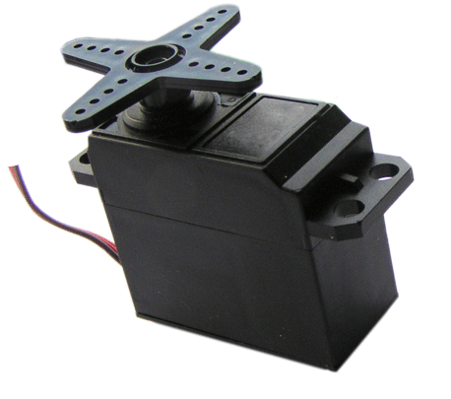
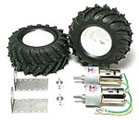
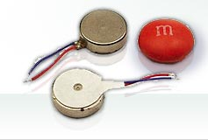
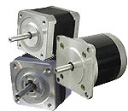
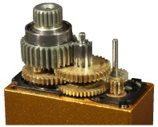
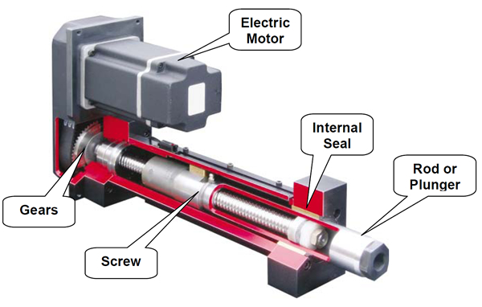
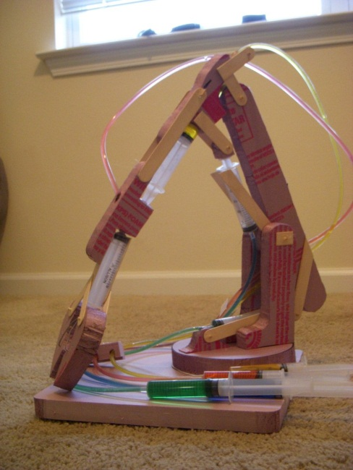
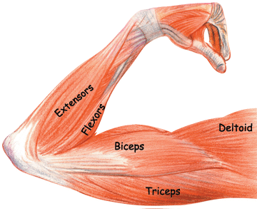
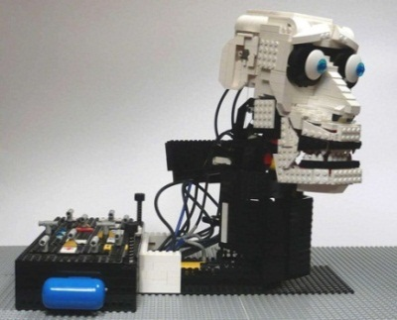
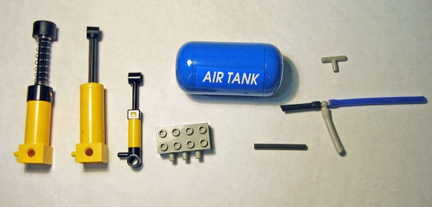
Robot hardware
Robots generally have:
Effectors – allow the robot
to take an action
Actuators – mechanisms that
drive the effectors, e.g.:
      Motors / servos
      Hydraulics
      Pneumatics

Slide 4
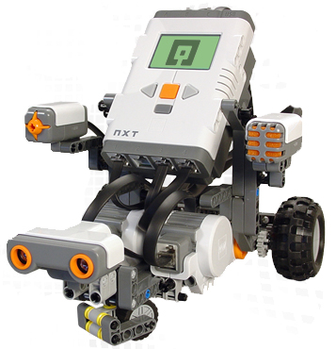
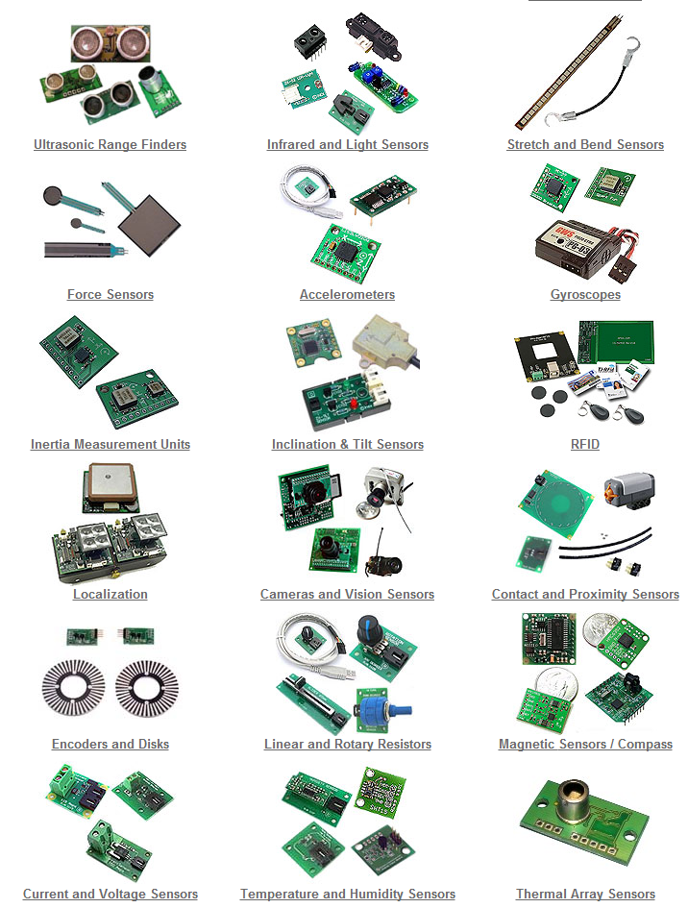
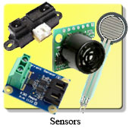
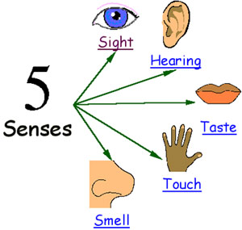
Robot hardware
Robots generally have:
Effectors – allow the robot to take an action
Actuators – mechanisms that drive the effectors
Sensors – allow the robot to know (sense) things about the world

Slide 5
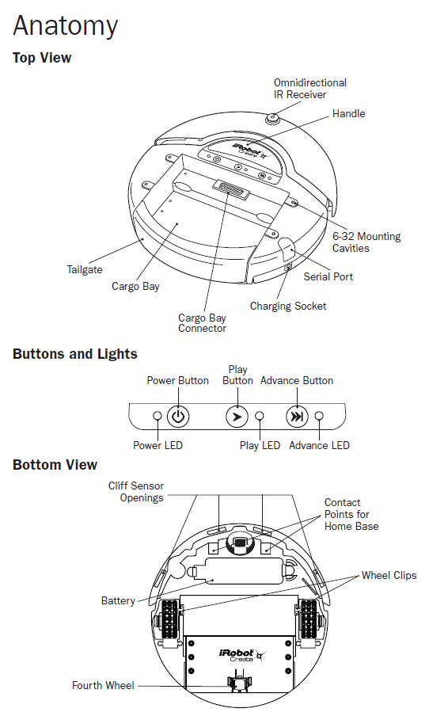
iRobot Create hardware
Effectors – 3 wheels, 1 speaker, 3 lights, output ports that send signals
Actuators:
  2 independent motors
  Battery power
Sensors:
  2 touch (bump)
  3 buttons
  3 wheel-drop sensors
  4 active IR cliff sensors
  1 passive IR receiver
  2 wheel encoders
  And more!

Slide 6
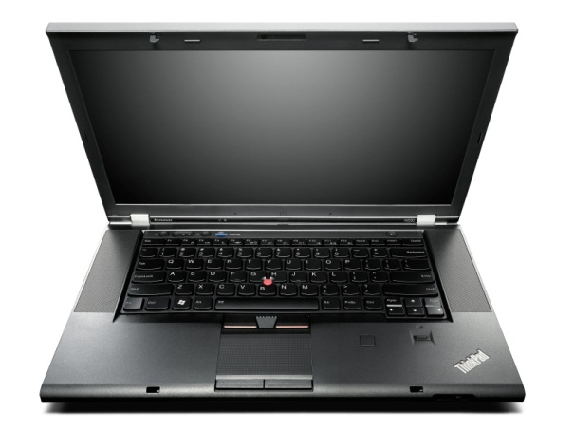
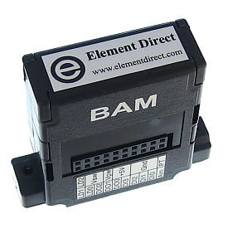
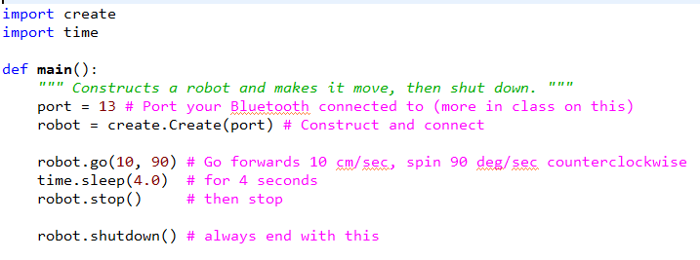
Your Python program uses the create library. It supplies functions that send commands:
to your laptop’s Bluetooth radio,
then to the BAM on the Create,
then to the Create’s controller.
Ditto for the reverse path.

Slide 7
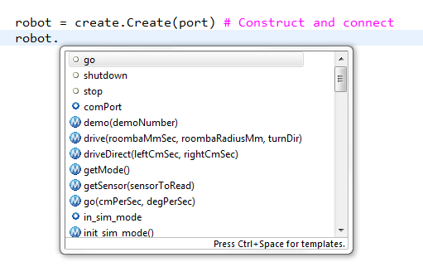
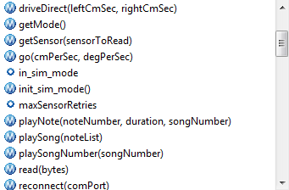
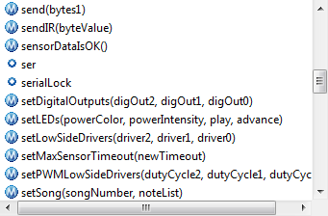
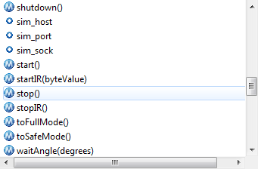
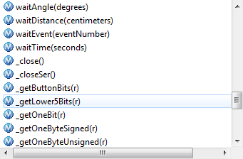
As usual, use the dot trick to learn the methods in the Create class. This slide highlights a few particularly useful methods.

