Slide 1
Day 04- Cryptography
Acknowledgements to Dr. Ola Flygt of Växjö University, Sweden for providing the original slides

Slide 2
Conventional Encryption Principles
An encryption scheme has five ingredients:
  Plaintext
  Encryption algorithm
  Secret Key
  Ciphertext
  Decryption algorithm

Slide 3
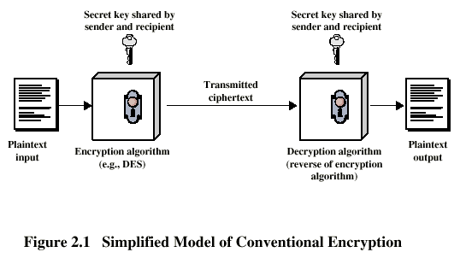
Conventional Encryption Principles

Slide 4
Requirements for Security
Strong encryption algorithm
  Even if known, should not be able to decrypt or work out key
  Even if a number of cipher texts are available together with plain texts of them
Sender and receiver must obtain secret key securely
Once key is known, all communication using this key is readable

Slide 5
Cryptography
Classified along three independent dimensions:
  The type of operations used for transforming plaintext to ciphertext
  The number of keys used
    symmetric (single key)
    asymmetric (two-keys, or public-key encryption)
  The way in which the plaintext is processed

Slide 6
Average time required for exhaustive key search
Key Size (bits) | Number of Alternative Keys | Time required at 10⁶ Decryption/µs
32 | 2³² = 4.3 x 10⁹ | 2.15 milliseconds
56 | 2⁵⁶ = 7.2 x 10¹⁶ | 10 hours
128 | 2¹²⁸ = 3.4 x 10³⁸ | 5.4 x 10¹⁸ years
168 | 2¹⁶⁸ = 3.7 x 10⁵⁰ | 5.9 x 10³⁰ years

Slide 7
Classical Encryption Techniques
Substitution Techniques : plaintext are replaced by other letters or by numbers or symbols
  Caesar Cipher
  Monoalphabetic Cipher
  Polyalphabetic Cipher
Transposition Techniques : some sort of permutation on the plaintext letters

Slide 8
Caesar Cipher
Replacing each other letter of the alphabet with the letter standing three places further down
- plain : meet me after the toga party
- cipher : PHHW PH DIWHU WKH WRJD SDUWB
Note that the alphabet is wrapped around, so that the letter following Z is A.
- plain : abcdefghijklmnopqrstuvwxyz
- cipher : DEFGHIJKLMNOPQRSTUVWXYZABC
If we assign a numerical equivalent to each letter(a=1, b=2 etc)
- C = E(p) = (p+3) mod (26)
- P = D(c) = (c–3) mod (26)

Slide 9
Crypto analysis of the Caesar Cipher
brute-force cryptanalysis
Three important characteristic of this problem:
  The encryption/decryption algorithm are known
  There are very few keys to try
  The language of the plaintext is known and easily recognized

Slide 10
Monoalphabetic Cipher
Cipher line can be any permutation of the 26 alphabetic characters
  If an enemy agent could check one of these possible keys every second, it would take roughly one billion times the lifetime of the universe to check all of them and find the correct one.This simple brute force approach clearly will not work.
  http://www.simonsingh.net/The_Black_Chamber/generalsubstitutionWithMenu.html

Slide 11

Crypto analysis of the Monoalphabetic Cipher
Attack : regularities of the language

Slide 12
Polyalphabetic Cipher
Instead of having one key (table) that is used to encrypt each block of plaintext, we use several different keys.
The Vigenère cipher is the classical example.
http://www.simonsingh.net/The_Black_Chamber/Swapping_Cipher_Alphabets.html

Slide 13
Vignere cipher
To produce an unbreakable Vignere cipher, you must:
  Choose a key that is as long as the plaintext message(Vernam cipher).
  Build the key from random characters.
  Never use the key again.
  Don't use text decorations (spaces, punctuations, capitalization).
  Protect the key
Notes:
Unfortunately, these steps take all the fun out of the Vigenere cipher. Most people use English words or phrases for the key (violating step 2) that are significantly shorter than the message being coded (violating step 1). Then they use the same key to encrypt additional messages (violating step 3) because they don't want to remember a new key for each message. Some people use quotations from their favorite book for the key or invent one and write it down (violating step 5). Lastly, it's no fun to handle text that doesn't look like text, so they don't remove the decorations (violating step 4). The moral of the story is that security is free, but it requires effort.
http://sharkysoft.com/misc/vigenere/

Slide 14
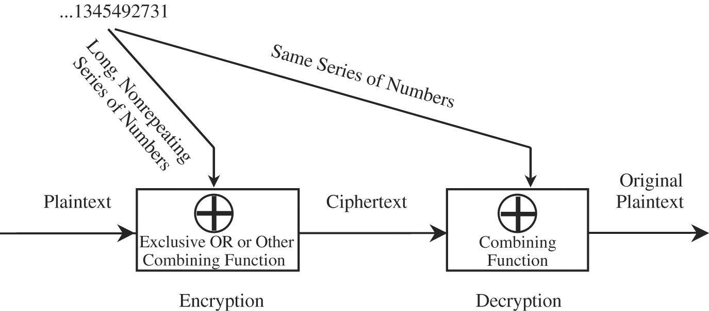
Example: Vernam cipher
Figure 2-3 Vernam Cipher

Slide 15
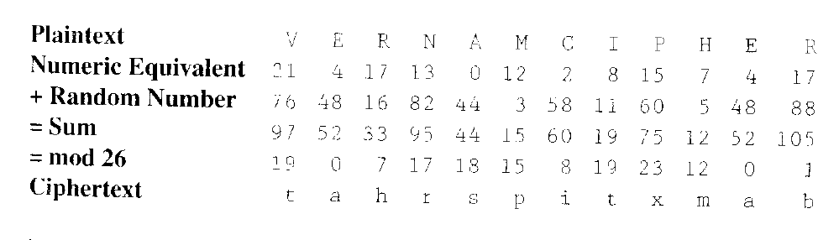
Example: Vernam cipher

Slide 16
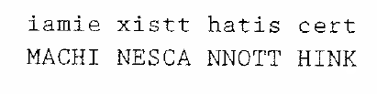
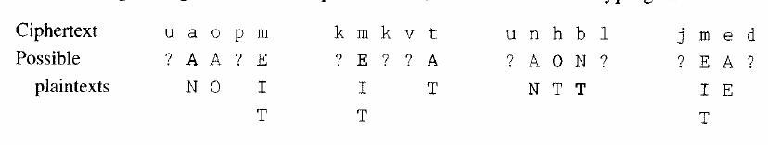

Slide 17
One time pad
Messages
  n-bit strings [b₁,…,b_{n}]
Keys
  Random n-bit strings [k₁,…,k_{n}]
Encryption/Decryption
  c = E(b, k) = b  k = [b₁  k₁, …, b_{n}  k_{n}]
     denotes exclusive or
  b = D(b, k) = c  k = b  k  k = b  [1, …, 1] = b

Slide 18
One time pad (cont.)
Properties
  Provably unbreakable if used properly
  Keys must be truly random
  Must not be used more than once
  Key same size as message

Slide 19
One-time pad
Book ciphers
  Use the text of a book, piece of music as key
  Key should be known to both parties
  Vignere table can be used for encryption

Slide 20
Transposition ciphers
An alternative to substitution ciphers
Instead of changing the coding of the characters (blocks) in the plaintext, we rearrange the text.
The effect is that the cipher text and the plaintext contains the same symbols.

Slide 21
Simple permutation
Algorithm
  Divide to plaintext into blocks
  Decide on a permutation order
  Rearrange the blocks according to this
Example:
  Plaintext: We a|re t|he b|est!
  Key: 1 4 2 3
  Cipher text: Wae |rte |hbe |e!st

Slide 22
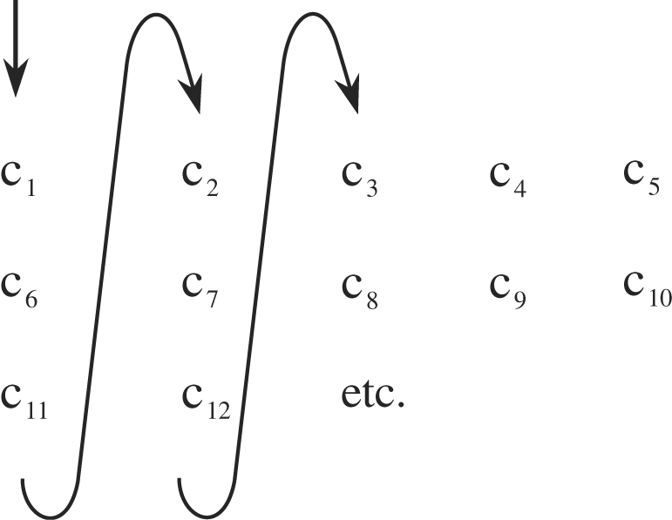
Columnar transposition cipher
Figure 2-4 Columnar Transposition

Slide 23
Columnar transposition
Write the message in a rectangle, row by row, and read the message off, column by column
  Input : t h e e x a m
  p l e j u s t
  g i v e n s u
  g g e s t s t
  h a t m u l t
  Ciphertext: tpggh hliga eevet ejesm xuntu asssl mtutt

Slide 24
Transposition ciphers
A more complex transposition cipher is to write the message in a rectangle, row by row, and read the message off, column by column but permute the order of the columns (one-time pad)
  K e y : 4 3 1 2 5 6 7
  Input : t h e e x a m
  p l e j u s t
  g i v e n s u
  g g e s t s t
  h a t m u l t
  Ciphertext EEVETEJESMHLIGATPGGHXUNTUASSSLMTUTT

Slide 25
Cryptanalysis of a columnar transposition
Is it a transposition or a substitution?
Where the column ends and which are the adjacent columns

Slide 26
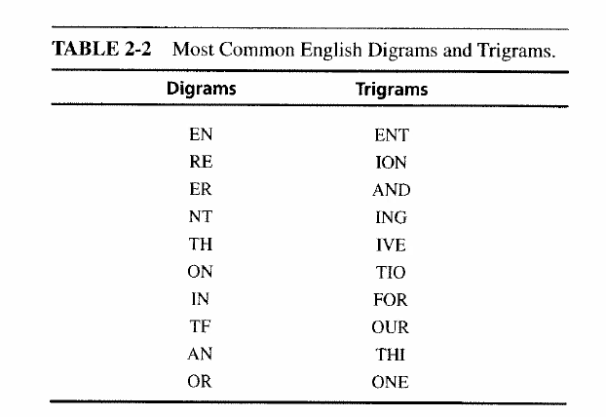
Digrams and Trigrams

Slide 27
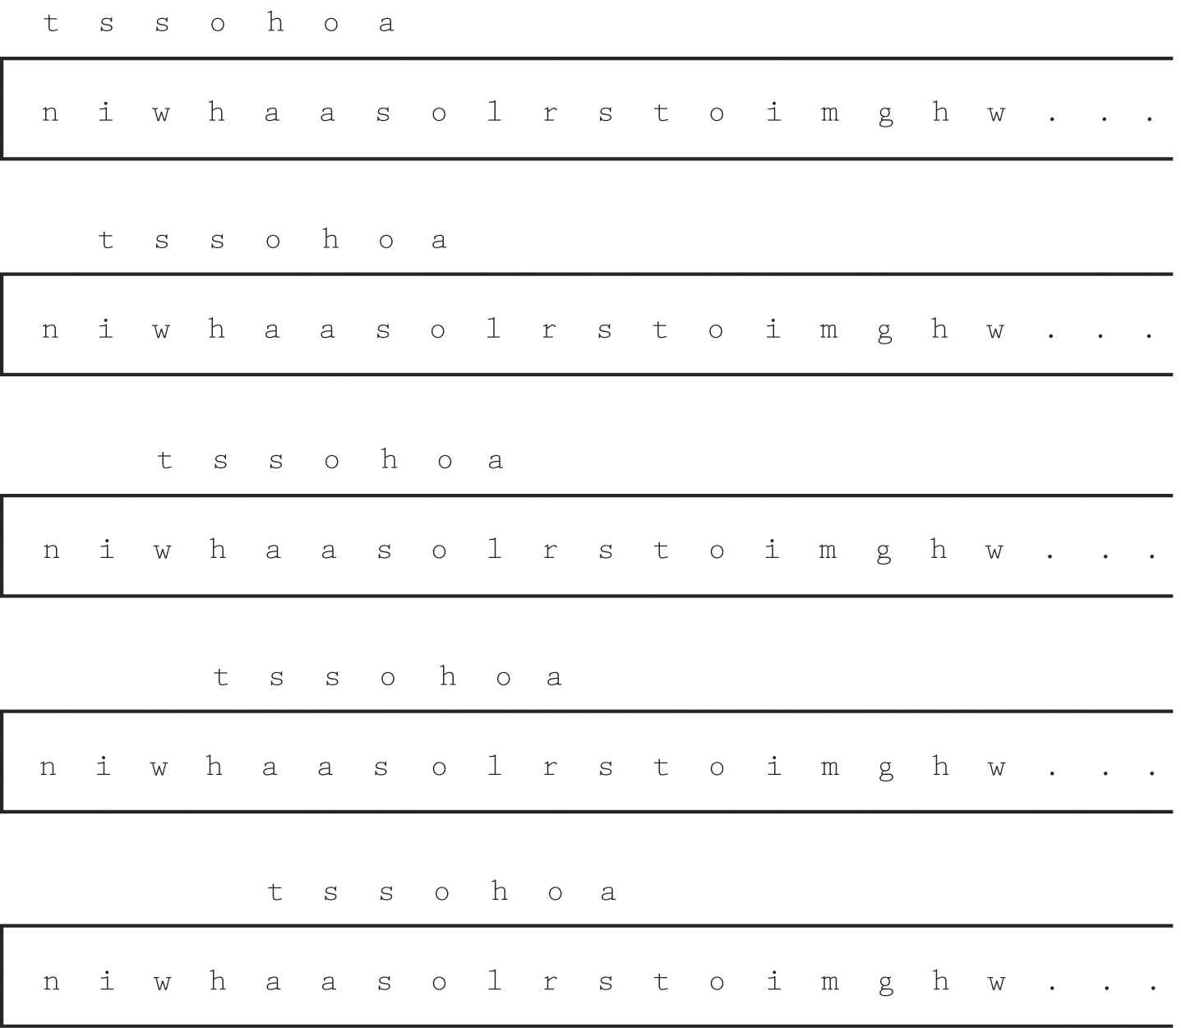
Figure 2-5 Moving Comparisons

Slide 28
Problems with classical ciphers
Neither substitution nor transposition ciphers are secure enough today.
They also often have problems with complex keys that are hard to remember.
Solution?

Slide 29
Product ciphers
Combine both methods!
Simple ciphers can be implemented in hardware
  S-box = substitution cipher
  P-box transposition cipher
Warning: Combining two ciphers does not imply that the resultant is stronger or even as strong as the original two

