Slide 1
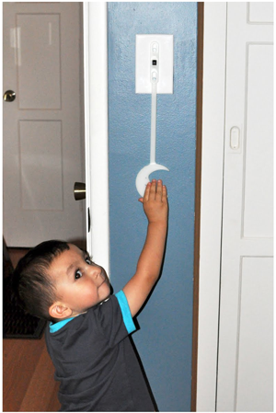

CSSE 374:
More GRASP’ing for Object Responsibilities
Left – How far should you “reach” before you “GRASP”? The tool shown is the opposite of kid-proofing your house.
Steve Chenoweth
Office: Moench Room F220
Phone: (812) 877-8974
Email: chenowet@rose-hulman.edu
Chandan Rupakheti
Office: Moench Room F203
Phone: (812) 877-8390
Email: rupakhet@rose-hulman.edu
These slides and others derived from Shawn Bohner, Curt Clifton, Alex Lo, and others involved in delivering 374.
Q1
Notes:
Q1. List three of the five GRASP patterns that we’ve used so far.
Image from http://umeandbabymakesthree.blogspot.com/2011_07_01_archive.html

Slide 2
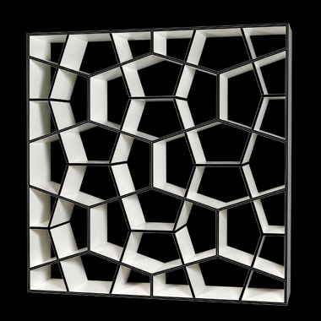
Learning Outcomes: Patterns, Tradeoffs
Identify criteria for the design of a software system and select patterns, create frameworks, and partition software to satisfy the inherent trade-offs.
Four more GRASP Patterns:
  Polymorphism
  Pure Fabrication
  Indirection
  Protected Variation
Q3

Slide 3
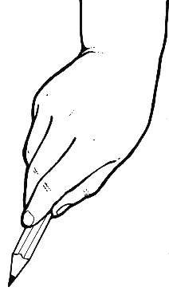
GRASP II – And Furthermore…
All these are very general
OO principles:
  Polymorphism
  Indirection
  Pure Fabrication
  Protected Variations
Result in systems that
are more easy to
maintain
easier

Slide 4
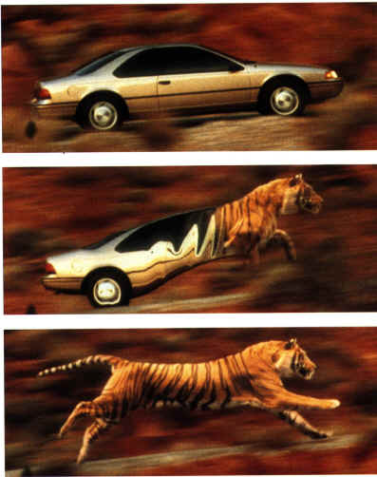
Polymorphism
Problem:
  How do we handle alternatives
  based on type?
  How do we create pluggable
  software components?
Solution:
  When related alternatives vary by type, assign responsibility to the types for which the behaviors varying.
  Use subtypes and polymorphic methods
  Eliminates lots of conditional logic based on type
  Corollary: Avoid instanceof tests
Q2,3
Notes:
How do we handle alternatives based on type?
Chained ifs and lots of switch statements are a bad code smell → new types require finding conditions and editing
How do we create pluggable software components
Pluggable components require swapping one module for another without changing surrounding design
Q2: Briefly, what problem does the Polymorphism principle solve?
Q3: Briefly, what solution does the Polymorphism principle suggest?

Slide 5
Polymorphism Example 1/6
Bad:
switch (square.getType()) {
case GO:
…
case INCOME_TAX:
…
case GO_TO_JAIL:
…
default:
…
}
What happens when we need to add other sorts of squares in future iterations?
Solution: Replace switch with polymorphic method call
Notes:
Sketch figure 25.2 on board. (Design class diagram showing abstract Square class with subclasses for RegularSquare, GoSquare, IncomeTaxSquare, and GoToJailSquare. Also show Player with attribute location pointing to Square))
Leave room for adding the landedOn method, a JailSquare, fields and associations.

Slide 6
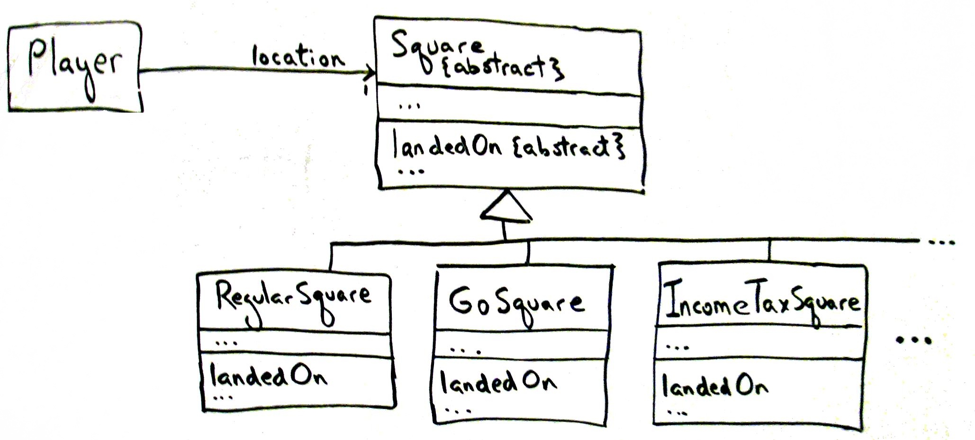
Polymorphism Example 2/6
Guideline: Unless there is a default behavior in a superclass, declare a polymorphic operation in the superclass to be {abstract}
Notes:
Each type of square exhibits variable behavior when a player lands on it
- Superclass’s polymorphic method is abstract unless there is default behavior in subclasses

Slide 7
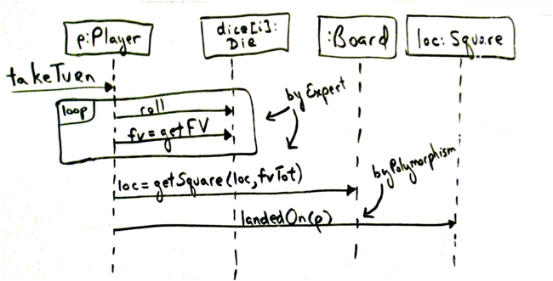
Polymorphism Example 3/6
Make abstract unless clear default behavior
Details of polymorphic method drawn separately
Notes:
Walk through diagram briefly, point out the multiple occurrences of p and loc.
landedOn() msg sent to each square at end of takeTurn()
It applies a square’s rules to the player
Player passes itself to the square so square can ‘talkback’ to player
Add landedOn(p:Player) {abstract} to DCD on board in Square.

Slide 8
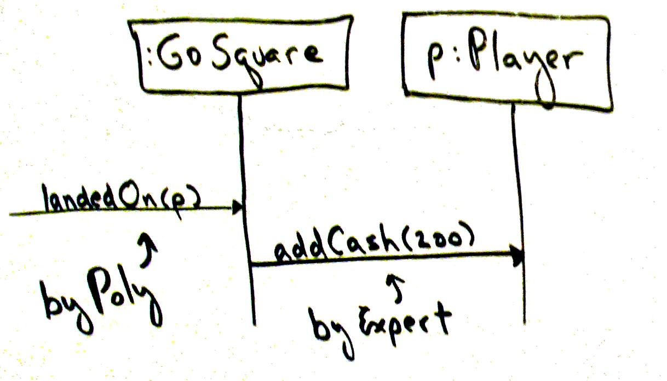
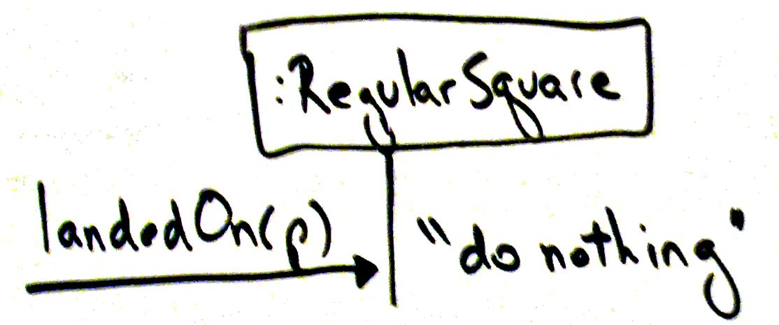
Polymorphism Example 4/6
What about that pesky “Go to jail!” square?
Notes:
landedOn() for the GoSquare
Players gets $200 for ‘landing on’ Go square
landedOn() for Regular square
Nothing happens so the method is empty (NO-OP)

Slide 9
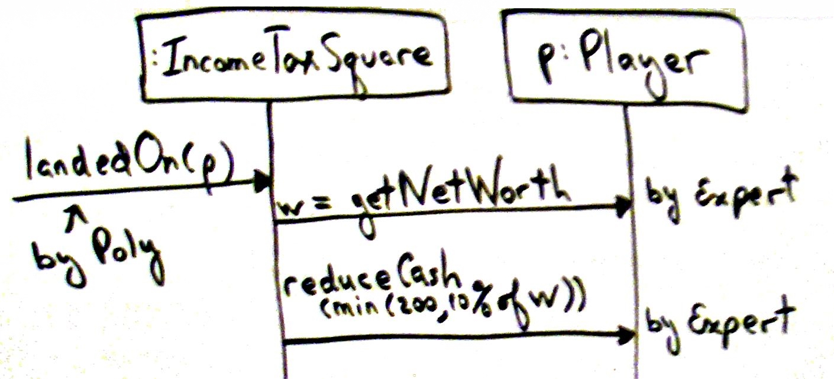
Polymorphism Example 5/6
Notes:
landedOn() for IncomeTaxSquare
Square needs to know player’s net worth to determine tax due
Is reduceCash() well named? Why not payTax()?

Slide 10
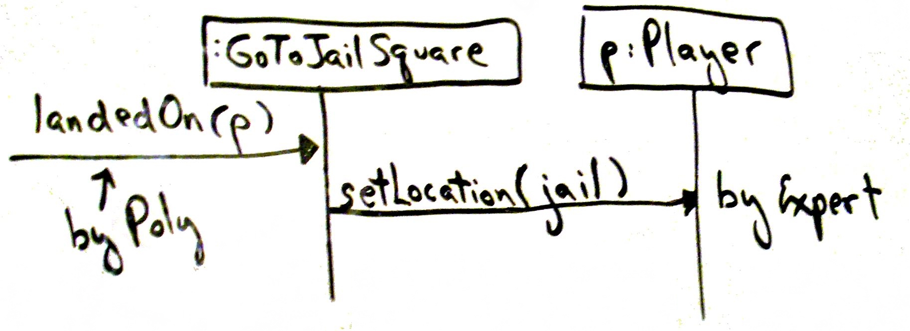
Polymorphism Example 6/6
Notes:
landedOn() for GoToJailSquare

Slide 11
Polymorphism Observations
Using polymorphism indicates that Piece class not needed since it’s a proxy for the Player
A design using Polymorphism can be easily extended for new variations
When should supertype be an interface?
  Don’t want to commit to a class hierarchy
  Need to reduce coupling
Contraindication: Polymorphism can be over-used – “speculative future-proofing”
Don’t be too clever!
Q4,5
Notes:
Remember subclassing is a very strong form of coupling.
Q4: How does Polymorphism support future extension of a system?
Q5: What is a contraindication for the Polymorphism principle?

Slide 12
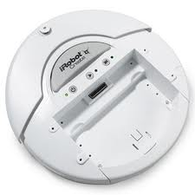
Pure Fabrication
The OO rule to “follow reality” only gets us so far…
Problem:
What object should have responsibility when solutions for low representation gap (like Info. Expert) lead us astray (i.e., into high coupling and low cohesion)
Solution:
Assign a cohesive set of responsibilities to a fictitious class (not in the domain model)
Q6
Notes:
This is really our first pattern that argues for violating other principles.
Q6: Briefly, what solution does the Pure Fabrication principle suggest?

Slide 13
Pure Fabrication Example 1/2
Die
Face Value
Role
getFV
Cup
1
Cup
Roll
getTotal
Player
Dice
*
{ordered}
Pure Fabrication
Notes:
How do we model the player rolling the dice? If Player rolls dice, then dice rolling behavior not very reusable
How do we provide something that would be more reusable?
>>>Cup is a Pure Fabrication responsible for rolling the dice

Slide 14
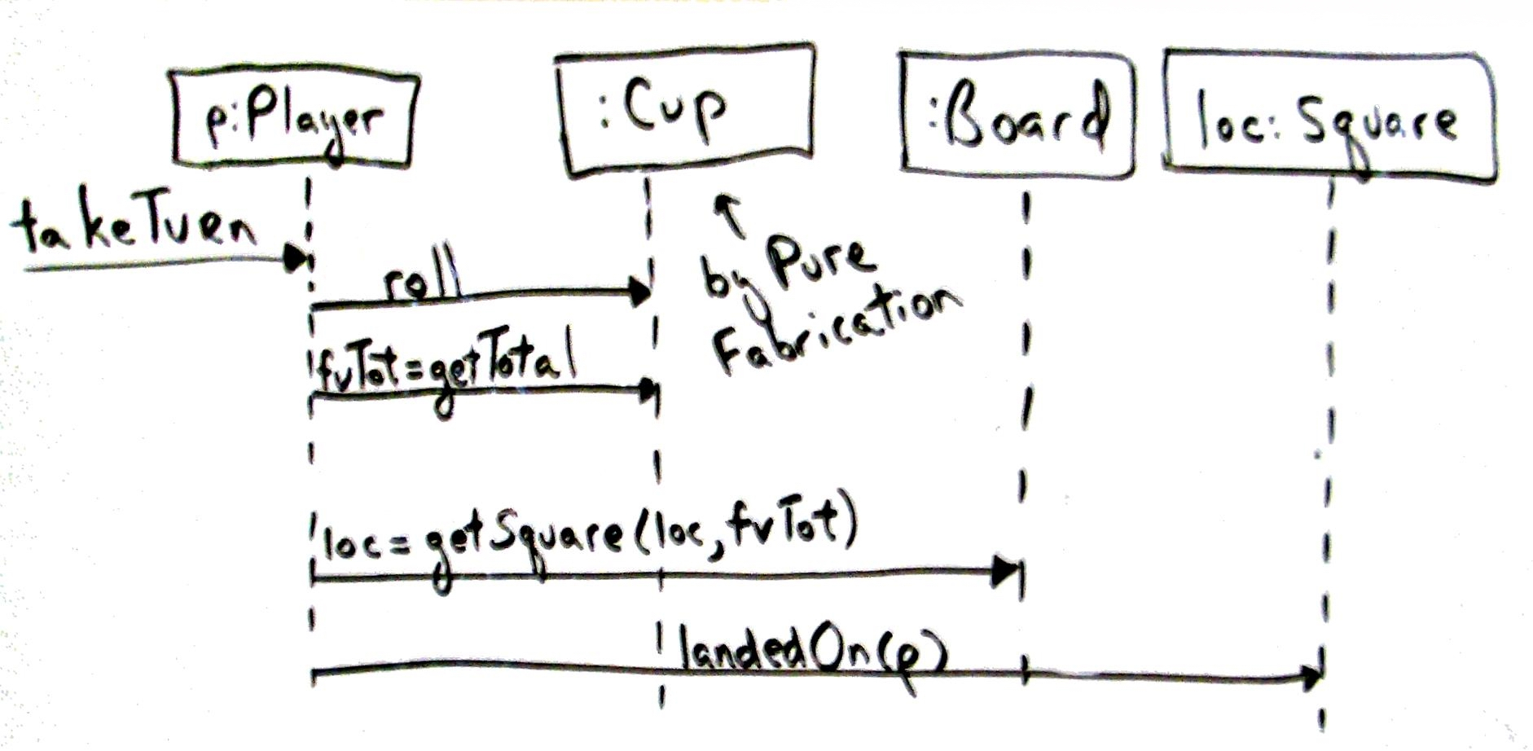
Pure Fabrication Example 2/2
Notes:
Using Cup to roll the dice
Note the lack of loop interaction frame – cup takes the combination of dice and creates total of dice values

Slide 15
Common Design Strategies
Representational decomposition
  Based on what they represent in domain
  Lowering the representation gap (noun-based)
Behavioral decomposition
  Based on what they do!
  Centered around behaviors (verb-based)
Pure Fabrications are often “behavioral decompositions”
Notes:
Representation decomposition
Design objects based on what they represent in the domain
What we’ve been doing to date
Behavioral decomposition
Design objects based on what they do
Function-centric, encapsulate an algorithm or special method
- break code into objects focusing on lowering the representation gap (noun-based)
- break code into objects centered around behaviors (verb-based)
Behavioral decomposition is more abstract, harder to reason about, but sometimes other advantages make it worth the cost.

Slide 16
Pure Fabrication Observations
Benefits:
  Higher cohesion
  Greater potential for reuse
Contraindications:
  Can be abused to create too many behavior objects
  Watch for data being passed to other objects for calculations
Keep operations with data unless you have a good reason not to
Q7
Notes:
Q7: True or False (circle one): Over use of Pure Fabrication can lead to too many behavior objects.
Downsides:
Commonly used to encapsulate an algorithm that doesn’t fit well in other classes
When overused, model has lots of classes that encapsulate a single method

Slide 17
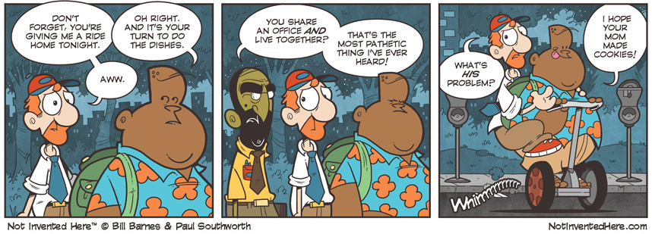
Cartoon of the Day
Used with permission. http://notinventedhe.re/on/2009-10-13

Slide 18
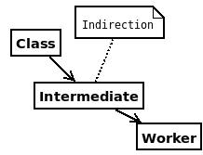
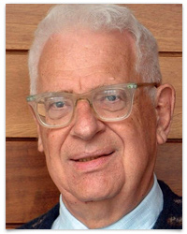
Indirection
Problem:
  How to assign responsibility
  in order to avoid direct coupling that is undesirable?
Solution:
  Assign responsibility to an intermediate object to mediate between the other components
There is no problem in computer science that cannot be solved by an extra level of indirection.
— David Wheeler
Q8,9
Notes:
Problem: How to assign responsibility in order to avoid direct coupling that is undesirable?
Especially when server object is highly unstable or could result in vendor lock-in (e.g., proprietary API)
Solution: Assign to an intermediate object that mediates between components like client-server
Q8: Briefly, what problem does the Indirection principle solve?
Q9: Briefly, what solution does the Indirection principle suggest?
The late David Wheeler was a computer science pioneer and professor at Cambridge University in England.

Slide 19
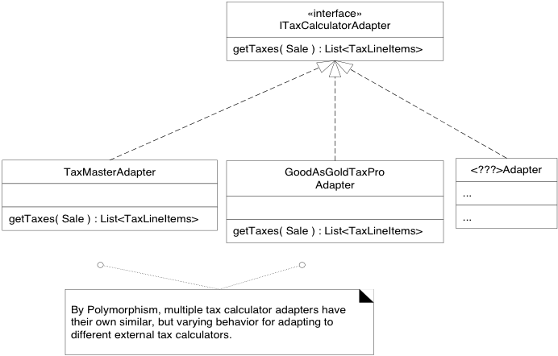
Indirection & Polymorphism Example
Notes:
Adapters serve as a layer of indirection between NextGen POS and service providers. One might use TCP socket communication, another SOAP, another some other protocol
- Controllers are a special case of indirection
Each tax calculator has a unique API
NextGen (client) should be immune to any specific calculator
Abstract interface has getTaxes() method
Specific adapters inherit from interface.
Each concrete adapter calls the actual tax calculator

Slide 20
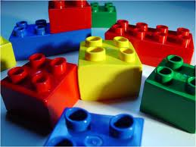
Protected Variation
Key
Concept
Problem:
How do we design objects and systems so that instability in them does not have undesirable effects on other elements?
Solution:
Identify points of predicted instability (variation) and assign responsibilities to create a stable interface around them
Q10
Notes:
“Find what varies and encapsulate it” --- Design Patterns Explained, Trott & Shalloway
A foundational design principle
Used in conjunction with Polymorphism & Indirection
Q10: Briefly, what solution does the Protected Variations principle suggest?
Why is ITaxCalculatorAdaptor an example of PV?
- Indirection protects against changes in existing providers.
- Polymorphism protects against adding new providers

Slide 21
Protected Variations: Observations
When to use it?
  Variation point – a known area where clients need to be protected from variable servers
  Evolution point – an area where future variation may occur
Should we invest in protecting against future variation?
  How likely is it to occur? If it is, then should probably use PV now
  If unlikely, then should probably defer using PV
Notes:
Benefits (if we guessed variation points correctly):
Extensions easy to add
Can plug in new implementations
Lower coupling
Lower cost of change
Risk: watch out for speculative future-proofing

Slide 22
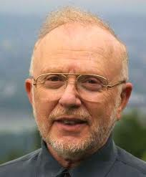
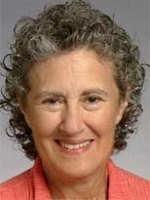
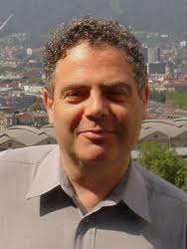
Protected Variations by Other Names
Information hiding [David Parnas ‘72]
“… a list of difficult design decisions which are likely to change. Each module is then designed to hide such a decision from the others.”
Liskov Substitution Principle [Barbara Liskov ‘87]
Methods of a subtype must have (at least) the expected behavior of overridden methods
Open-Closed Principle [Bertrand Meyer ‘88]
Modules should be both open for extension and closed to modification[s] that affect clients
Notes:
LSP: coined by Turing winner Barbara Liskov
- methods of a subtype must have (at least) the expected behavior of overridden methods
I.e., you can plug a subtype instance in where a supertype is expected without “breaking anything”

Slide 23
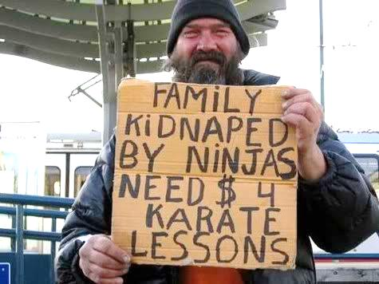
Law of Demeter
Special case of PV
Don’t talk to strangers who seem unstable
This guideline warns against code like:
sale.getPayment().getAccount().getAccountHolder()
Notes:
Within a method, messages should only be sent to: “this”, a parameter, a field of “this”, an element in collection of field of “this”, or new objects
What variation does this protect against?
• Build in photo and caption
It isn’t such a sin to chain calls into stable library code.

