Slide 1
CSSE 374: More GRASP’ing and Use Case Realization
Steve Chenoweth
Office: Moench Room F220
Phone: (812) 877-8974 Email: chenowet@rose-hulman.edu
Chandan Rupakheti
Office: Moench Room F203
Phone: (812) 877-8390 Email: rupakhet@rose-hulman.edu
These slides and others derived from Shawn Bohner, Curt Clifton, Alex Lo, and others involved in delivering 374.

Slide 2
Learning Outcomes: Patterns, Tradeoffs
Identify criteria for the design of a software system and select patterns, create frameworks, and partition software to satisfy the inherent trade-offs.
Recap GRASP Patterns:
Creator
Information Expert
Controller
Low Coupling
High Cohesion
Examine Use Case Realization
Outline Command-Query Separation Principles
Q3

Slide 3
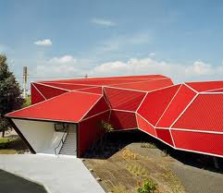
Recall GRASP: Creator
Problem: Who should be responsible for creating a new instance of some class?
Solution: Make B responsible for creating A if…
B contains or is a composition of A
B records A
B closely uses A
B has the data to initialize A
Notes:
Chocolate factory ☺

Slide 4
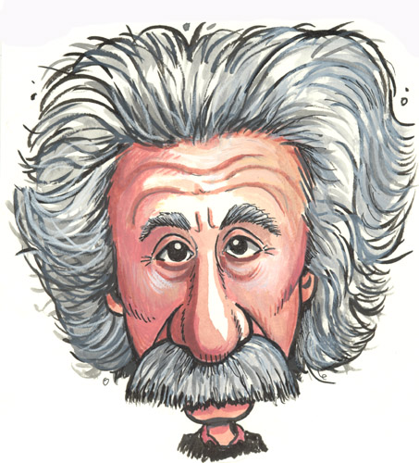
Recall GRASP: Information Expert
Problem: What is a general principle of assigning responsibilities?
Solution: Assign a responsibility to the class that has the necessary information

Slide 5
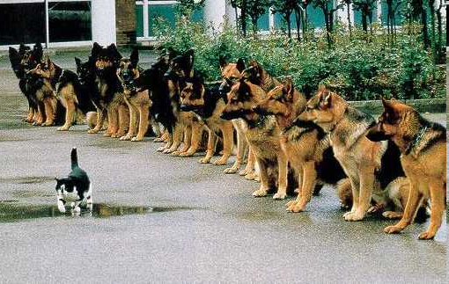
Recall GRASP: Controller
Problem: What is the first object beyond the UI layer that receives and coordinates a system operation?
Solution: Assign the responsibility to either…
A façade controller, representing the overall system and handling all system operations, or
A use case controller, that handles all system events for a single use case
Proper control of your system is a discipline. From http://www.swapmeetdave.com/Humor/Cats/Brave.htm.
Notes:
- What’s a system operation again?
- On-board: “Model-View separation”

Slide 6
Recall GRASP: Low Coupling
Problem: How do you support low dependency, low change impact, and increased reuse?
Solution: Assign a responsibility so that coupling remains low. Use this principle to evaluate alternatives.
Notes:
Degree of Isolation from other object’s changes

Slide 7
Types of Coupling
No Direct Coupling
Stamp Coupling
External
Content
Data Coupling
Control Coupling
Common Coupling
Low Coupling Spectrum High
A measure of the interdependence among software components
Content: one component directly references the content of another
Common: both components have access to the same global data
Control: One component passes the element of control to another
Stamp: Two components modify or access data in the same object
Data: One component passes simple data to another as an argument
Q1
Notes:
Q1: What is content coupling?
Direct Coupling: Modules share variables
Common Coupling: Modules share a common block
Block Coupling: Nested modules can access all of outer scope
Import/Export Coupling: Only functions, operations and variables explicitly exported in interface may be imported.
Procedure Coupling: Interface consists only of access and update operations.

Slide 8
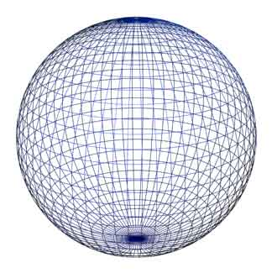
Recall GRASP: High Cohesion
Problem: How do you keep objects focused, understandable, and manageable, and as a side-effect, support low coupling?
Solution: Assign a responsibility so that cohesion remains high. Use this principle to evaluate alternatives.
Notes:
Degree of Isolation from other object’s changes

Slide 9
Types of Cohesion
Coincidental
Temporal
Communicational
Functional
Logical
Procedural
Low Cohesion Spectrum High
“Pathological”
“Single-Minded”
A measure of the relative functional strength of a software component
Coincidental: multiple, completely unrelated actions or components
Logical: series of related actions or components (e.g. library of IO functions)
Temporal: series of actions related in time (e.g. initialization modules) Procedural: series of actions sharing sequences of steps.
Communicational: procedural cohesion but on the same data.
Functional: one action or function
Q2
Notes:
Q2: What is the strongest form of cohesion?
Coincidental Cohesion: No meaningful connection (e.g. functions in an overlay)
Logical Cohesion: Collection of functionally related components (e.g. library of IO functions)
Temporal Cohesion: Functions in a module happen to be executed together (e.g. initialisation functions)
Abstract Cohesion: Provides collection of services associated with a single data structure (e.g. ADT or class)

Slide 10
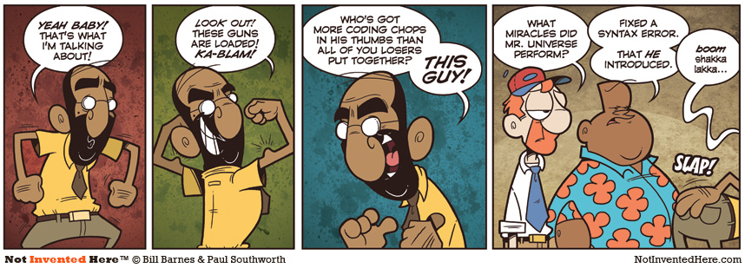
Legend in his own lunchtime…
Jan 4, 2010. Used by permission

Slide 11
Getting a GRASP on Design
No ‘magic’ to assigning responsibilities
If you don’t have a reason for placing a method in a class, …it shouldn’t be there!
You should be able to say: ‘I placed method X in class Y based on GRASP Z’
Q3
Notes:
Q3: If you don’t have a reason for placing a method in a class, it _______________________!

Slide 12
Use Case Realization
The process of generating the design model from use cases and other requirements artifacts
Use Cases drove the development of
Domain Model
System Sequence Diagrams
Operation Contracts
Q4
Notes:
Q4: Use Case realization is the process of generating the design model from use cases and other requirements artifacts such as?

Slide 13
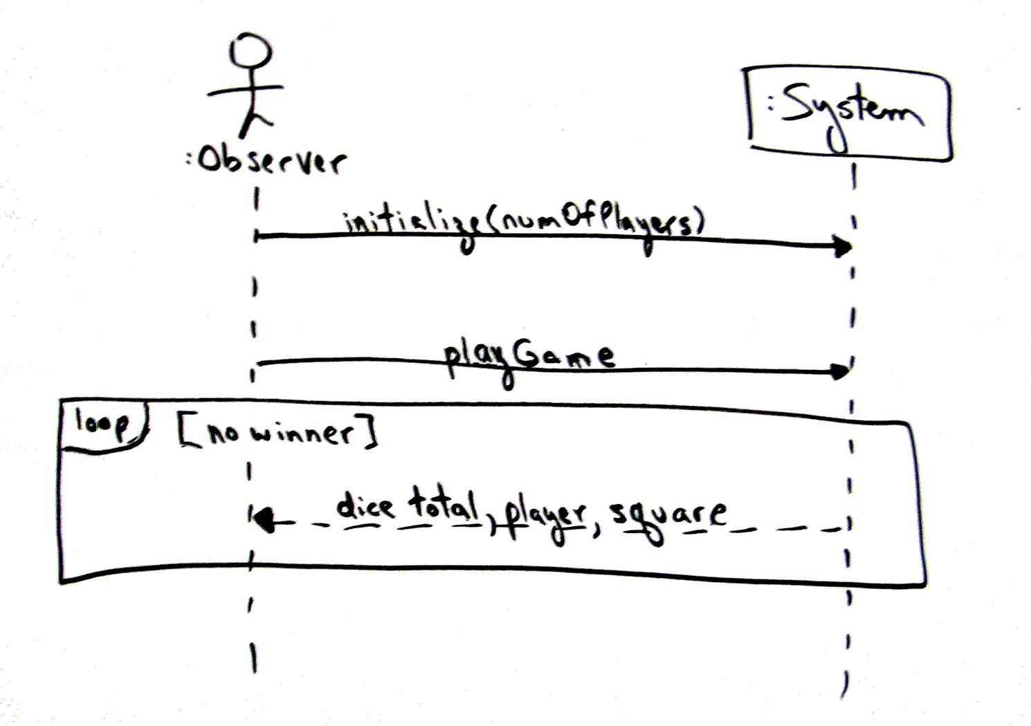
System Sequence Diagrams (SSD)
Help us identify system operations
Use these to begin interaction diagrams
System operations are the starting (AKA found) messages
Starting messages are directed at controller objects
Q5
Notes:
Q5: Which type of diagram is the primary source for the starting messages passed into the domain layer’s controller objects?

Slide 14
Operation Contracts (OC)
Define post-conditions of system operations as changes to objects/associations in the domain model
Use post-conditions to help determine…
What should happen in the interaction diagrams
What classes belong in the design class diagram
Also, often discover classes that were missed in the domain model
Q6
Notes:
Q6: How do operations contracts help with bridging from system operations to design class diagrams and interaction diagrams?

Slide 15
Where to Begin
Register (the controller) implements to system operation makeNewSale()
In code, you begin at the beginning
In design, you defer design of the Start Up UC
Start Up handles created and initializing objects
Discover necessary objects as we do the other UCs
So, defer Start Up design to avoid rework
Q7
Notes:
While Startup UC is first to be invoked, it should be modeled last
You need to know what ‘root’ objects need to be created
Therefore, Process Sale is modeled prior to Startup System
Assign makeNewSale() to a controller
Select Register as a device-object façade since not too many system operations to handle
Q7: True/False (circle one): When designing a system we typically begin with the “Start Up” use case? Why?

Slide 16
Example: Design makeNewSale
Operation: | makeNewSale()
Cross References: | Use Case: Process Sale
Preconditions: | none
Postconditions: | A Sale instance s was created s was associated with the Register Attributes of s were initialized
Notes:
This example is out of the book. We’ll do several from scratch examples on Monday.
Work toward putting something like figures 18.6 and 18.8 (bottom half) on board.

Slide 17
Fulfilling Duties per Ops. Contract
1.
2.
3.
Initialize Sale attribute
Q8
Notes:
Q8: Where does one find what the controller (Register) must be accomplish with system operation makeNewSale?
Steps are:
Create a new Sale
Associate it with the Register
Initialize Sale attributes

Slide 18
Example: Design enterItem
Operation: | enterItem(itemID: ItemID, quantity: integer)
Cross References: | Use Case: Process Sale
Preconditions: | Sale underway.
Postconditions: | A SaleLineItem instance sli was created sli was associated with current Sale sli.quantity became quantity sli was associated with a ProductDescription, based on itemID match.
Notes:
This example is out of the book. We’ll do several from scratch examples on Monday.
Work toward putting something like figures 18.6 and 18.8 (bottom half) on board.

Slide 19
Assign enterItem() to a Controller
What must controller with enterItem() accomplish?
Examine the operation contract…
Create a SalesLineItem (sli)
Associate it with current Sale
Set quantity attribute of sli
Associate sli with a ProductDescription …
Whew! That’s a lot of responsibility!
Requires careful analysis of operation contract to avoid missing any of these duties

Slide 20
enterItem() Communication Diagram
Q9
Notes:
Register converts itemID into ProductDescription (desc)
Register forwards desc & qty to Sale who creates SaleLineItem(sl)
Assumes Register & ProductCatalog created initially with longterm association
What is design impact of letting Sale convert itemID->ProdDesc?
Q9: Why do we choose “Map” for ProductDescription and “List” for SaleLineItems?

Slide 21
Exercise on Design Examples
Break up into your project teams
Given the following:
The makeNewSale(…) and enterItem(...) OCs and SSDs
Draw a partial Design Class Diagram to represent them.
Notes:
We’ll do this in class!

Slide 22
Static View: Visibility
Method-return dependency
Parameter dependency

Slide 23
Command-Query Separation Principle
Each method should be either a command or a query
Command method: performs an action, typically with side effects, but has no return value
Query method: returns data but has no side effects
Why?
Q10
Notes:
Why? (get ideas from class)
- principle of least surprise, side effects only happen in “void” methods
provides for most flexible interface, e.g., a value can be queried multiple times without changing it
Q10: According to the Command-Query Separation Principle, we should design mutator methods (commands) to change the state of the object but return nothing, while accessor methods (queries) should return a value but leave the object state unchanged. Why is this usually a good idea?

Slide 24
Command-Query Separation Principle
Example:
Object A Object B
Create Object B → Reports ok
…
Get a cust record (acct no) → Gets it
Check success → Reports ok
Get matching Name & Addr → Return these
Change Addr → Make change
Write back current rec → Writes it
Check success → Reports ok
Notes:
Why? (get ideas from class)
- principle of least surprise, side effects only happen in “void” methods
provides for most flexible interface, e.g., a value can be queried multiple times without changing it
Q10: According to the Command-Query Separation Principle, we should design mutator methods (commands) to change the state of the object but return nothing, while accessor methods (queries) should return a value but leave the object state unchanged. Why is this usually a good idea?

