Slide 1
CSSE 374: Introduction to Gang of Four Design Patterns
These slides derived from Steve Chenoweth, Shawn Bohner, Curt Clifton, and others involved in delivering 374.
Q1
Notes:
Q1.True or False (circle one): A design pattern often combines multiple GRASP principles.

Slide 2
Learning Outcomes: Patterns, Tradeoffs
Identify criteria for the design of a software system and select patterns, create frameworks, and partition software to satisfy the inherent trade-offs.
First Design Studios this week
Introduce Gang of Four Concepts
Describe and use GoF Patterns
Adapter
Factory
Singleton
Strategy
Q3
Notes:
NOTE: New approach to Design Studio…

Slide 3
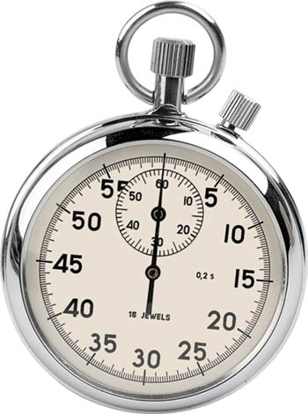
So, why bother to learn design patterns?
Think for 15 seconds…
Turn to a neighbor and discuss it for a minute
Notes:
- communicating with other developers
- quickly moving to a principled solution

Slide 4
Gang of Four (GoF)
http://www.research.ibm.com/designpatterns/pubs/ddj-eip-award.htm
Ralph Johnson, Richard Helm, Erich Gamma, and John Vlissides (left to right)

Slide 5
Gang of Four Design Patterns
Behavioral
Interpreter
Template Method
Chain of Responsibility
Command
Iterator
Mediator
Memento
Observer
State
Strategy
Visitor
Creational
Factory Method
Abstract Factory
Builder
Prototype
Singleton
Structural
Adapter
Bridge
Composite
Decorator
Façade
Flyweight
Proxy
Q2
Notes:
Q2: What are the three main categories of Gang of Four Design Patterns?

Slide 6
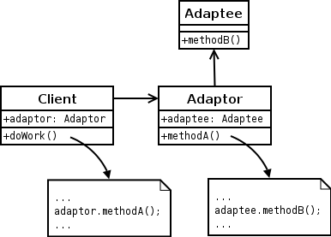
Adapter: Structural Pattern
Problem: How do we provide a single, stable interface to similar components with different interfaces?
How do we resolve incompatible interfaces?
Solution: Use an intermediate adapter object to convert calls to the appropriate interface for each component
1. Adapter
Q3
Notes:
One of the most useful and used GoF patterns…
Q3: With what sorts of variations does Adapter help us deal?
Hide the incompatible/unstable interface behind the adapter’s interface
Client collaborates with stable adapter
Adapter relays messages to unstable interface
Uses Protected Variations, Polymorphism, Indirection

Slide 7
Adapter Examples
Guideline: Use pattern names in type names
1. Adapter
Q4
Notes:
Larman’s lousy example does not show adapting outside code
Q4: True or False (circle one): Adaptors use interfaces and polymorphism to add a level of indirection to varying APIs in other components.
Working with your project team, identify a situation in your project where Adapter might be applicable. If no such situation exists, try to come up with an extension to your system (perhaps an external system?) that might use Adapter.
Clients send message to Adapter; Enables Plug n’ Play with respect to 3rd party software!
Notice adherence to good naming conventions

Slide 8
Example of Adapter
1. Adapter
Notes:
Register posts the sale to an Adapter
Adapter communicates with the SAP accounting system
SAP accounting system exposes functionality as a web service

Slide 9
Which GRASP Principles in Adapter?
Low coupling
High cohesion
Information Expert
Creator
Controller
Polymorphism
Pure Fabrication
Indirection
Protected Variations
1. Adapter
Q5
Notes:
Get students to argue whether or not adapter embodies each of these principles.
Q5: Which GRASP principles are embodied in Adapter (check all that apply)?

Slide 10
GoF Adapter mapped to GRASP
1. Adapter
Q5
Notes:
Q5, cntd: Which GRASP principles are embodied in Adapter (check all that apply)?

Slide 11
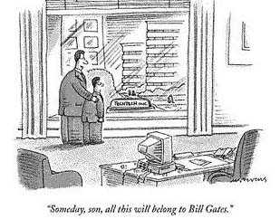
Factory: Creational Pattern
Problem: Who should be responsible for creating objects when there are special considerations like:
Complex creation logic
Separating creation to improve cohesion
A need for caching
Solution: Create a “Pure Fabrication” called a “Factory” to handle the creation
Software factory
humor…
Also known as Simple Factory or Concrete Factory
2. Factory
Cartoon from www.cartoonbank.com. All rights reserved.
Notes:
Simplification of Abstract Factory

Slide 12
Factory Example
2. Factory
Notes:
ServicesFactory creates adapter objects for many 3rd party services
Each get.???.Adapter() method checks to make sure no instance already exists
The concrete adapter class is read from an external property file
Class.forName(..) returns a reference to a class given its name:string
First call to get.???.Adapter() creates adapter, subsequent calls access it

Slide 13
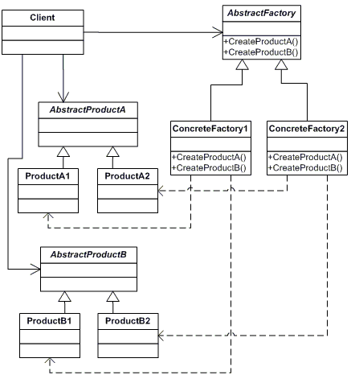
Abstract Factory: Creational Pattern
Provides an interface to create and return one of several families of related objects without needing to specify their concrete classes.
2. Factory
Notes:
Assign creation responsibility to a pure fabrication Factory object
Commonly implemented via the Singleton pattern

Slide 14
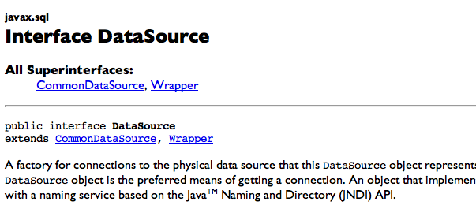
Another Factory Example
From JDK 1.4…
2. Factory
Notes:
This is just an example of how the patterns terminology is pervasive.

Slide 15
Advantages of Factory
Puts responsibility of creation logic into a separate, cohesive class —separation of concerns
Hides complex creation logic
Allows performance enhancements:
Object caching
Recycling
2. Factory
Q6
Notes:
Q6: List a couple of advantages of using a Factory object versus just distributing the logic for deciding what objects to create.

Slide 16
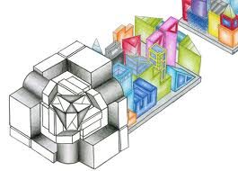
Who creates the Factory?
Several classes need to access Factory methods
Options:
Pass instance of Factory to classes that need it
Provide global visibility to a Factory instance
Dependency Injection
Singleton
2. Factory
Notes:
•• call-outs

Slide 17
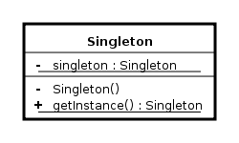
Singleton: Creational Pattern
Problem: How do we ensure that exactly one instance of a class is created and is globally accessible?
Solution: Define a static method in the class that returns the singleton instance
Created only once for the life of the program (a non-creational pattern?)
Provides single global point of access to instance
Similar to a static or global variable variable
3. Singleton
Notes:
Problem: Exactly one instance of a class is needed/allowed
Other objects need single, global point of access to it
Solution: Define a static method of a class that returns the Singleton
The static method can only create one instance
Issues
Who should create the Factory? The Singleton!
Provides global visibility via static method
Avoids passing factory reference to many clients

Slide 18
Singleton Example
3. Singleton
Notes:
All clients have global visibility to static method getInstance()
First call to getInstance() creates a ServicesFactory singleton
Subsequent calls just access the singleton

Slide 19
Lazy vs. Eager Initialization
Lazy:
private static ServicesFactory instance; public static synchronized Services Factory getInstance() { if (instance == null) instance = new ServicesFactory(); return instance; }
Eager:
private static ServicesFactory instance = new ServicesFactory(); public static ServicesFactory getInstance() { return instance; }
Pros and cons?
3. Singleton
Notes:
• build in eager version
Lazy initialization:
- saves resources by only creating if needed
- allows for more complex initialization logic
Eager:
- simple, little or no conditional logic

Slide 20
Why don’t we just make all the methods static?
Instance methods permit subclassing
Instance method allow easier migration to “multi-ton” status
Can swap singleton implementations at runtime (ie: testing, different applications)
3. Singleton
Q7
Notes:
Q7: Please list a couple of reasons why we use instance methods in a singleton, instead of just declaring static methods.

Slide 21
Singleton Considered Harmful?
Favor Dependency Injection
Hides dependencies by introducing global visibility
Hard to test since it introduces global state (also leaks resources)
A singleton today is a multi-ton tomorrow
Responsibilities get heaped on it because it is convenient to get at
Low cohesion — class is responsible for domain duties and for limiting number of instances
Instead, use Factory to control instance creation
http://blogs.msdn.com/scottdensmore/archive/2004/05/25/140827.aspx
http://tech.puredanger.com/2007/07/03/pattern-hate-singleton/
3. Singleton
Q8
Notes:
Singleton is probably the most overused pattern.
Many consider Singleton a bad code smell.
Q8: List four ways that using singleton can lead to problems:
•••••• Animated bullets and call-outs

Slide 22
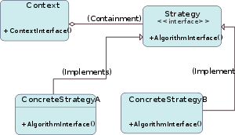
Strategy: Behavior Pattern
Problem: How do we design for varying, but related, algorithms or policies? How do we design for the ability to change these?
Solution: Define each algorithm or policy in a separate class with a common interface.
4. Strategy
Q9
Notes:
Define a family of algorithms that are interchangeable and vary independently from the client that uses them
Q9: With what sorts of variations does Strategy help us deal?

Slide 23
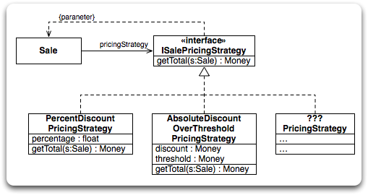
Strategy Example
pdt = s.getPreDiscountTotal(); if (pdt < threshold) return pdt; else return pdt - discount;
Context Object
return s.getPreDiscountTotal() * percentage;
4. Strategy
Notes:
Each pricing strategy subclass implements a different pricing algorithm
All implement the getTotal(..) method
Strategy object attached to a context object (Sale, in this case)
•• code for method bodies

Slide 24
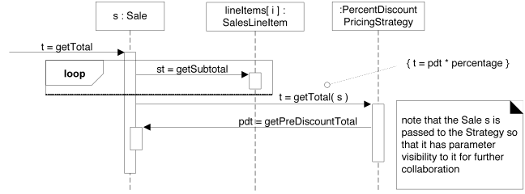
Strategy Example (cont.)
4. Strategy
Notes:
Client tells Sale to getTotal(), Sale gets subtotals from all SaleLineItems
Sale passes ‘this’ reference to its strategy object so strategy can obtain needed data from Sale, its context object

Slide 25
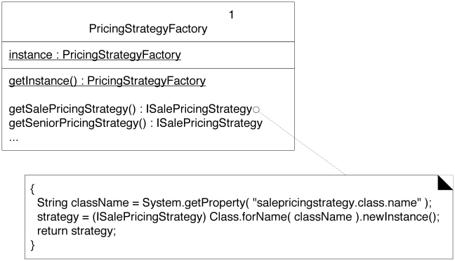
Where does the PricingStrategy come from?
4. Strategy
Q9
Notes:
Q9: Where does the PricingStrategy come from? [when a Sale is created, it requests the PricingStrategy from PricingStrategyFactory]
• build in sequence diagram

Slide 26
Examples of Change and Patterns
What Varies | Design Pattern
Algorithms | Strategy, Visitor
Actions | Command
Implementations | Bridge
Response to change | Observer
Interactions between objects | Mediator
Object being created | Factory Method, Abstract Factory, Prototype
Structure being created | Builder
Traversal Algorithm | Iterator
Object interfaces | Adapter
Object behavior | Decorator, State

Slide 27
Working for Google
2. Factory
I hear once you've worked there for 256 days they teach you the secret of levitation.
Notes:
• secondary punchline
• arrow pointing at “factory”

Slide 28
+/∂ Feedback
We’ll do in class.
On a separate piece of paper – Please give us some team-level-anonymous feedback! Possible topics –
Class
Quizzes
Homework
Book
Projects
Schedule
…
Anything else
+ = things going well
∂ = things to fix
Thanks –
We’ll show results next class!

